Slide 1
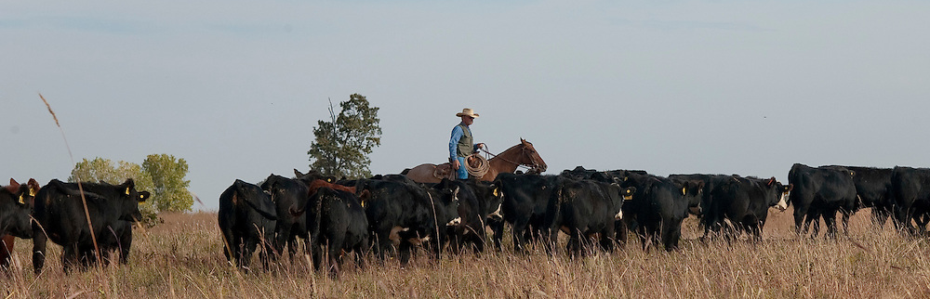

Beginning of the Year Financial Planning for Livestock Enterprises
Scott Clawson
Area Ag Econ Specialist

Slide 2

Why are these issues?
Tracking into 2023 we expect better cattle prices
Tracking into 2023 we expect input prices to still be high +/-
Better prices can lead to opportunities, cash flow and working capital are what we can use to take advantage of those opp.
The cost of credit won't be easing anytime soon.
Increased input costs may strain cash until revenue can be generated.

Slide 3
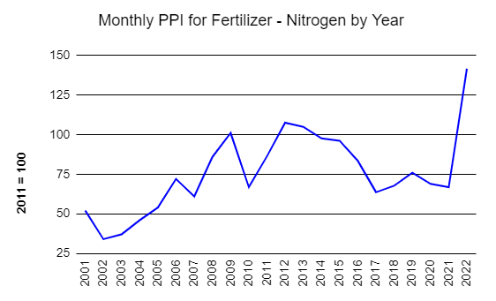
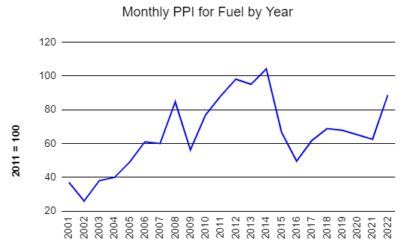
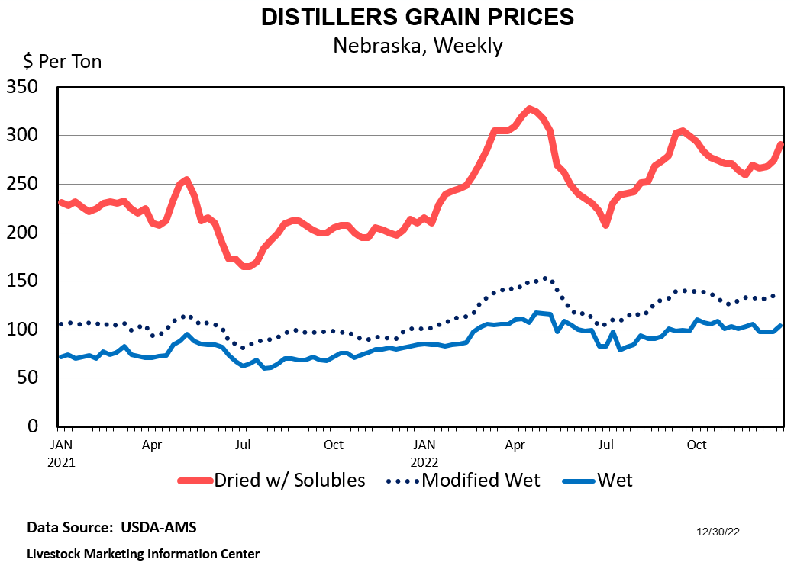
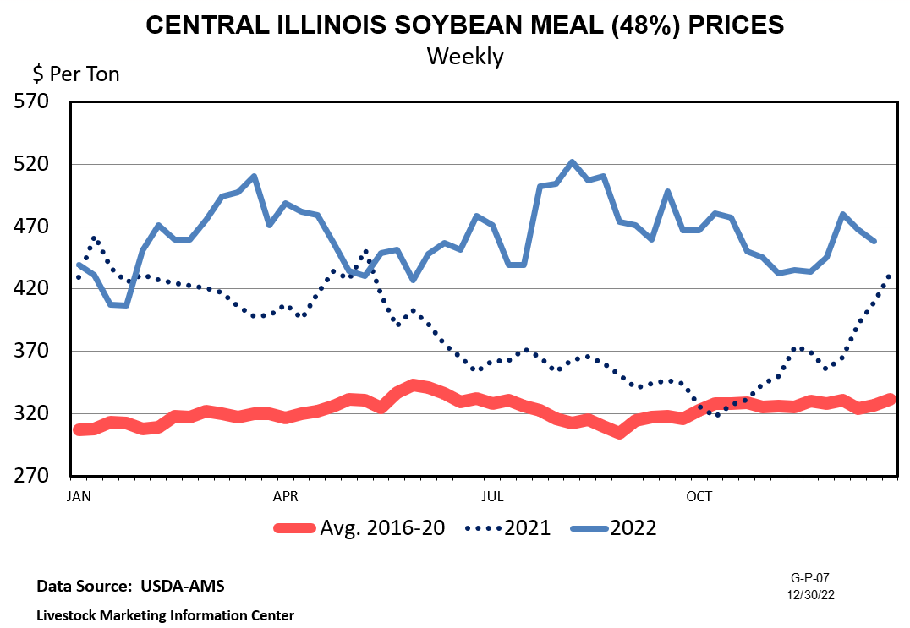
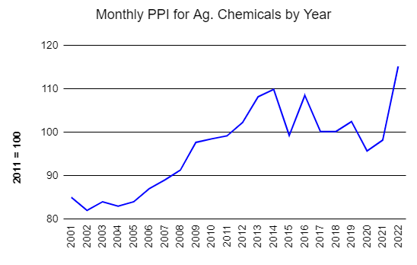
Graphs from: AMAP University of Missouri https://amap.missouri.edu/home/market-data/ an Livestock Marketing Information Center

Slide 4
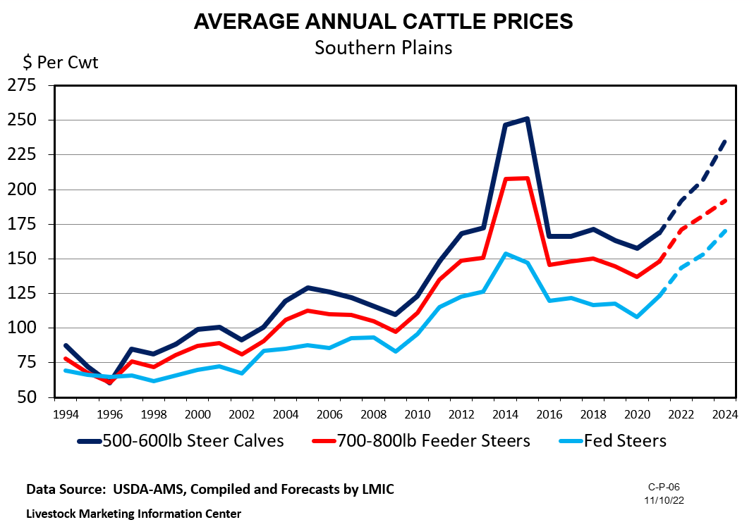
Other 2023 Considerations
Spring/Summer forage conditions
Cattle inventory situations
Resiliency of beef demand
Feed markets
Cost of credit

Slide 5
Three key financial steps for 2023
(according to me anyway )
Build a cash flow
Track working capital
Leaches and Leeches
For every complex problem there is an answer that is clear, simple, and wrong. – HL Mencken

Slide 6
1. Build Your Monthly Cash Flow
 | January | February | March | April |  |  |  |  |  |  | Total
Salary/Wages | $2,200 | $2,200 | $2,200 | $2,200 |  |  |  |  |  |  | $26,400
Calf Sales | - | $32,000 | - | - |  |  |  |  |  |  | $125,000
Cull Sales | - | - | - | $10,000
Total Inflow | $2,200 | $34,200 | $2,200 | $12,200
Family Living | -$3,000 | -$3,000 | -$3,000 | -$3,000 |  |  |  |  |  |  | -$36,000
Fuel | -$600 | -$600 | -$600 | -$600 |  |  |  |  |  |  | -$7,200
Feed | -$7,000 | -$7,000 | -$7,000 | -$2,200
Fertilizer | - | f | - | -$10,000 |  |  |  |  |  |  | -$12,500
Land Payment | - | - | - | -
Total Outflow | -$10,600 | -$10,600 | -$10,600 | -$15,800
BALANCE | -$8,400 | $23,600 | -$8,400 | -$3,600
Notes:
There are a million templates for CF out there, some of the ag specific ones will let you start with your cash on hand and incorporate you RLOC.
My preference would be to run a projected / Actual version

Slide 7
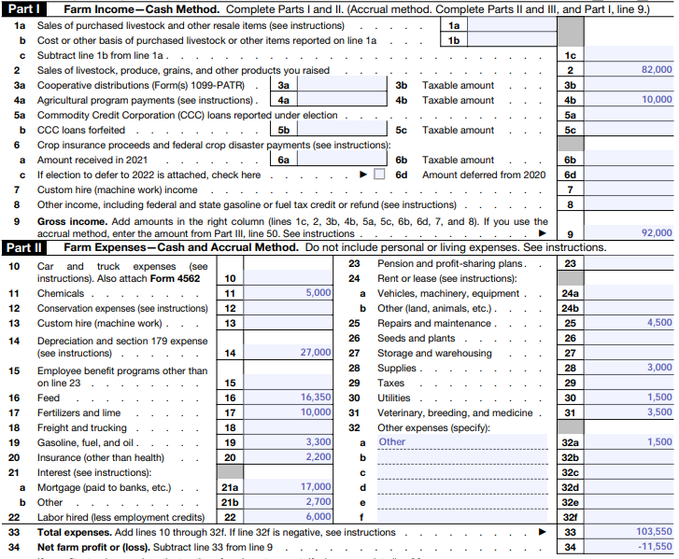
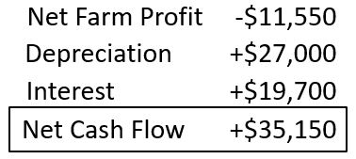
1. Build Your Monthly Cash Flow
Many cow calf operation struggle with timing of cash flows as much as actual cash flow
It gives an expectation for RLOC needs and usage
Management changes will need capital
Highlight high costs areas
If you can’t explain it simply, you don’t understand it well enough.
– Albert Einstein

Slide 8
2. Calculate Your Working Capital Monthly (+/-)
https://www.agproud.com/articles/32034-what-is-working-capital-really?v=preview
X
X
EQUITY
X
X
X
WORKING CAPITAL
X
X
X
X
X
X
CASH FLOW
Signs that our WC is not in place
  Moving intermediate/ long term assets for cash flow
  Not zeroing RLOC annually
Notes:
There are a million templates for CF out there, some of the ag specific ones will let you start with your cash on hand and incorporate you RLOC.
My preference would be to run a projected / Actual version

Slide 9
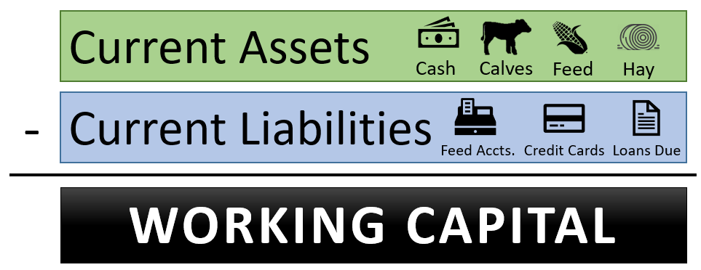
2. Calculate Your Working Capital Monthly (+/-)
WC is a financial cushion / indication
  Can WC go negative? Is that an issue?
  Key indication our path isn’t paved…
  On a cow calf operation, when is a calf used in the calculation?
  Don’t let price runs cloud a long-term issue…
Notes:
There are a million templates for CF out there, some of the ag specific ones will let you start with your cash on hand and incorporate you RLOC.
My preference would be to run a projected / Actual version

Slide 10
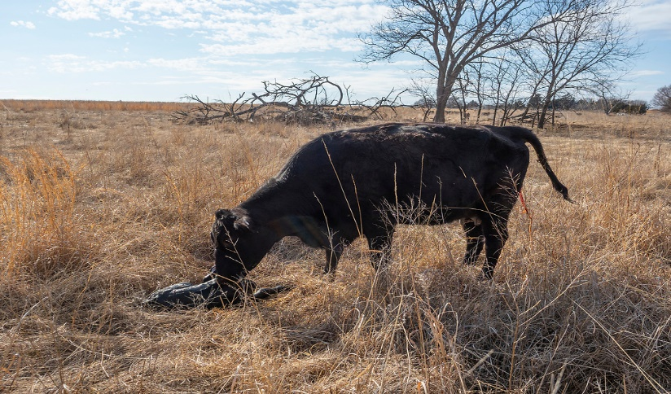
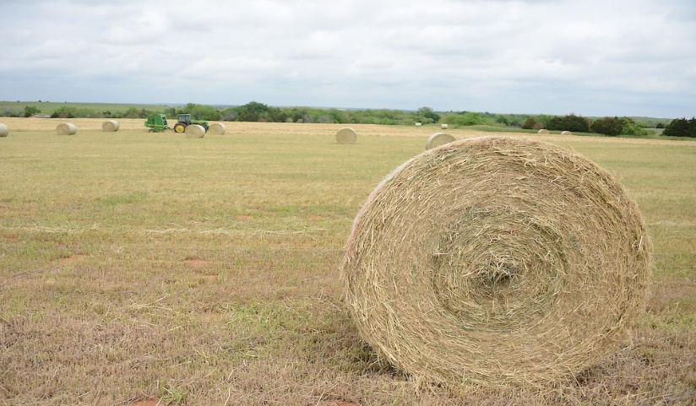
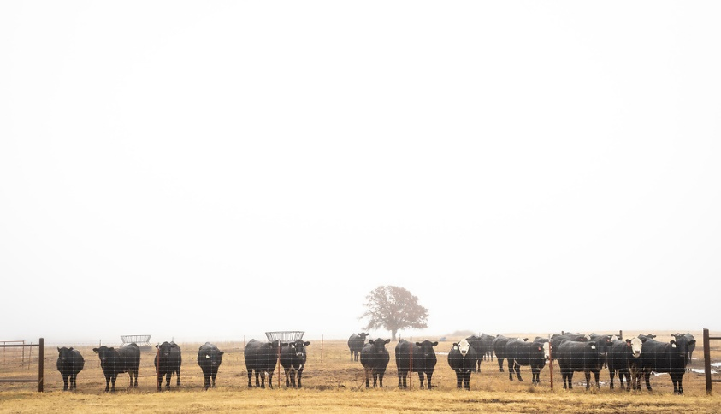
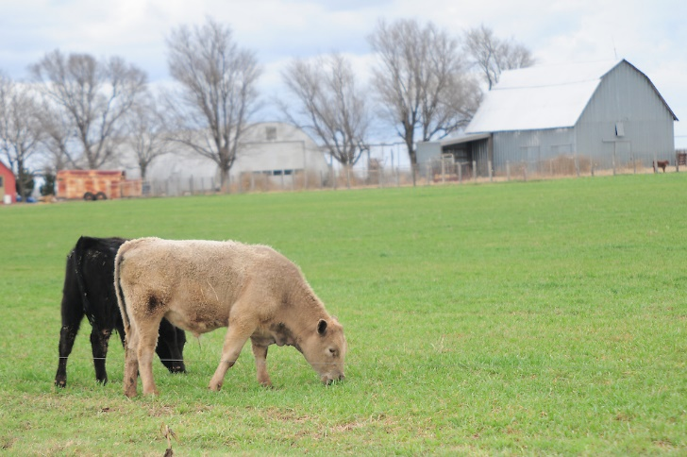
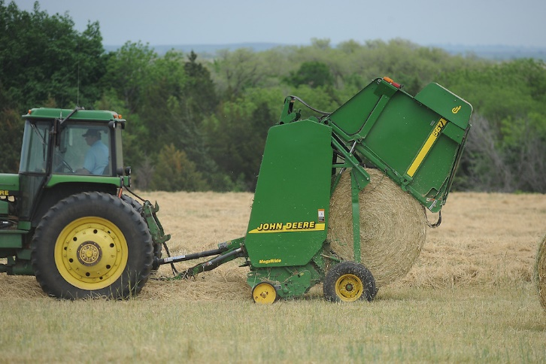
3. Identify Leaches and Leeches
VALUE
LEACH is to seep or drain
LEECHES clings to another, exhaust resources
WHERE DOES YOUR OPERATION GENERATE THE MOST ECONOMIC VALUE?
COW CALF?
HAY?
DEVELOPING REPLACEMENTS?
CUSTOM GRAZING?
CUSTOM HIRE?
Notes:
There are a million templates for CF out there, some of the ag specific ones will let you start with your cash on hand and incorporate you RLOC.
My preference would be to run a projected / Actual version

Slide 11

3. Identify Leaches and Leeches
LEACH is to seep or drain
LEECHES clings to another, exhaust resources
WHERE DOES YOUR OPERATION GENERATE THE MOST ECONOMIC VALUE?
Separate enterprises
Charge the full value of each output to the enterprise using it
It will vary annually
By doing so, we develop our UCOP
UCOP is our decision tool
HEIFER
DEV
STOCKERS
LAND
COWS
HAY
Notes:
There are a million templates for CF out there, some of the ag specific ones will let you start with your cash on hand and incorporate you RLOC.
My preference would be to run a projected / Actual version

Slide 12
Put a bow on it…
Don’t let perfect be the enemy of good
Better prices can lead to opportunities, cash flow and working capital are what we can use to take advantage of those opp.
The cost of credit won't be easing anytime soon.
Increased input costs may strain cash until revenue can be generated. Timing of CC cash flows makes this more strenuous.
Beware of things on the horizon… How will we replace assets?
ABC - Always Be Calculating

Slide 13
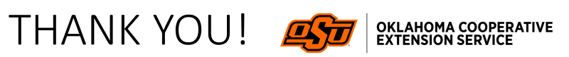
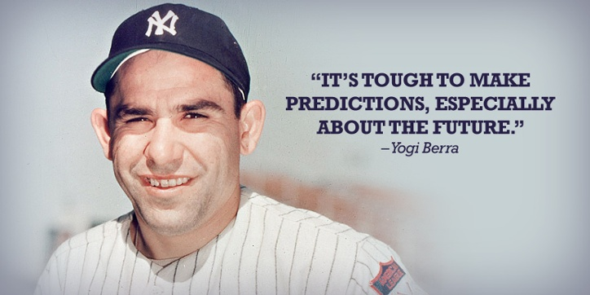
https://okstatecasnr.az1.qualtrics.com/jfe/form/SV_42DhtAwcMaFXUAC

