Slide 1
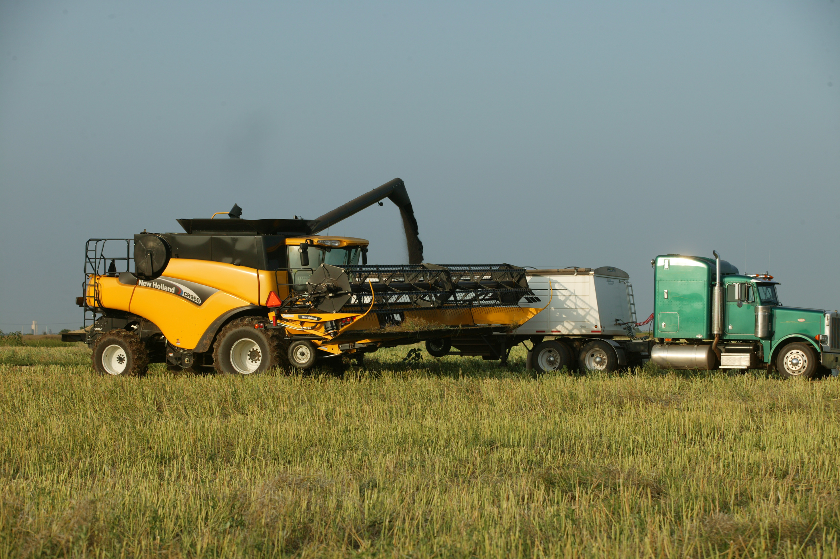

Results of the 2021 Custom Rate Survey and Some Machinery Management Considerations
Roger Sahs, Associate Extension Specialist
OSU Agricultural Economics Department

Slide 2
Webinar will talk about the following:
Survey procedures and survey responses
The pros and cons of custom work
Determining and comparing costs

Slide 3
Custom rate survey procedures
OSU provides survey content
Oklahoma Field Office – NASS mailings + follow-up phone calls
180+ operations
Usable surveys – 675
Approximately 75 operations reported
Publication Current Report-205, Oklahoma Farm and Ranch Custom Rates, 2021-2022

Slide 4
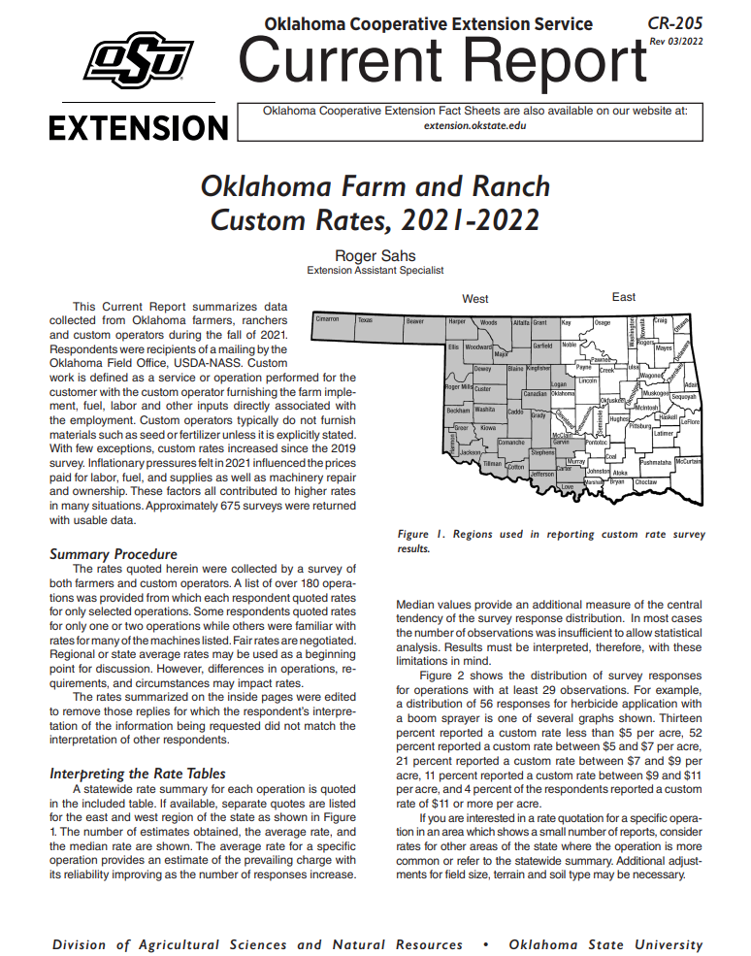
https://extension.okstate.edu/fact-sheets/oklahoma-farm-and-ranch-custom-rates-2021-2022.html

Slide 5
Price increase
20+ responses 2021 compared to 2019 (2011 in red)
  Castrating cattle, 24%, $5.28 vs $4.25/hd $2.86
  Preg test cattle, 1%, $4.78 vs $4.73/hd
  Brush hogging, 14%, $55.24 vs $48.40/hr $40.25
  Building fence w/o materials -
  (4-6 wire, steel posts) 35%, $4875 vs 3603/mi $2475
  Mowing hay, 10%, $16.19 vs $14.68/ac $10.75
  Swathing, .5%, $16.09 vs $16.01/ac $13.55
  Baling small square bales, 34%, $2.05 vs $1.53 $1.29
  Cutting, raking, baling rd bales (4-ft width), 4%, $22.56 vs $21.61
  Cutting, raking, baling rd bales (5-ft width), 14%, $25.55 vs $22.34
  Combining sm grains–flat rate, 4%, $23.89 vs $22.97/ac. $21.34
  Combining sm grains–base rate, .1%, $23.61 vs $23.57/ac. $21.61
Source: OSU Current Report 205, Oklahoma Farm and Ranch Custom Rates.

Slide 6
Price decrease
20+ responses 2021 compared to 2019 (2011 in red)
  Apply bulk dry fertilizer -22%, $6.09 vs $7.82/ac $4.22
  Apply liquid fertilizer -24%, $5.82 vs $7.66/ac $4.67
  Raking hay, -24%, $4.22 vs $5.57/ac $4.86
  Baling round bales (4-ft width), -12%, $14.67 vs $16.62
  Baling round bales (5-ft width), -3%, $16.16 vs $16.65
Source: OSU Current Report 205, Oklahoma Farm and Ranch Custom Rates.

Slide 7
Responses = 38
Average = 23.61
Median = 24.00
Source: OSU Current Report 205, Oklahoma Farm and Ranch Custom Rates.

Slide 8
Responses = 38
Average = .24
Median = .24
Source: OSU Current Report 205, Oklahoma Farm and Ranch Custom Rates.
Notes:
In many cases, custom harvesters will include an additional charge with “high” yields.

Slide 9
Responses = 38
Average = 22
Median = 20
Source: OSU Current Report 205, Oklahoma Farm and Ranch Custom Rates.
Notes:
Kansas = 23, Texas = 22 yields charged over
35.5, 27.9, OK = 28.9 since 1968
38, 30, OK = 28 since 2006

Slide 10
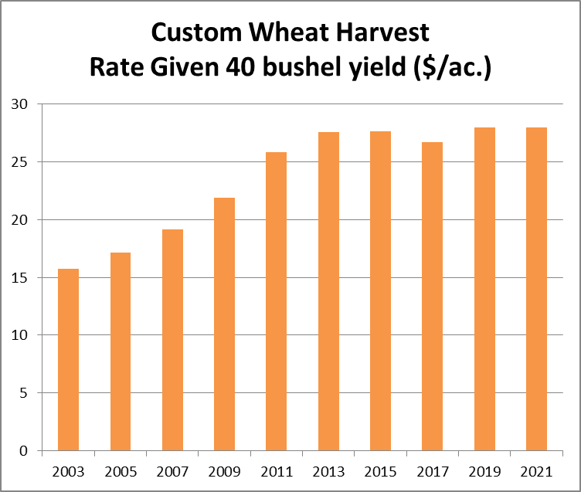
Custom Wheat Harvest
Historical Rates
 | Base Rate | Extra charge for high yield
 |  |  |  | Above
Year | $/ac. | $/bu. |  | Bushels
2003 | 13.26 | 0.13 |  | 21
2005 | 14.14 | 0.15 |  | 20
2007 | 15.93 | 0.16 |  | 20
2009 | 18.47 | 0.18 |  | 21
2011 | 21.61 | 0.21 |  | 21
2013 | 22.97 | 0.23 |  | 21
2015 | 23.24 | 0.23 |  | 21
2017 | 22.74 | 0.22 |  | 22
2019 | 23.57 | 0.23 |  | 21
2021 | 23.61 | 0.24 |  | 22
Source: OSU Current Report 205, Oklahoma Farm and Ranch Custom Rates.
Notes:
78% since 2003, about 4% per year.

Slide 11
Custom work considerations
Pros and cons
Advantages of using custom operations.
  Ownership costs are avoided.
  Frees up your time for other uses.
  Operations may benefit from a skilled operator.
Disadvantages of using custom operations
  Timeliness – not getting hay put up on time costs $.
  Reliability of the operator may not be known.
  Rates may be excessive at the optimal time.

Slide 12
Other considerations - What should I pay for custom work?
Be careful when quoting custom rates from various sources.
Can be a wide variation in rates due to:
  Competition
  Custom work between friends, neighbors or family usually at reduced rates.
  Soil conditions, field sizes/shapes, and distance from custom operator’s home base.
  Easy to underestimate the full operation and ownership costs.

Slide 13
Most Important Principles to Know - What should I charge for custom work?
Determine your total cost to help set a custom rate.
  Estimate operating costs - fuel/lube, repairs, and labor - on the appropriate ($/acre, hour, bale, etc) basis.
  Estimate annual fixed (ownership) costs - depreciation, interest, taxes, and insurance.
  Refer to your own records and use page 7 in Current Report-205 “Oklahoma Farm and Ranch Custom Rates” to help figure your costs.
  Decision tools also available from Kansas State. http://www.agmanager.info/decision-tools

Slide 14
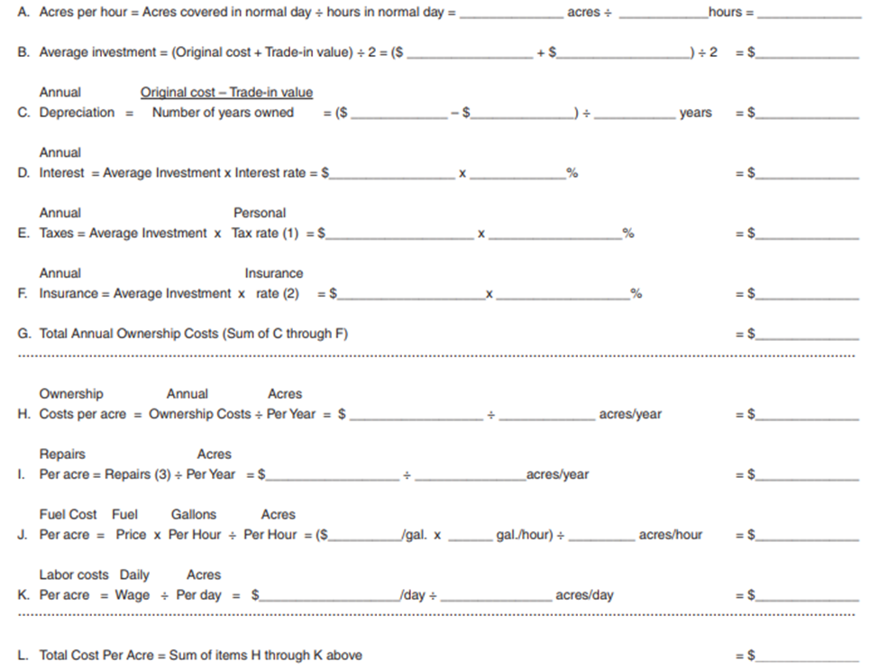
Most Important Principles to Know - What should I charge for custom work?
120
10
12
Step1
Determine your machinery cost, used combine example.
200,000
85,000
142,500
200,000
85,000
7
16,430
142,500
6%
8,500
500
1,000
26,430
26,430
2000
13.21
7.00
6.50
200
120
1.67
28.38
Source: Worksheet from OSU Current Report 205, Oklahoma Farm and Ranch Custom Rates

Slide 15
Most Important Principles to Know - What should I charge for custom work?
Step 2
Add the Profit & Risk Margin
Custom Work Charges
Typical Operation Average Custom Charges
Light Tillage, favorable field Cost + 20-30%
Conditions
Plowing or chiseling
Medium to heavy disking Cost + 30-40%
Average field conditions
Hay and silage operations Cost + 40-50%
Combining, high risk
Total cost from used combine example = $28.38+(.40 x $28.38) =
suggested custom rate charge $39.73/ac. vs quoted rate of $27.93*
*Source: Assuming 40 bu. yield, $23.61/ac + ($.24*22 bu), OSU Current Report 205.

Slide 16
Most Important Principles to Know – What should I charge for custom work?
Breakeven point to justify ownership will occur when the total savings in operating costs is equal to the average annual fixed cost.
Breakeven = Annual fixed cost
Custom rate* – operating cost
Combine $26,430
example $27.93* - $15.17
Breakeven = 2017 acres
*Source: OSU Current Report 205

Slide 17
Another principle to know – What is the additional cost to own a combine with less acres?
Let’s say the farmer only has 1500 acres of his own and is willing to accept the higher cost of ownership for the ability to harvest when the crop is ready. What is the cost for that timeliness/convenience?
Custom harvest = $27.93* x 1500 = $41,895
Ownership = $26,430 per year
Operating = $15.17 x 1500 = $22,755
Total cost = $49,185
Extra cost per year vs custom charge = $7,290 = $4.86/acre
*Source: OSU Current Report 205

Slide 18
In summary….
Estimating your machinery costs is important!
What should I pay?
  Consider the pros and cons when hiring work done.
What should I charge?
  Consider your costs and a potential profit and risk margin
  Take into consideration other factors such as travel distance, field conditions, competition, etc.
  Know the breakeven point of ownership. The greater the volume, the greater the profit potential. In our example, anything over 2017 acres means a profit of $12.76/ac.
Wide variation in rates charged for most jobs and for many reasons…so do your homework!

Slide 19
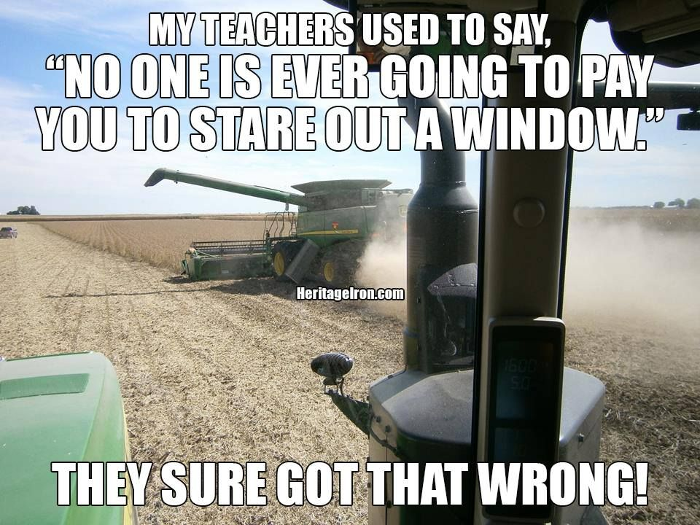
Thanks for stopping by!
webinar survey:
https://okstatecasnr.az1.qualtrics.com/jfe/form/SV_0rHsbuoEbwsZEge
Roger Sahs, Associate Extension Specialist
Roger.sahs@okstate.edu, 405.744.7075

