Slide 1
Impact of COVID on the ag supply chain
Courtney Bir
Assistant Professor
Department of Agricultural Economics
Oklahoma State University
courtney.bir@okstate.edu

Slide 2
Immediate Response to COVID
As an immediate response- most restaurants closed
Shift from out-of-home eating to in-home eating
  food away from home went from 54% of food budget to ~15%

Slide 3
What does that mean?
Think about what you choose in a restaurant vs what you eat at home.
Think about the impact of EVERYONE making the same shift.

Slide 4
Eggs- An easy example
Disruptions are happening for all products- eggs are an easy example that had fast legislation changes
Egg consumption shifted from at restaurants to the home

Slide 5
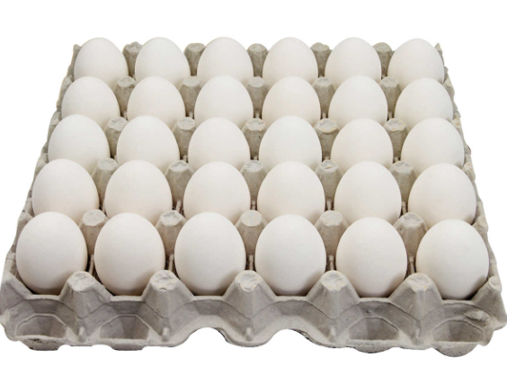
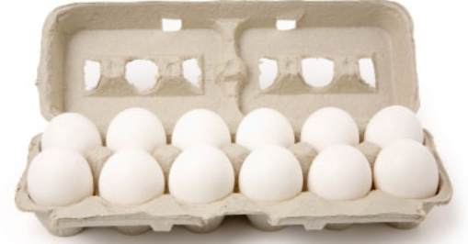
Why can’t restaurant eggs be sold in the store?

Slide 6
Not Just Convenience
Store eggs
  Strict packaging requirements
  Nutrition information required
  Additional regulations to prevent Salmonella
Restaurant eggs
  Different packaging- large flats or sold as liquid
Notes:
https://www.fda.gov/food/cfsan-constituent-updates/fda-provides-temporary-flexibility-regarding-egg-safety-rule-during-covid-19-pandemic-while-still

Slide 7
Temporary Solution
FDA allowed for relaxation of rules
  Flats can now be sold in stores
  Information regarding distributor and safe handling required to be on display
  With certain criteria- additional Salmonella precautions are not needed

Slide 8
Issues faced by other livestock products
Strict inspection rules
COVID cases in packing plants
  Guymon 2,700 workers (roughly ¼) tested positive for COVID in Seabord pork plant
Cattle slaughter temporarily fell by 32%
Notes:
https://www.reuters.com/article/us-health-coronavirus-meat-plant-special/special-report-in-oklahoma-pork-packing-town-covid-stirs-fear-faith-and-sorrow-idUSKBN22Z0SK

Slide 9
Solutions
Continue to develop safety protocols for workers
No one knows if at-home food consumption will be a new trend
Continue to evaluate and adjust trends as needed

Slide 10
Questions??

