Slide 1

Wheat and Cotton,
Situation and Outlook
Oklahoma State University

Slide 2
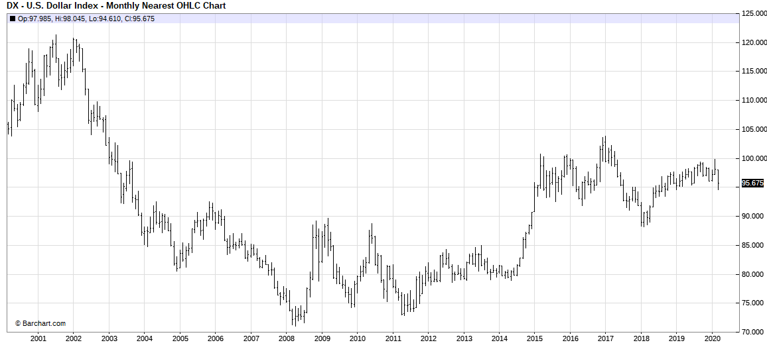
ICE/US Dollar Index:
Weekly Nearest April 15 - Present

Slide 3
Percentage of World Exports
2000
2019
Wheat
  U.S. 27%
  B.S. 6%
Corn
  U.S. 67%
  B-U-A 17% (2,0,15)
Soybeans
  U.S. 58%
  Brazil 25%
Cotton
  U.S. 38%
  Other 50%
  India 1%
  Brazil 2%
Wheat
  U.S. 14%
  B.S. 31%
Corn
  U.S. 34%
  B-U-A 52% (19,15,18)
Soybeans
  U.S. 37%
  Brazil 48%
Cotton
  U.S. 36%
  Other 32%
  India 11%
  Brazil 13%

Slide 4
Forward Contract Prices
Wheat $4.31 -23 Jly $4.14 -40
Corn $3.50 -30 Dec
Milo $3.25 -55 Dec $3.25 -55
Soybeans $8.04 -100 Nov
Cotton $0.59 -0.03 Dec

Slide 5
Wheat

Slide 6
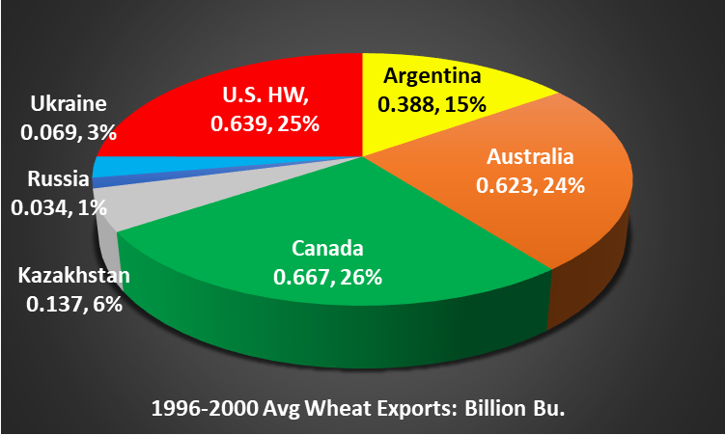
1996-2000 Average Hard Wheat Exporters’ Exports
Billion Bushels

Slide 7
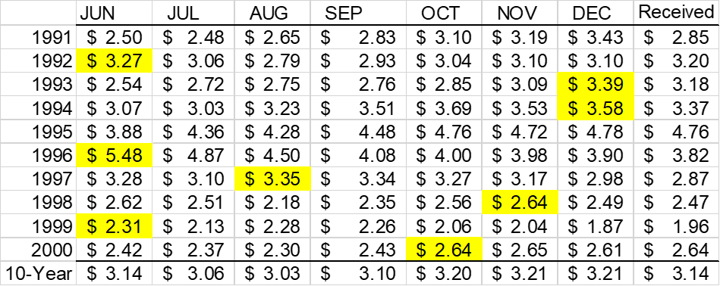
1991-2000 Oklahoma Monthly Average Prices
Starting in August, minus 4 cents per month storage costs
Received is the average price received by Oklahoma wheat producers.

Slide 8
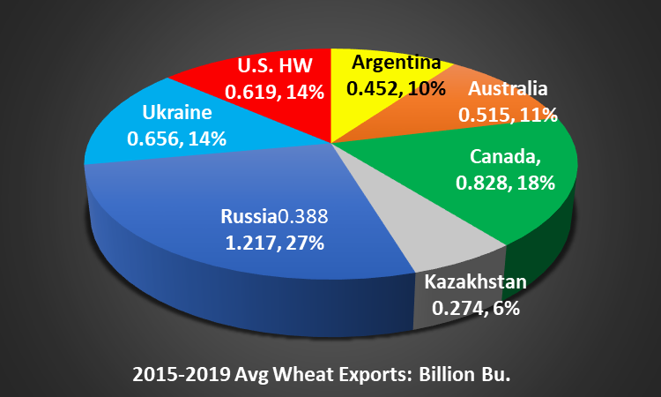
2015-2019 Average Hard Wheat Exporters’ Exports
Billion Bushels

Slide 9
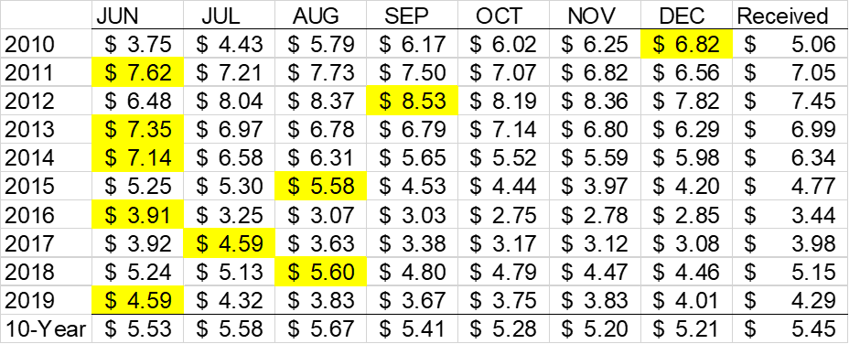
2010-2019 Oklahoma Monthly Average Prices
Starting in August, minus 5 cents per month storage costs
Received is the average price received by Oklahoma wheat producers.

Slide 10
Percentage World Wheat Production by Month

Slide 11
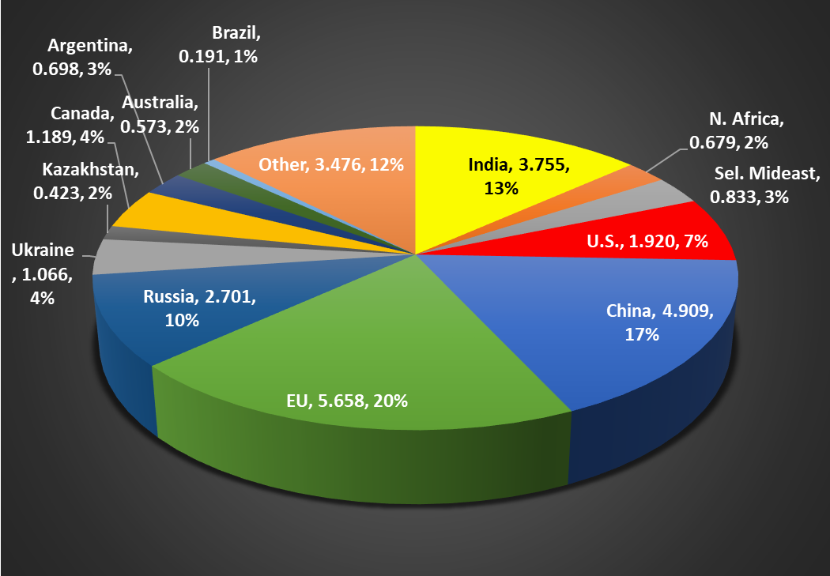
Start of Harvest
Mid-March
End of Harvest
January
2019/20 Wheat Production in Order of Harvest Time:
(billion bushels)

Slide 12
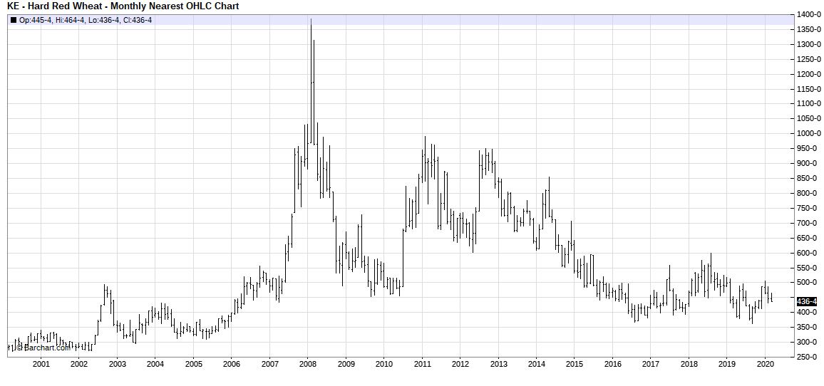
KC Wheat Contract Price: Monthly
---Present
High Ending Stocks
Low Protein &/or TW

Slide 13

U.S Average Annual Wheat Price
Marketing Year | 17/18 | 18/19 | 19/20 | 20/21 | 21/22 | 22/23 | 23/24 | 24/25 | 25/26 | 26/27 | 27/28 | 28/29
 |  |  | $4.55 | $4.90
UM Average Annual | $4.72 | $5.16 | $5.00 | $4.73 | $4.86 | $4.98 | $5.08 | $5.15
USDA Average Annual | $4.72 | $5.16 | $5.31 | $4.80 | $4.90 | $5.00 | $5.00 | $5.05 | $5.10 | $5.10 | $5.15 | $5.15

Slide 14
U.S. Wheat Situation
Ending
Stocks
U. S.
Price
Year
Production
Consumption
(Billion Bushels)
2012 | 2.25 | 2.41 | .718 | $7.77
2013 | 2.14 | 2.43 | .590 | $6.87
2014 | 2.03 | 2.02 | .752 | $5.99
2015 | 2.06 | 1.95 | .976 | $4.89
2016 | 2.31 | 2.22 | 1.18 | $3.89
2017 | 1.74 | 1.98 | 1.01 | $4.72
2018 | 1.89 | 2.04 | 1.08 | $5.16
2019 | 1.92 | 2.17 | .940 | $4.55
2020 | 1.84 | 2.14 | .777 | $4.90
7-YR Avg. | 2.06 | 2.15 | .901 | $5.61
25%
37%
43%
36%

Slide 15
Russia 63%; Ukraine 25%, Kazakhstan 11%
Black Sea Wheat Situation
Ending
Stocks
Stocks
To Use
Year
Production
Consumption
(Billion Bushels)
2012 | 2.327 | 2.812 | 0.384 | 14%
2013 | 3.245 | 3.265 | 0.400 | 12%
2014 | 3.558 | 3.432 | 0.560 | 16%
2015 | 3.750 | 3.913 | 0.431 | 11%
2016 | 4.200 | 4.061 | 0.593 | 15%
2017 | 4.665 | 4.700 | 0.581 | 12%
2018 | 4.067 | 4.264 | 0.407 | 10%
2019 | 4.189 | 4.235 | 0.391 | 9%
7-YR Avg. | 3.687 | 3.778 | 0.479 | 13%

Slide 16
Market News
World record wheat production 28.3 bb
Black Sea wheat production higher
  Russia +150 mb; Ukraine -100 mb; Kazakhstan + 100 mb
Australia +150 mb
U.S. – Production and Ending Stocks lower
Russia staggering out exports (-19% Feb)
Russia attempting to sell wheat to Philippines

Slide 17
Cotton

Slide 18
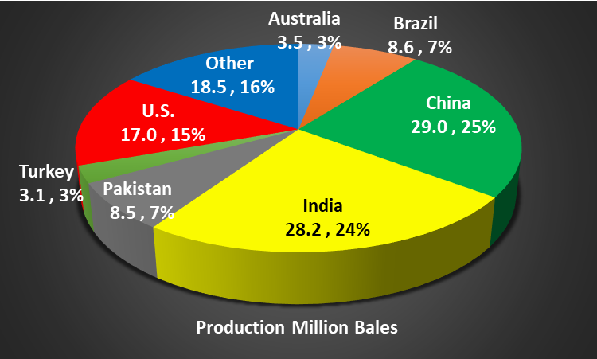
2015-2019 Average Cotton Production
5-year average-Million 480# Bales

Slide 19
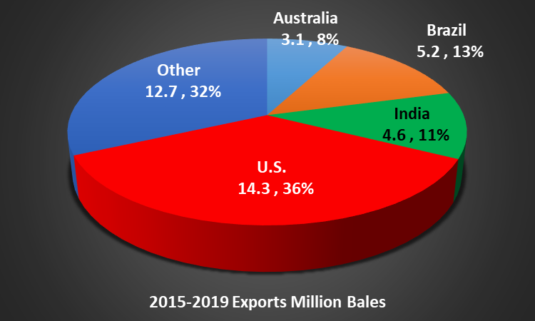
2015-2019 Average Cotton Exports
5-year average-Million 480# Bales

Slide 20
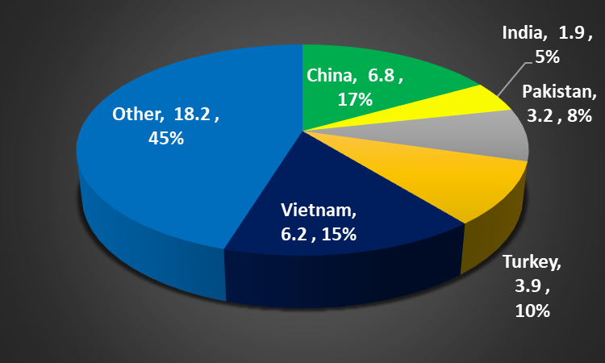

2015-2019 Average Cotton Imports
5-year average-Million 480# Bales

Slide 21
World Cotton Situation
Ending
Stocks
Year
Production
Consumption
(Million Bales)
2012 | 123.6 | 108.2 | 89.3
2013 | 120.4 | 109.9 | 99.9
2014 | 119.2 | 113.2 | 106.7
2015 | 96.2 | 115.2 | 90.1
2016 | 106.7 | 116.2 | 90.1
2017 | 123.8 | 122.8 | 80.3
2018 | 118.6 | 120.3 | 80.2
2019 | 121.6 | 118.2 | 83.4
2020 | 118.5 | 121.2 | 80.7
7-YR Avg. | 115.4 | 115.0 | 90.9

Slide 22
U.S. Cotton Situation
Ending
Stocks
U. S.
Price
Year
Production
Consumption
(Million Bales)
2012 | 17.3 | 16.5 | 3.9 | 72.5 | ¢
2013 | 12.9 | 14.1 | 2.4 | 77.9 | ¢
2014 | 16.3 | 14.8 | 3.7 | 61.3 | ¢
2015 | 12.9 | 12.6 | 3.8 | 61.2 | ¢
2016 | 17.2 | 18.2 | 2.8 | 68.0 | ¢
2017 | 20.9 | 19.5 | 4.2 | 68.6 | ¢
2018 | 18.4 | 17.7 | 4.9 | 70.3 | ¢
2019 | 19.8 | 19.5 | 5.1 | 60.0 | ¢
2020 | 19.5 | 19.5 | 5.0 | 64.0 | ¢
7-YR Avg. | 16.6 | 16.2 | 3.7 | 68.5 | ¢

Slide 23
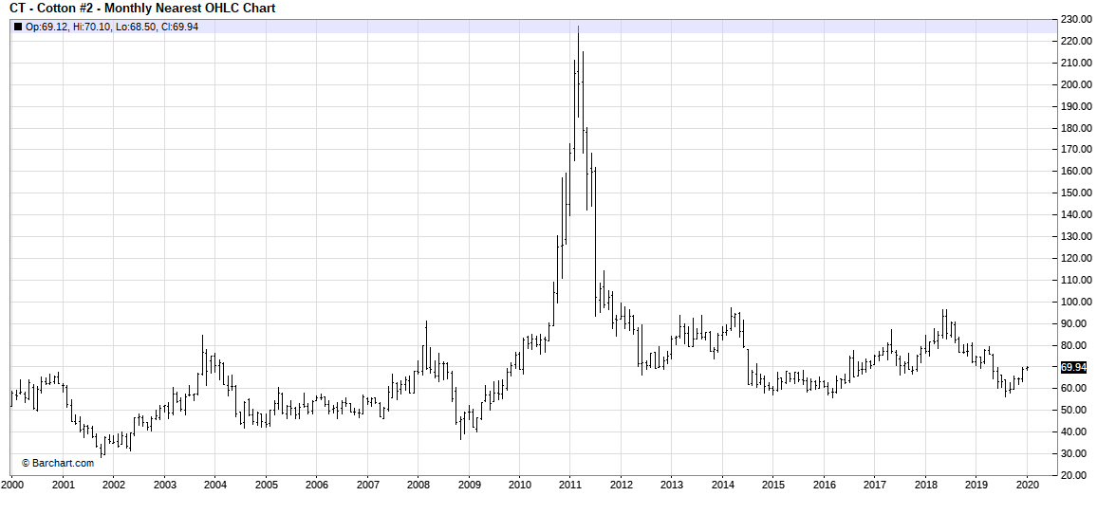
CBT Cotton Contract Price: Monthly
January 2000 to Present

Slide 24
Kim’s Observations
World production has may have a larger impact on U.S. prices than U.S. production.
The Black Sea region will continue to impact prices.
  Increased corn production and exports
  Need to maintain grain quality
  Potential weather problems
There is excess grain
Sell wheat at harvest
No change in prices without weather problems.

