Slide 1
Managing Farm Stress
Matt Brosi, Ph.D.
Jordan Shuler

Slide 2
Stress vs. Distress
Stress is a normative process
For farmers, stress is a part of everyday life
Being under stress is not the same thing as feeling distressed

Slide 3
Stress Defined
Positive stress = eustress

Slide 4
Distress
When stress gets too high, we experience distress.

Slide 5
Eustress vs. Distress
The Eustress-Distress Curve
Maximum Performance
Eustress: positive stress which motivates, energizes, and excites
Distress: negative stress which is oppressive, elevates emotions, and reduces performance
Good
Low
performance
illness
Eustress
Distress
Poor
poor performance
poor performance
High
low
bored
moderate
optimal
high
overwhelmed

Slide 6
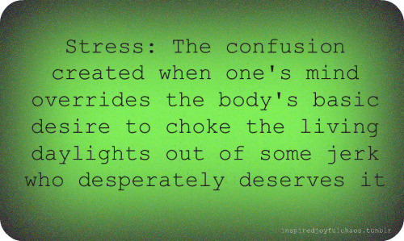
Consequences of Too Much
Stress suppresses the immune system; easier for you to get sick and harder to fight off bugs.
Numerous emotional and physical disorders linked to stress:
  Sleep disturbances are a major factor!
  Diminished capacity for logical thought, making accidents more likely.
  Depression, anxiety, heart attacks, stroke, hypertension, immune system disturbances, digestive disturbances, skin issues, etc.

Slide 7
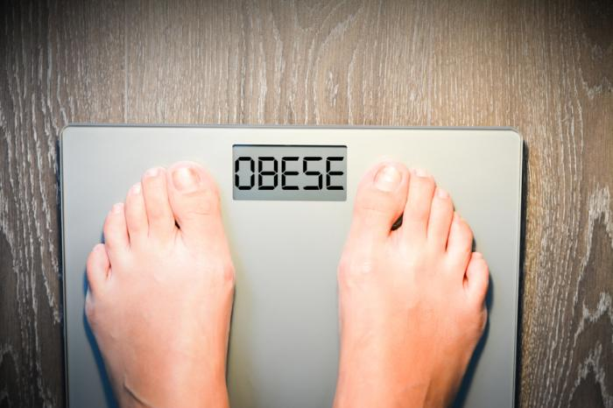

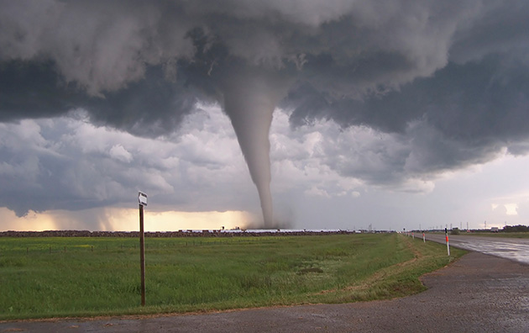
Stress in Oklahoma
Financial Stress / Poverty
  16% living in poverty
Obesity
  More than one in three qualify as obese
Substance Use
  2nd in the nation for substance abuse problems
Divorce
  3rd in the nation for divorce rates
Natural disasters
  Higher than average tornado rates and drought conditions

Slide 8
Farm Stress
Distress in rural Oklahoma
Recent (and upcoming?) Farm Stress issues in OK
    Loss or decrease of income
    Rising debt
    Concerns about drought
  Farm Transitions/Losses:
    Death
    Divorce
    Disease
    Disaster
    Disability

Slide 9
Farm Stress
Farming is among the most stressful and dangerous professions
  Dangerous conditions
  Low income
  Lack of control
COVID-19
Despite more spread-out communities
  Rural communities tend to be older
  Higher levels of long-term health problems
  Hospitals already strained
Equipment Failure
Damaged property
Foreclosures

Slide 10
Farmers and Suicide
Suicide rates higher in rural communities
Depression on the farm
  Loss of income and increased debt
  Health problems
  Family troubles
  Fear of the unknown
The connection to higher suicide rates
  Farming culture
  Less access to medical care
  High access to lethal means

Slide 11
Warning Signs and Barriers
Acute Crisis and Warning Signs
Unique Circumstances
Thoughts about killing oneself
A specific plan
Means
Self-reliance and “toughness”
Ongoing pressure
Less experience with emotional expression

Slide 12
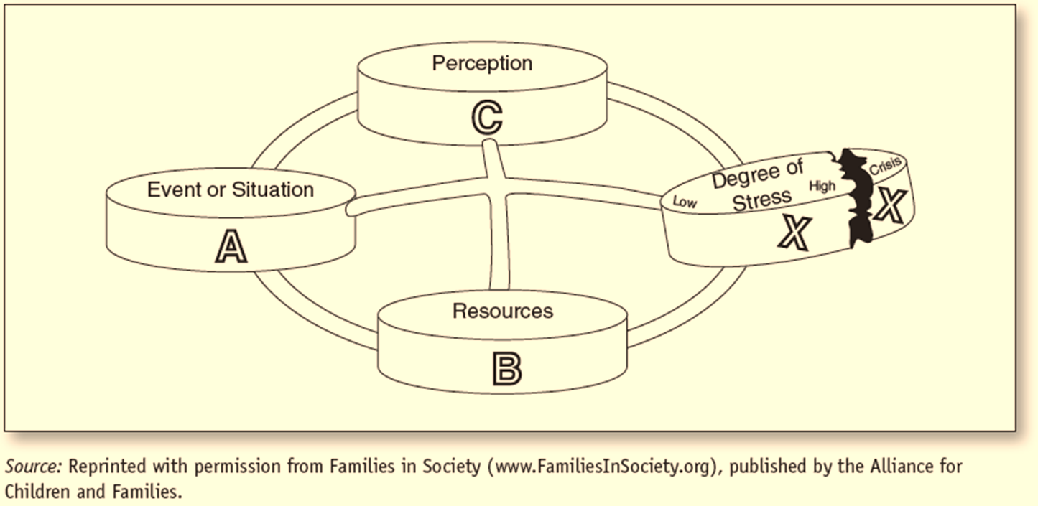
One More Way To Think About Stress

Slide 13
Relationships as Resources
You & Your Significant Other
Friends and Faith
Flood your relationships with Positive Experiences
Starting soft
Humility and Acceptance
Sharing your stories
Building routines of support
Faith communities

Slide 14
Putting it All Together
Reducing potentially stressful circumstances
  Is there a place you could cut back pressure?
Using resources
  Ag lenders and creative plans
  Family or communities of support
Changing perspectives
  Challenge defeating thoughts
  Know a hard time doesn’t define you
  Challenge can be an opportunity
  Be patient with yourself

Slide 15
Additional Resources
Suicide Prevention Hotline
  National hotline: 1-800-273-8255
Talk with Someone
  Mental health professional: https://www.psychologytoday.com/us/therapists/online-counseling
  Coffee shop groups
  Faith leaders or trusted others

Slide 16
Q&A and Feedback
Questions
We appreciate your feedback!
https://okstatecasnr.az1.qualtrics.com/jfe/form/SV_9NsdbazthcfQWCV

