Slide 1
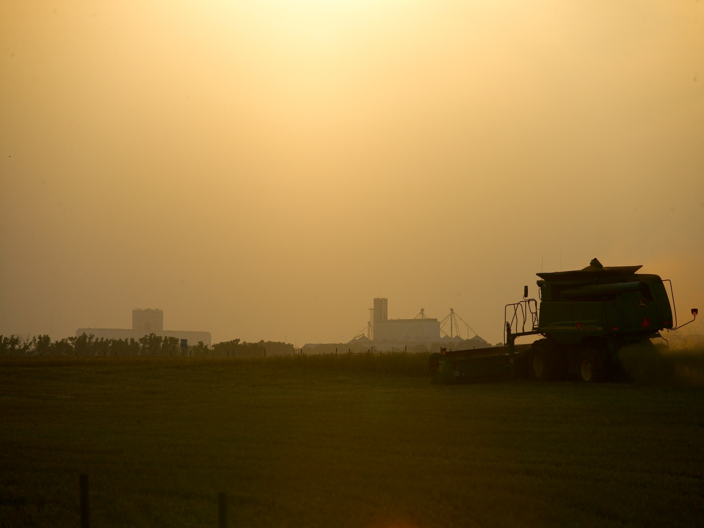
Agricultural Land Rental Update
Roger Sahs, Extension Specialist
OSU Agricultural Economics Department

Slide 2
Survey procedures
Oklahoma Ag Statistics Service mailings
Questions on crop shares and cash rents for cropland & pasture
Usable responses – 175 (cropland) 410 (pasture)
Current Report-216 “Oklahoma Pasture Rental Rates” and Current Report-230 “Oklahoma Cropland Rental Rates”
http://factsheets.okstate.edu/documents/cr-216-oklahoma-pasture-rental-rates-2018-2019/
http://factsheets.okstate.edu/documents/cr-230-oklahoma-cropland-rental-rates-2018-19/

Slide 3
Average Annual Non-irrigated Cropland Cash Rental Rates ($)
Wheat | NW | SW | NC | E | State | 2018 vs 2016
Average Median 2016 Avg | 30.80 30.00 31.22 | 31.29 30.00 37.07 | 34.01 35.00 39.21 | NA 30.75 | 32.90 33.00 36.01 | -8.6%
North central
Northwest
East
Southwest
Source: OSU/NASS survey, 2018

Slide 4
Wheat – Monthly Average Price
Received by Oklahoma farmers during the marketing year
Source: USDA-NASS

Slide 5
Cropland Cash Rent, 2018
($ per acre)
203.00
32.00
65.00
167.00
159.00
160.00
119.00
140.00
63.00
123.00
231.00
80.50
130
195.00
152.00
77.50
64.00
198.00
74.50
223.00
45.00
112.00
66.50
149.00
63.00
113.00
340.00
132.00
87.00
34.00
98.00
253.00
111.00
48.50
120.00
61.50
N/A
116.00
42.50
30 to 69.99
89.00
70 to 109.99
115.00
110 to 149.99
150+
USDA/NASS data

Slide 6
2017 Rental Rates for Cropland, Oklahoma
CIMARRON
TEXAS
BEAVER
HARPER
WOODS
NOWATA
ALFALFA
GRANT
KAY
WASHINGTON
OTTAWA
OSAGE
CRAIG
DELAWARE
WOODWARD
NOBLE
*
ROGERS
ELLIS
MAJOR
GARFIELD
PAWNEE
TULSA
MAYES
DEWEY
KINGFISHER
PAYNE
WAGONER
ROGER
BLAINE
LOGAN
CREEK
CHEROKEE
< $20
MILLS
CUSTER
CANADIAN
*
LINCOLN
OKMULGEE
MUSKOGEE
ADAIR
OKLAHOMA
OKFUSKEE
SEQUOYAH
$20 to $27.99
BECKHAM
WASHITA
*
MCINTOSH
CADDO
POTTAWATOME
SEMINOLE
HASKELL
CLEVELAND
HUGHES
$28 to $34.99
GREER
GRADY
*
PITTSBURG
KIOWA
*
LATIMER
$35 +
HARMON
MCCLAIN
PONTOTOC
*
GARVIN
LE FLORE
JACKSON
COMANCHE
*
*
TILLMAN
*
STEPHENS
MURRAY
COAL
COTTON
*
JOHNSTON
ATOKA
PUSHMATAHA
*
*
JEFFERSON
CARTER
MARSHALL
*
MCCURTAIN
LOVE
*
CHOCTAW
BRYAN
Source: USDA/NASS website, http://www.nass.usda.gov/Statistics_by_State/Oklahoma/ Publications/County_Estimates/index.asp.
* Indicates rate for Other (Combined) Counties

Slide 7
Typical Oklahoma Cropland Share Lease Agreement
Income items shared | Landlord’s share
Crop | 1/3
Other income | 1/3
Expense items shared
Seed | None
Fertilizer | 1/3
Pesticide | 1/3 (or none)
Chemical applications | 1/3 (or none)
Harvesting | None
Lime application | 1/3 (or all or none)
Irrigation | None (or 1/3)
Source: OSU CR-230, February 2019.

Slide 8
Average Annual Pasture Cash Rental Rates ($/acre)*
 | NW | SW | NC | E | State | 2018 vs 2016
Native Pasture 2016 | 11.61 10.00 10.94 | 15.32 15.00 12.78 | 16.76 15.00 13.95 | 17.97 15.00 16.73 | 15.33 13.31 13.95 | +10%
Bermuda 2016 | NA | 21.15 22.19 20.27 | 25.22 20.00 24.55 | 22.85 20.00 23.96 | 23.15 20.00 22.79 | +2%
Other Pasture 2016 | 14.43 14.00 17.83 |  | 20.40 20.00 21.00 | 26.82 25.00 25.55 | 22.27 20.00 22.09 | +1%
North central
* 2018 Average (black font)
2018 Median (blue font)
2016 Average (red font)
Northwest
East
Southwest
Source: OSU/NASS survey, 2018

Slide 9
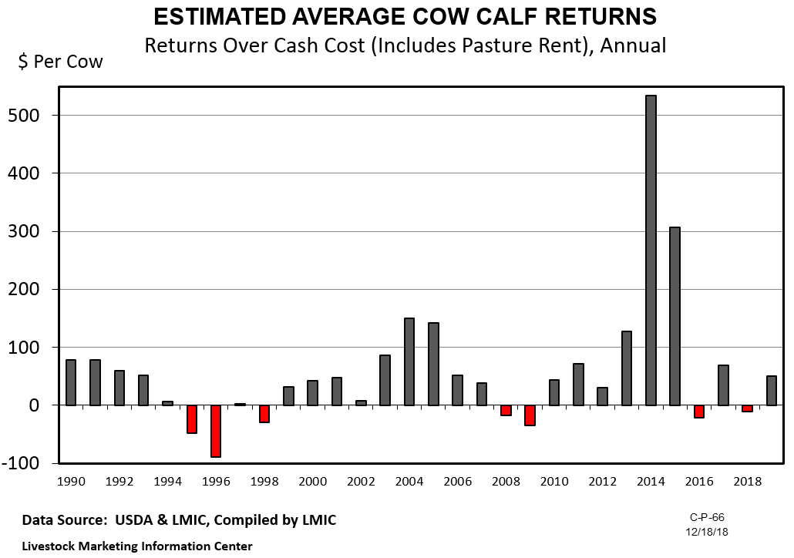

Slide 10
Average Pastureland Rent, 2018
($ per acre)
6.30
17.00
31.00
12.00
11.00
23.00
40.00
54.00
22.50
39.00
19.50
33.00
21.00
13.00
20.00
28.00
13.50
18.00
19.00
22.00
27.00
N/A
5 to 14.99
6.70
18.00
17.00
15 to 24.99
25+
USDA/NASS data

Slide 11
2017 Rental Rates for Pasture, Oklahoma
CIMARRON
TEXAS
BEAVER
HARPER
WOODS
NOWATA
ALFALFA
GRANT
KAY
WASHINGTON
OTTAWA
OSAGE
CRAIG
DELAWARE
WOODWARD
MAJOR
GARFIELD
NOBLE
ROGERS
ELLIS
*
*
PAWNEE
MAYES
DEWEY
PAYNE
TULSA
KINGFISHER
CREEK
WAGONER
CHEROKEE
ROGER
BLAINE
LOGAN
*
< $10
MILLS
CUSTER
CANADIAN
LINCOLN
OKMULGEE
MUSKOGEE
ADAIR
OKLAHOMA
*
OKFUSKEE
SEQUOYAH
$10 to $12.99
BECKHAM
WASHITA
*
MCINTOSH
CADDO
POTTAWATOME
SEMINOLE
*
HASKELL
*
CLEVELAND
HUGHES
PITTSBURG
$13 to $15.99
GREER
GRADY
KIOWA
MCCLAIN
LATIMER
$16 +
HARMON
GARVIN
PONTOTOC
*
LE FLORE
*
JACKSON
COMANCHE
*
TILLMAN
STEPHENS
MURRAY
COAL
COTTON
JOHNSTON
ATOKA
PUSHMATAHA
*
CARTER
MARSHALL
*
JEFFERSON
LOVE
CHOCTAW
MCCURTAIN
BRYAN
Source: USDA/NASS website http://www.nass.usda.gov/Statistics_by_State/Oklahoma/ Publications/County_Estimates/index.asp.
* Indicates rate for Other (Combined) Counties

Slide 12
USDA/NASS data

Slide 13
USDA/NASS data

Slide 14
USDA/NASS data

Slide 15
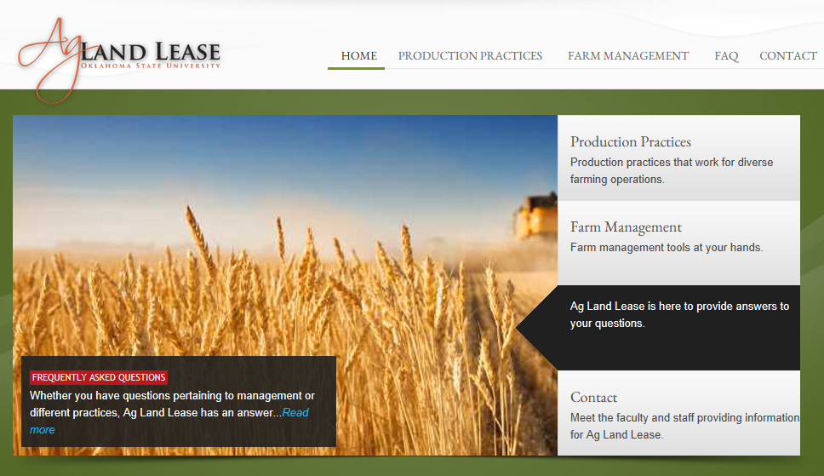
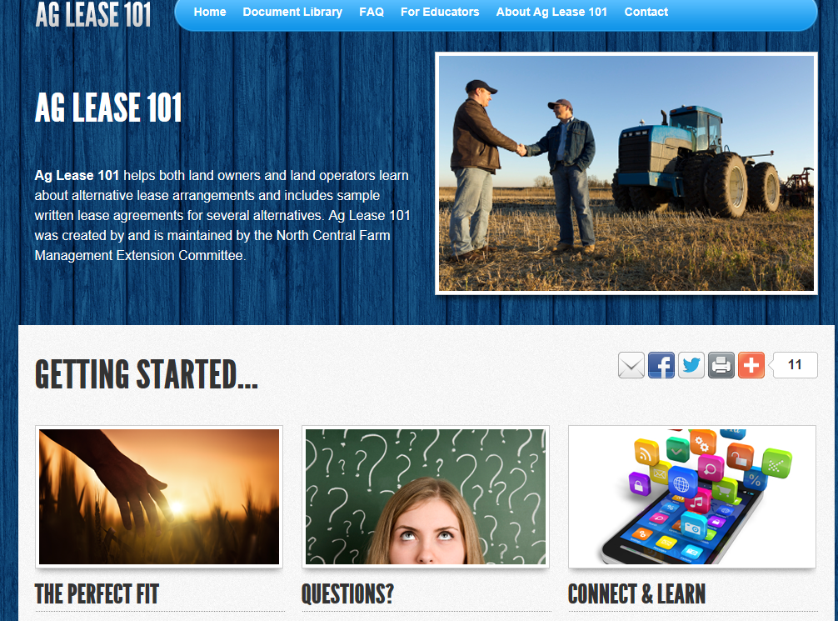
Check out these websites:
aglease.info & aglease101.org

Slide 16
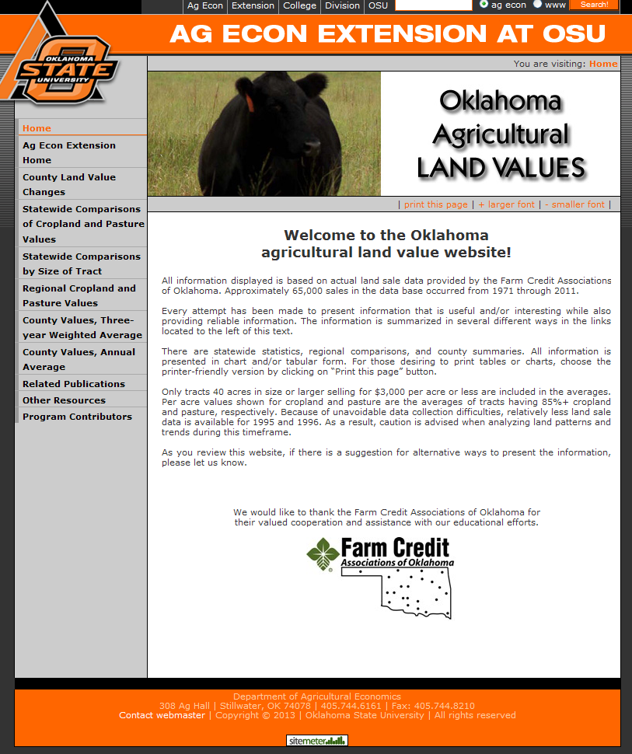
www.agecon.okstate.edu/oklandvalues

Slide 17
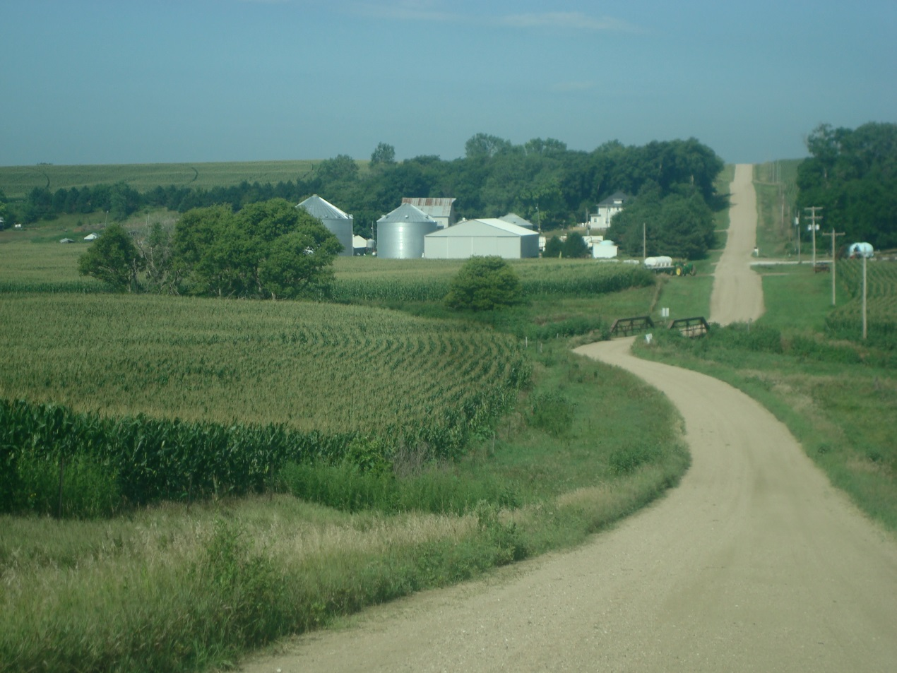
Thank you for listening in!
Roger Sahs
520 Ag Hall
405/744-9836
roger.sahs@okstate.edu
We would like your feedback! Please go to the link below to fill out a short survey.
https://okstatecasnr.az1.qualtrics.com/jfe/form/SV_cZPCxxzjhu9TYkB

