Slide 1
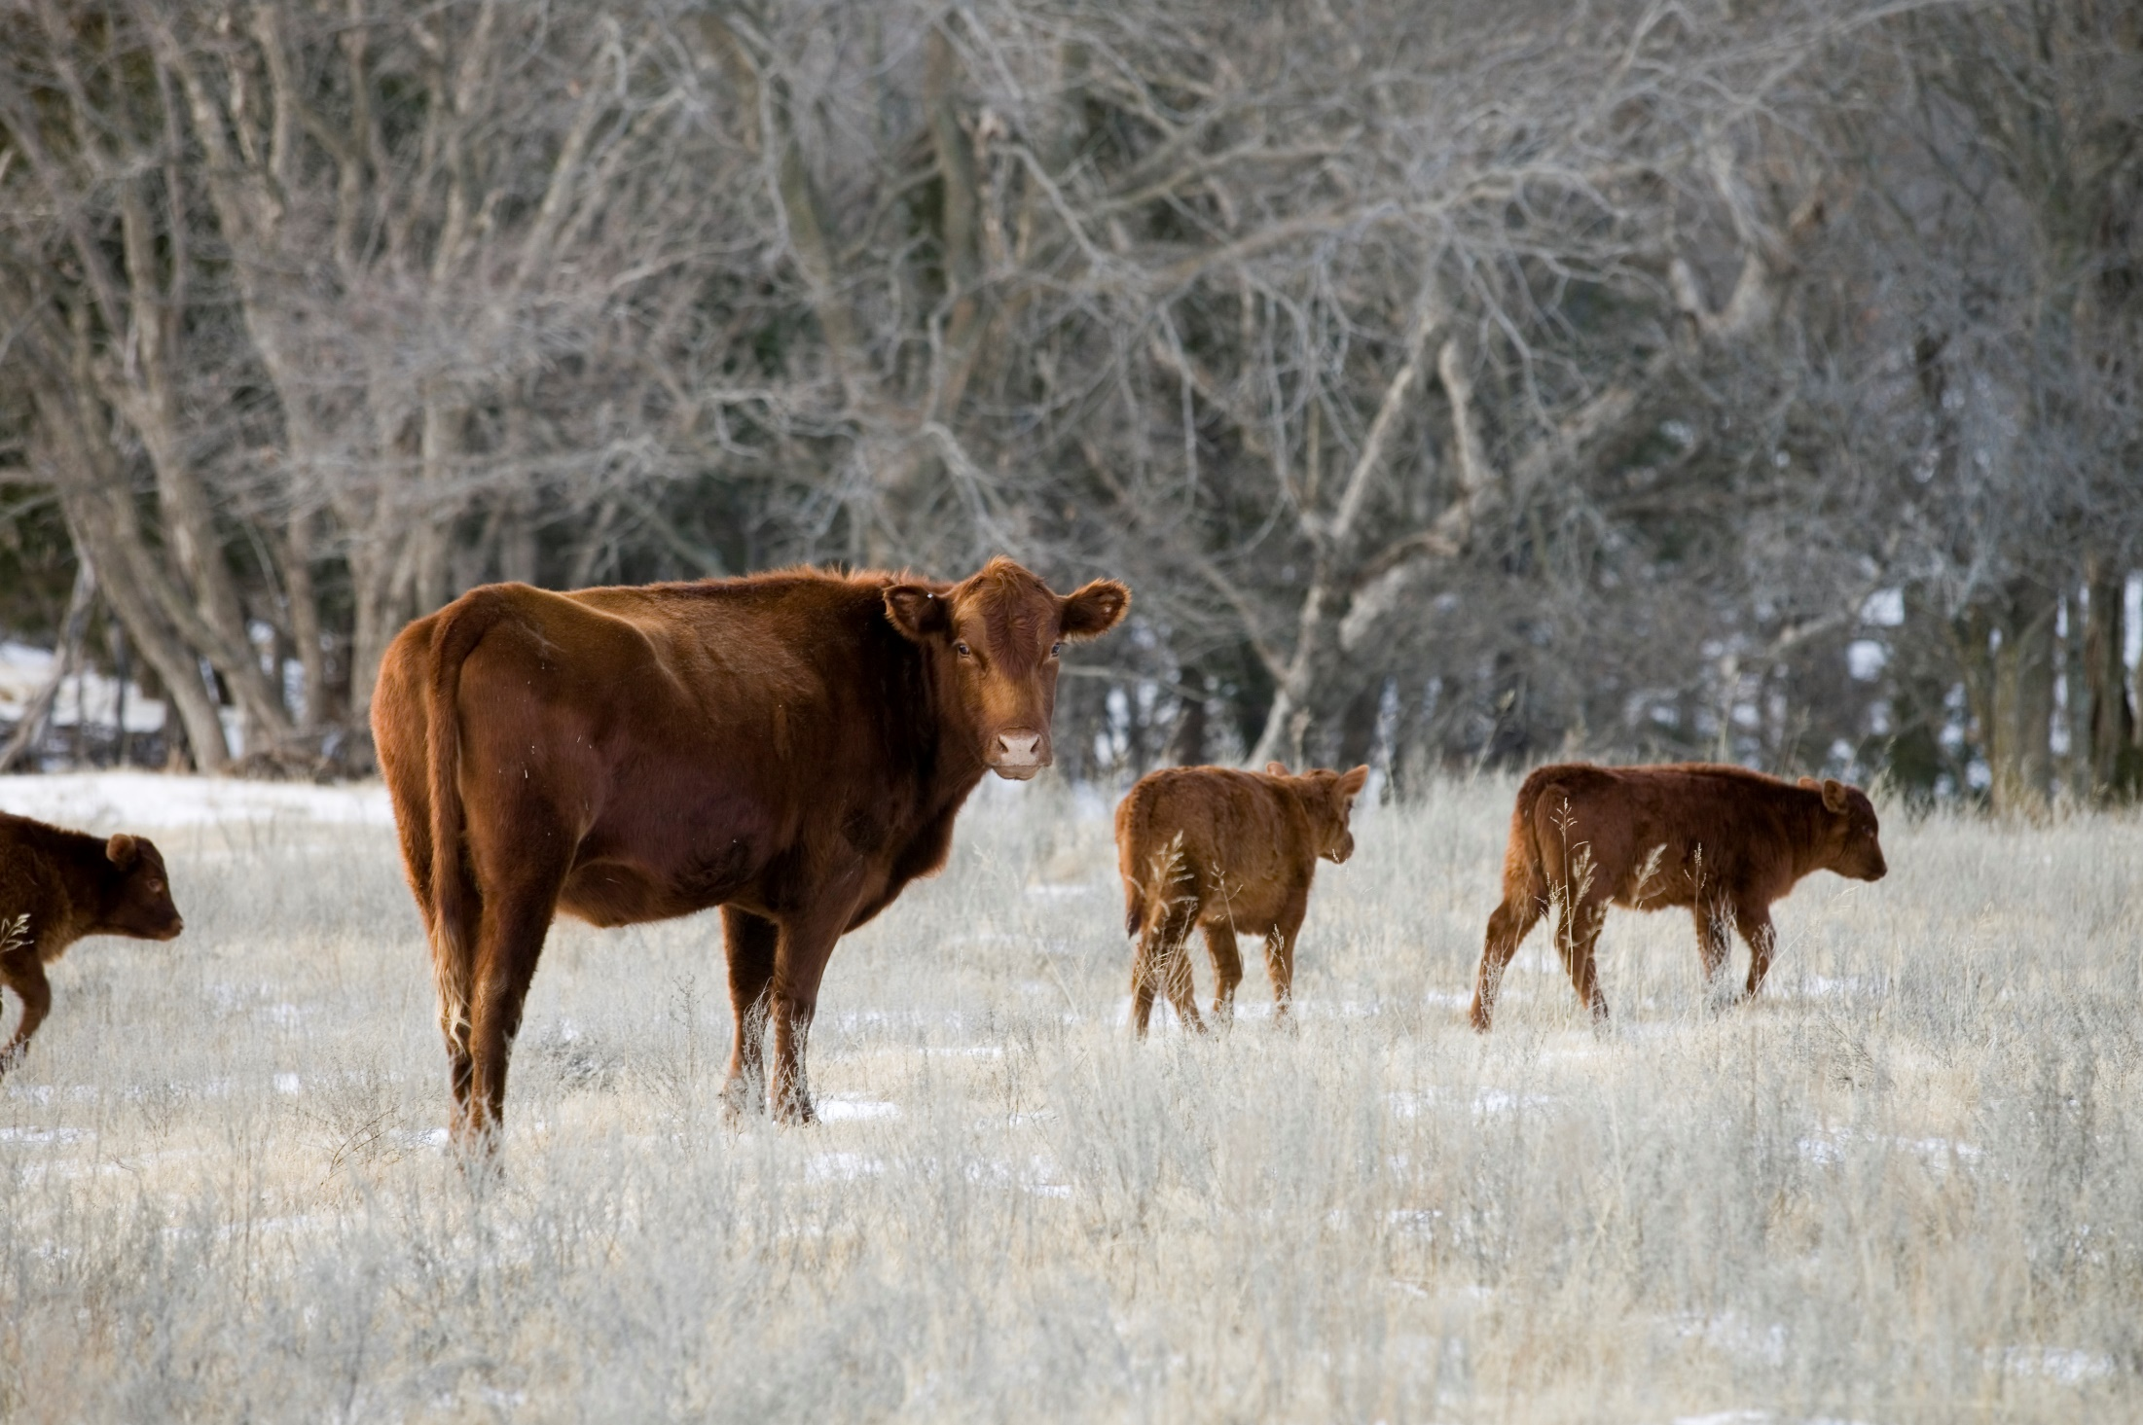

Oklahoma Agricultural Land Value Update
Roger Sahs, Extension Specialist
OSU Department of Agricultural Economics

Slide 2
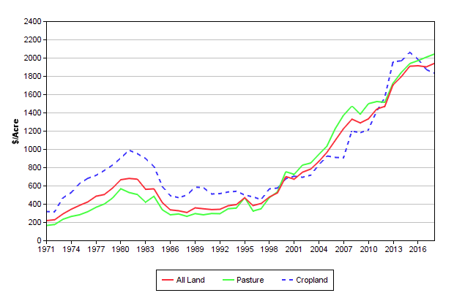
Oklahoma Cropland vs Pastureland Prices*
Statewide values have leveled off in recent years. Have values peaked? It depends on your location…
*Cropland and pasture tracts defined as having 85%+ cropland and pasture utilization, respectively.
Source: www.agecon.okstate.edu/oklandvalues

Slide 3
OK Land Values by Region, 2018*
www.agecon.okstate.edu/oklandvalues
Panhandle
Tracts 42
Size 468
$/Acre $992
% Chg +27.5
West-Northwest
Tracts 158
Size 228
$/Acre $1,564
% Chg -2.0
North Central
Tracts 228
Size 147
$/Acre $2,113
% Chg +9.0
Northeast
Tracts 286
Size 156
$/Acre $2,215
% Chg -0.2
East-Central
Tracts 47
Size 183
$/Acre $2,811
% Chg +16.4
State Averages
Tracts 1,405
Size 185
$/Acre $1,939
% Chg +2.1
Southeast
Tracts 189
Size 204
$/Acre $2,071
% Chg +0.6
Southwest
Tracts 267
Size 193
$/Acre $1,410
% Chg +4.1
South Central
Tracts 188
Size 148
$/Acre $2,233
% Chg -0.6
*Tracts >= 40 Acres and <= $6000/Acre

Slide 4
Recent Trends in Oklahoma Land Values
District | 2018 | Since 2017 | Since 2013 | Since 2008
 | $/ac | Change (%)
Panhandle* | 992 | 27.5 | 25.6 | 92.0
West-NW | 1,564 | -2.0 | 2.3 | 55.1
Southwest | 1,410 | 4.1 | 4.1 | 50.5
N Central | 2,113 | 9.0 | 8.2 | 60.1
S Central | 2,233 | -0.6 | 27.6 | 31.4
Northeast | 2,215 | -0.2 | 21.5 | 43.0
East-Central* | 2,811 | 16.4 | 46.1 | 44.8
Southeast | 2,071 | 0.6 | 22.1 | 40.7
Cropland | 1,829 | -2.2 | -6.4 | 52.9
Pasture | 2,041 | 1.8 | 18.5 | 38.7
All tracts | 1,939 | 2.1 | 13.7 | 46.1
*Fewer than 50 sale tracts included. www.agecon.okstate.edu/oklandvalues

Slide 5
Oklahoma Panhandle Land Values
3-Year Weighted vs Annual Average

Slide 6
Oklahoma Land Values by Region
3-Year Weighted Average

Slide 7
Oklahoma Cropland Values by Region
3-Year Weighted Average

Slide 8
Oklahoma Pasture Values by Region
3-Year Weighted Average

Slide 9
USDA and OSU Cropland Values

Slide 10
USDA and OSU Pastureland Values

Slide 11
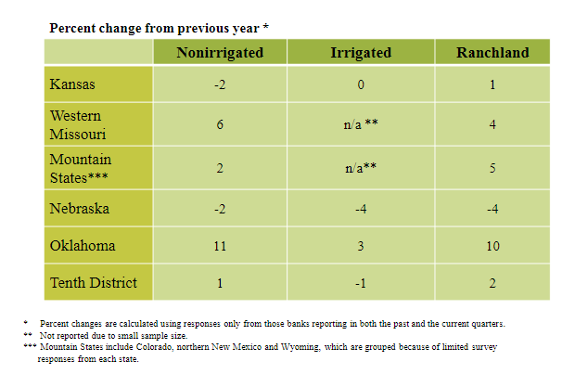
Tenth District Farmland Values by State, 1st Quarter 2019
Source: Kansas City Federal Reserve, May 2019

Slide 12
What’s driving these trends?

Slide 13
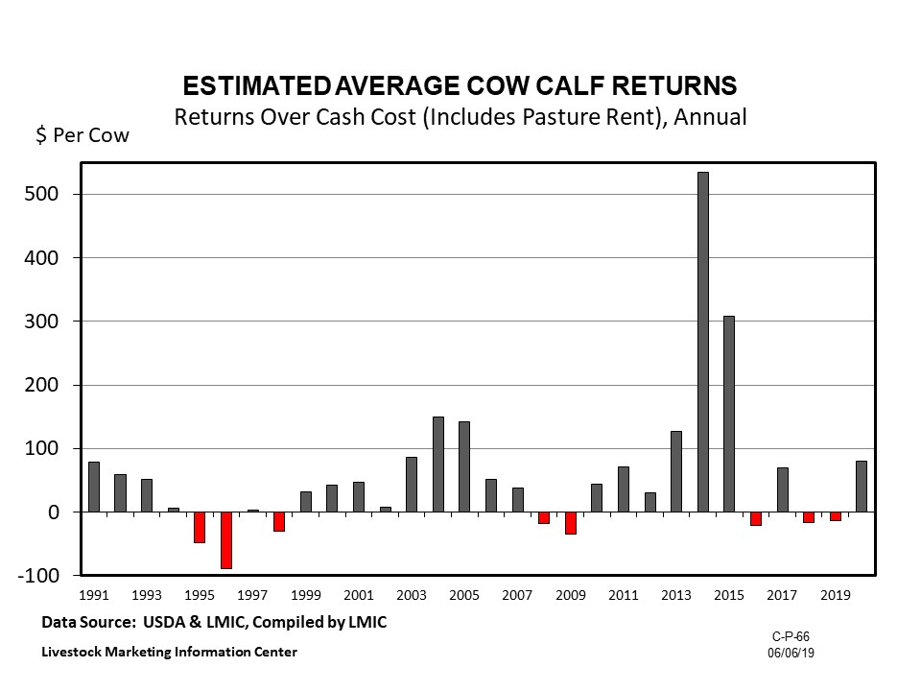

Slide 14
Wheat – Monthly Average Price
Received by Oklahoma farmers during the marketing year
Source: USDA-NASS

Slide 15
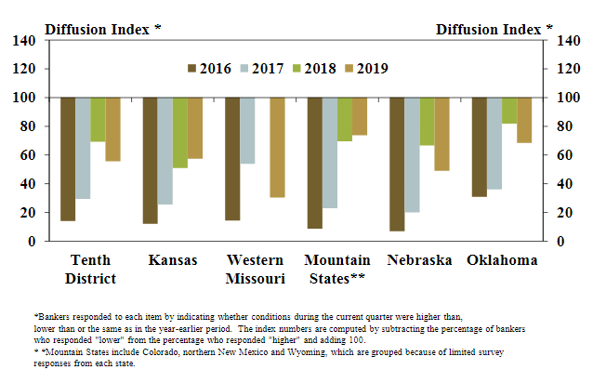
Tenth District Farm Income by State, First Quarter 2019
Source: KC Federal Reserve Bank, May 2019

Slide 16
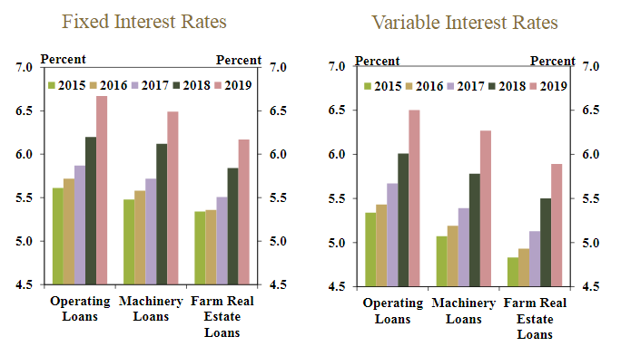
Tenth District Average Farm Loan Interest Rates, First Quarter 2019
Source: KC Federal Reserve Bank, May 2019

Slide 17
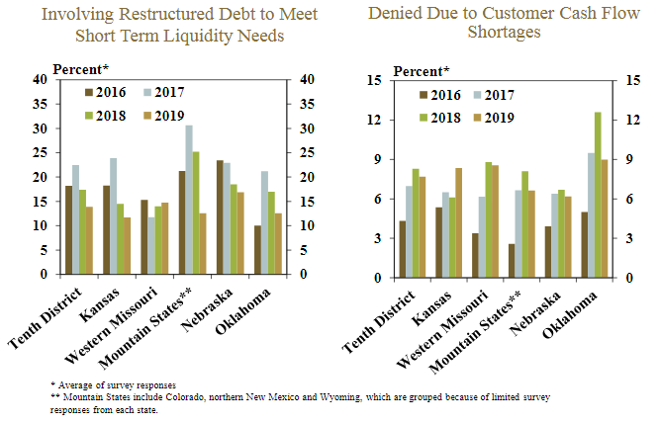
Tenth District Farm Loan Requests, First Quarter 2019
Source: Kansas City Federal Reserve, May 2019

Slide 18
In Summary….
Farmland markets in Oklahoma have remained steady.
◦ Cropland -2%, Pasture +2% All tracts +2% in 2018. Modest growth in the pasture markets and mostly sideways trend in cropland is anticipated through 2019.
◦ Commodity prices and resulting farm income, interest rate levels, and financial health of current buyers will all determine future trends.
◦A turnaround in land values won’t happen until projections for net farm income rebound and credit conditions improve.

Slide 19
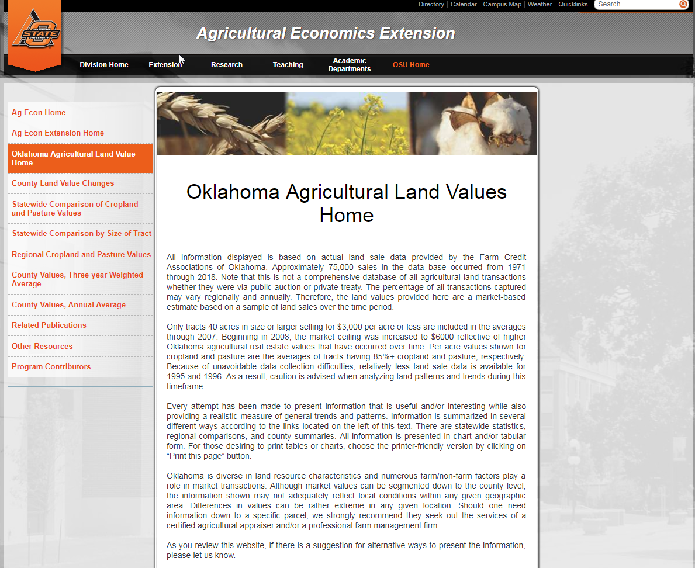
www.agecon.okstate.edu/oklandvalues

Slide 20
Other Resources
Kansas City Federal Reserve Bank
  http://www.kc.frb.org/
  Choose Ag in Economy section, then Current Survey
USDA Ag Land Value Data and Reports
  http://www.nass.usda.gov/
  Choose Economics and Prices Link, then Agricultural Land Values in Reports section

Slide 21
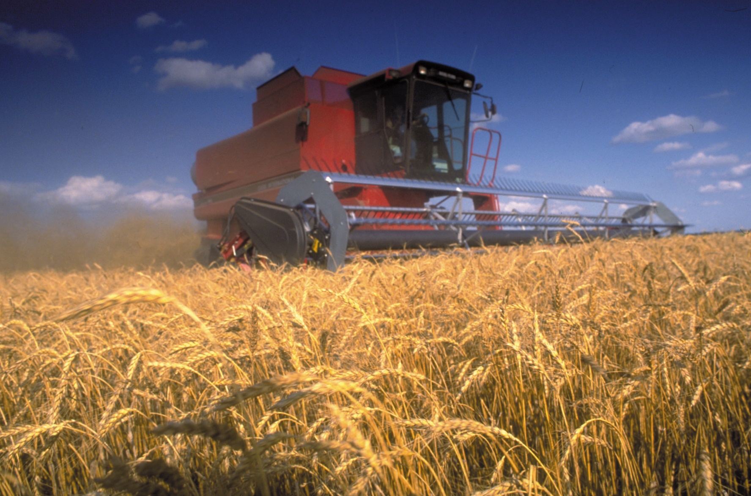
Thanks for stopping by!

