Slide 1
2018 Income Taxes: Federal & Oklahoma
The difference between death and taxes is death doesn’t get worse every time Congress meets. – Will Rogers
J C. Hobbs
Associate Extension Specialist
Agricultural Economics Department
Ag Econ – Current Issues 1/8/2019

Slide 2
Purpose
Discuss federal tax rules that apply to 2018 as well as Oklahoma tax rules that apply to 2018 for individual taxpayers

Slide 3
“Tax Cuts and Jobs Act”
December 22, 2017, President Trump signed H.R. 1, the “Tax Cuts and Jobs Act” into law which now changes the taxation landscape for both individuals and businesses.
Purpose: Reduce taxes but broaden the tax base to increase overall revenues
Topics: Individual changes

Slide 4
Tax Return
Federal
Postcard Form 1040
No longer a Form 1040A
No longer a Form 1040EZ

Slide 5
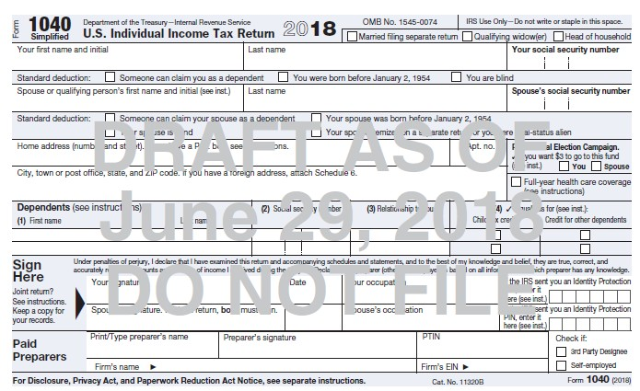
Form 1040 (page 1)

Slide 6
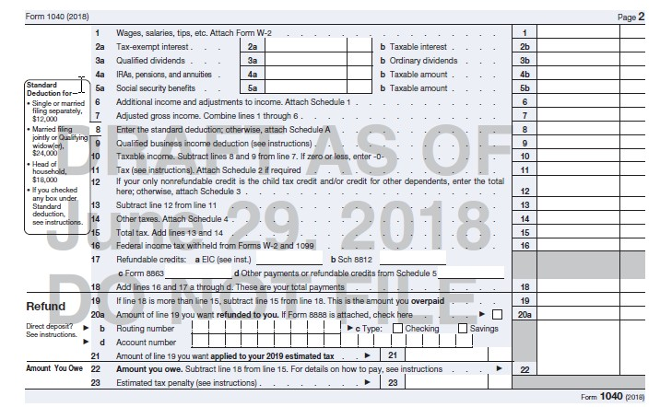
Form 1040 (page 2)

Slide 7
Individual Changes
Tax rates have changed:
  2017: 10%, 15%, 25%, 28%, 33%, 35%, and 39.6%
  2018: 10%, 12%, 22%, 24%, 32%, 35%, and 37%
  Rate changes are effective for tax years beginning after December 31, 2017 and before January 1, 2026
  Legislation is being introduced to make rate changes permanent

Slide 8
Tax Rate Comparison for Single Taxpayers
2018 Old Law 2018 TCJA
Rate Break Point Rate Break Point
10% >$0 10% >$0
15% >$9,325 12% >$9,525
25% >$37,950 22% >$38,700
28% >$91,900 24% >$82,500
33% >$191,650 32% >$157,500
35% >$416,700 35% >$200,000
39.6% >$418,400 37% >$500,000

Slide 9
Tax Rate Comparison for Married Filing Joint
2018 Old Law 2018 TCJA
Rate Break Point Rate Break Point
10% >$0 10% >$0
15% >$19,050 12% >$19,050
25% >$77,400 22% >$77,400
28% >$156,150 24% >$165,000
33% >$237,950 32% >$315,000
35% >$424,950 35% >$400,000
39.6% >$480,050 37% >$600,000

Slide 10
Federal Standard Deduction
Standard Deduction increased for tax years beginning after December 31, 2017 and before January 1, 2026
  Single = $12,000
  Married Filing Joint = $24,000
  Head-of-Household = $18,000
  Married Filing Separate = $12,000
  No change to additional deduction amount for elderly or blind ($1,300 or $1,600 dependent upon filing status)

Slide 11
Oklahoma Standard Deduction
Standard Deduction
Single = $6,350 (fed =$12,000)
Married Filing Joint = $12,700 (fed =$24,000)
Head-of-Household = $9,350 (fed =$18,000)
Married Filing Separate = $6,350 (fed =$12,000)
Oklahoma Tax Rates: 0.5%, 1.0%, 2.0%, 3.0%, 4.0%, and 5.0% (5% rate starts at $7,200 single / married filing separate and $12,200 married filing joint)

Slide 12
Standard Deduction
If federal Adjusted Gross Income is $12,000 or less, then a single individual pays no federal income tax in 2018 (the zero percent bracket)
or
If federal Adjusted Gross Income is $24,000 or less, then a married filing joint couple pays no income tax in 2018 (the zero percent bracket)
Amount is annually inflation indexed

Slide 13
Personal Exemptions
Federal Personal Exemptions -SUSPENDED
  For tax years beginning after December 31, 2017 and before January 1, 2026.
  Reduced the exemption amount to zero.
  NOTE
  2017 was $4,050 per exemption
  2018 was to be $4,150 per exemption, but the TCJA zeroed it
Oklahoma: $1,000 per allowed exemption

Slide 14
Better Off Tax Wise?
Married Couple Filing Joint (no dependents)
Old Law TCJA
Adj Gross Inc 100,000 100,000
Std Deduction 13,000 24,000
Exemption 8,300 0
Taxable Income 78,700 76,000
Tax Due 10,983 8,739

Slide 15
Child Tax Credit
New law increases to $2,000 from $1,000 for each qualifying child under 17 years of age.
    AGI phase outs apply but now $400,000 MFJ
    Refundable amount increased to $1,400 per qualifying child
    SSN required for each child
Non-child dependent was added under the new law for an amount of $500.

Slide 16
Better Off Tax Wise?
Married Couple Filing Joint with 2 children
Old Law TCJA
Adj Gross Inc 100,000 100,000
Std Deduction 13,000 24,000
Exemption 16,600 0
Taxable Income 70,400 76,000
Tax before Credit 9,608 8,739
Child Tax Credit 2,000 4,000
Tax Due 7,608 4,739

Slide 17
Better Off Tax Wise?
You will not know the exact answer to your specific tax situation until you file your 2018 federal income tax return.
For Oklahoma, it appears that the majority of taxpayers will be no worse off than before.
The devil is truly in the details.

Slide 18
Kiddie Tax
Child <19 or full-time student <24 years old
Unearned vs Earned Income
Beginning for tax years after Dec. 31, 2017 earned income is taxed at single individual rates
Taxable income from unearned sources (if >$2,100 from portfolio, capital gains, etc.) are taxed using the estate and trust income tax brackets.
  Estates and Trusts: 10%, 24%, 35% and 37%

Slide 19
Kiddie Tax
If Taxable Income Is: The Tax Is:
> $0 but ≤ $2,550 10% of the taxable income
> $2,550 but ≤ $9,150 $225 + 24% of excess > $2,550
> $9,150 but ≤ $12,500 $1,839 + 35% of excess > $9,150
> $12,500 and over $3,011.50 + 37% of excess > $12,500

Slide 20
Federal Capital Gains
Capital Gains rates are retained:
  0%, 15%, and 20% rates
  The new law maintains the breakpoints of the old law, but uses the chained CPI-U indexing for inflation for tax years after Dec. 31, 2017.
  2018: 15% breakpoint is $77,200 MFJ
  20% breakpoint is $479,000 MFJ
Capital Gain is the gain in excess of what you paid for an asset or investment.

Slide 21
Oklahoma Capital Gains
Capital gain is taxed as ordinary income (maximum rate is 5.0 %)
If Oklahoma property is sold at a gain, it is exempt from tax if it qualifies for capital gain treatment
  Property held 5 years or more
  Stock held 2 years or more

Slide 22
Federal Itemized Deductions
Many itemized deductions were suspended
With Standard Deduction at $24,000 MFJ ($12,000 Single) the tax relief from itemizing is greatly reduced
Typically, itemizing has value when the total of itemized deductions exceeds the taxpayer’s standard deduction amount

Slide 23
Federal Itemized Deductions
Medical expenses still deductible and the deduction applies to the amount in excess of 7.5% of adjusted gross income (was 10%)
No change to qualified charitable contributions (educational organizations, churches, private foundations, hospitals, and other 501c3 charities)
Charitable contribution for athletic tickets is no longer allowed after 2017

Slide 24
Federal Itemized Deductions
Itemized Deduction Changes for tax years beginning after December 31, 2017 and before January 1, 2026:
A Taxpayer may deduct State, Local and foreign property taxes, and State and local income taxes to a cap of $10,000 (MFJ) or $5,000 (MFS)
Home Mortgage Interest and Home Equity Mortgage Interest is allowed subject to indebtedness limitations $750,000 ($375,000 Married Filing Separate) and applies to the primary residence

Slide 25
Federal Itemized Deductions
Suspended Itemized Deductions
Unreimbursed employee expenses (travel, meals, uniform, job search, etc.)
Tax preparation expenses
Investment fees and expenses
Safe deposit box rental
Hobby expenses
Moving expenses (unless a member of the military)

Slide 26
Oklahoma Itemized Deductions
For 2018 and future years
Qualified charitable contributions are not limited
Medical expense are not limited
All others are limited to $17,000
  Mortgage interest
  Gambling losses
  Other deductions from IRS Schedule A

Slide 27
Personal Property Losses
Personal Casualty and Theft Losses
For tax years beginning after December 31, 2017 and before January 1, 2026
  Are suspended, except for personal casualty losses incurred in a Federally-declared disaster area.
NOTE: 2018 Oklahoma Fires includes Custer, Dewey, Harmon, Roger Mills, and Woodward counties

Slide 28
Charitable Contributions
Charitable Contribution Deduction Limitation Increased
Beginning with tax years after December 31, 2017 and before January 1, 2026, the contribution limit is increased to 60% from 50%
  Example: AGI = $100,000, limit is now $60,000, the $40,000 excess contribution can be carried forward five years. (old rule $50,000)

Slide 29
WARNING!!!
Government Accounting Office reports that 21% of taxpayers will under withheld for 2018
Employees may need to adjust the number of withholding allowances and possible additional amounts on:
  Federal - IRS Form W-4
  Oklahoma - Form OW-W-4
.

Slide 30
Avoiding the Penalty
Must withhold at these levels:
Federal
90% of current years tax due
100% of 2017 tax paid or 110% of 2017 tax paid for high income (AGI > $150,000)
Oklahoma
1. 70% of your current year’s tax liability
2. The tax liability shown on the 2017 return

Slide 31
Questions?
Be sure to visit your taxpreparer to avoid a surprise when it is time to file for 2018
Thank you for your attention!!
J C. Hobbs
Email: jc.hobbs@okstate.edu

