Slide 1
Assessing the Rate of Success of Alternative Farm Transition Strategies
Garrett James Reed
Thesis Presentation and Defense
Oklahoma State University

Slide 2
Committee Members
Dr. Shannon Ferrell (Advisor)
Dr. Rodney Jones
Dr. Eric DeVuyst

Slide 3
Also a Special Thanks To…
J.C. Hobbs
Dr. John Michael Riley
Mike Schrammel
Joe Kreger & Luke Werth
Jimmy Harmon & Loryn Schnaithman

Slide 4
Introduction

Slide 5
What is farm transition planning?
The process of transferring farm assets’ ownership and management to the next generation of farm operators
Encompasses:
  Estate planning (wills, trusts, estates, etc.)
  Retirement planning for the preceding generation
  Farm business management

Slide 6
Why is this important?
30% transfer from 1st generation to 2nd generation
    12% transfer from 2nd generation to 3rd generation
        3% transfer from 3rd generation to 4th generation……..
Well documented goals of many farmers (Kirkpatrick 2013)
  Long-term viability of the farm
  Financial security for the founding generation
  Keeping the farm within the family

Slide 7
Why is this important?
Survey of Minnesota Farmers conducted by Hachfeld et al. 2009
    524 workshop attendees, 296 completed surveys
    57.8% did not have an up-to-date estate plan
    88.9% did not have an up-to-date farm transfer plan
Finding time to complete the process
Difficulty developing goals
Lack of family consensus/disagreements
Difficulty finding the professionals
Parents not ready to give up control

Slide 8
Why do farm transitions fail?
Spafford (2006)
Inadequate estate planning
Insufficient capitalization
Failure to prepare the next generation properly

Slide 9
Purpose Statement
Develop a model that will allow researchers and extension educators to simulate alternative farm transition strategies in an effort to increase the success rate of farm asset transfers.

Slide 10
Objectives
Determine the ability of the farm’s cash flow, supplemented by the financial resources of the operating stakeholders, to support a given alternative farm transition strategy over a 20-year planning horizon.
  Commercial loan
  Seller financing
  Sinking fund investment
  Second-to-die whole life insurance policy
  Lifetime farm business transfer

Slide 11
Objectives
  Determine the probability of a successful farm transition using the aforementioned alternative strategies above subject to time, equity, and cash flow constraints.
  Provide educational examples and tools to support farm transition research and educational efforts.

Slide 12
Data and Methods
Notes:
Developed a hypothetical Oklahoma farm and family
Determine the set of alternative strategies
Built the model around the farm
Imposed each strategy on the farm
Simulated the model to determine each strategy’s probability of success

Slide 13
Representative Farm
  Wanted results to be applicable to a broad range of farm owners
  Commercially viable, 1.0 FTE farm
  Mom, Dad, Farm Heir, Off-Farm Heir
  Largely used KFMA data and farm financial ratios

Slide 14
Representative Farm
  Net farm income: $100,000
  Family living expense: $70,000
  Off-farm income: $44,356
  Value of farm production: $660,000
  Total assets: $3,300,000
  Total debt: $660,000
  50% income from cattle, 50% income from crops
  Owns 1,146 acres, leases 2,539 acres
Notes:
100,000/15.15%=660,000 660,000/20%=3,300,000

Slide 15
Representative Farm

Slide 16
Representative Farm Family
  All live (and die) on the averages
  Mom: 58, passes away at 81
  Dad: 58, passes away at 76
  Farm Heir: 32 at start of transition
  Off-Farm Heir: 30 at start of transition
Notes:
Farm Heir only has 21 years to operate after mom dies
When Dad dies, Farm Heir is 50
When Mom dies, Farm Heir is 55

Slide 17
Alternative Strategies
  Strategy 1: “Split Down the Middle”
  Strategy 2: “Grow to Equal”
  Strategy 3: “Estate Balancing”
  Strategy 4: “Sweat Equity Recognition/Discount”
  Strategy 5: “Lifetime Farm Business Transfer”

Slide 18
Strategy 1: “Split Down the Middle”
  Undivided ½ interests are given to both heirs
  Most common when:
    No plan is in place
    “We’ll let you kids sort it out!”
  Assume Off-Farm Heir demands a buyout
  Two options:
    Commercial Loan
    Seller Financing
Notes:
Intestate Succession Laws

Slide 19
Strategy 1a: Commercial Loan
  Cattle
    5 years at 5.75%
    Annual payment $38,554
  Equipment
    5 years at 5.75%
    Annual payment $47,157
  Real Estate
    20 years at 6.5%
    Annual payment $86,807
Notes:
20% down payment $330,000
Cattle: 40,878
Equipment: 50,000
Real Estate: 239,122
Uses operating credit if don’t have funds
In reality, 172,518 first 5 years, then 86,807 remaining

Slide 20
Strategy 1b: Seller Financing
  Financing with Off-Farm Heir
  All three notes combined into one
    20 years at 3.05% (Applicable Federal Rate)
    Annual payment $89,135
Notes:
Lowest interest rate can loan money to family member without it being a gift
330,000 Down payment

Slide 21
Strategy 2: “Grow to Equal”
  Farm Heir inherits all of the farm assets
  Mom and Dad create a financial asset to equal the value of the farm asset base
  Two options:
    Sinking investment fund
    Second-to-die whole life insurance policy

Slide 22
Strategy 2a: Sinking Investment Fund
  Total asset value: $3,300,000
  After-tax, real rate of return: 4.55%
  Pay period: 20 years
  Annual payment: $104,642

Slide 23
Strategy 2b: Life Insurance
  Total asset value: $3,300,000
  Proxy rate of return: 9%
  Pay period: 20 years
  Annual premium: $64,503

Slide 24
Strategy 3: “Estate Balancing”
  Farm operating assets and farm land are placed in separate entities, respectively
  Farm Heir inherits the operating entity
  Farm Heir and Off-Farm Heir receives equal interests in land entity
  Operating entity pays FMV rents to land entity
    Entity distributes income to Farm Heir and Off-Farm Heir

Slide 25
Strategy 3: “Estate Balancing”
  Mom and Dad create a financial asset to equal the value of the operating entity
  Off-Farm Heir inherits the financial asset
  Two options:
    Sinking investment fund
    Second-to-die whole life insurance policy

Slide 26
Strategy 3a: Sinking Investment Fund
  Operating entity value: $908,784
  After-tax, real rate of return: 4.55%
  Pay period: 20 years
  Annual payment: $28,817

Slide 27
Strategy 3b: Life Insurance
  Operating entity value: $908,784
  Proxy rate of return: 9%
  Pay period: 20 years
  Annual premium: $17,764
Notes:
Tax drag associated with investment versus life insurance

Slide 28
Strategy 4: “Sweat Equity Recognition/Discount”
  Similar to Strategy 3
  Farm operating assets and farm land are placed in separate entities, respectively
  Farm Heir inherits the operating entity
  Farm Heir and Off-Farm Heir receives equal interests in land entity
  Operating entity pays FMV rents to land entity
    Entity distributed income to Farm Heir and Off-Farm Heir

Slide 29
Strategy 4: “Sweat Equity Recognition/Discount”
  Mom and Dad create a financial asset to equal ½ the value of the operating entity
  Off-Farm Heir inherits the financial asset
  Recognize Farm Heir’s contribution to grow farm assets
  Two options:
    Sinking investment fund
    Second-to-die whole life insurance policy

Slide 30
Strategy 4a: Sinking Investment Fund
  ½ Operating entity value: $454,392
  After-tax, real rate of return: 4.55%
  Pay period: 20 years
  Annual payment: $14,409

Slide 31
Strategy 4b: Life Insurance
  ½ Operating entity value: $545,139
  Proxy rate of return: 9%
  Pay period: 20 years
  Annual premium: $8,882
Notes:
Tax drag associated with investment versus life insurance

Slide 32
Strategy 5: “Lifetime Farm Business Transfer”
  Farm operating assets and farm land are placed in separate entities, respectively
  Farm Heir receives annual salary of $42,000
  Farm Heir purchases shares of the operating entity each year
  Farm Heir receives a larger portion of farm income as well as farm debt with each additional share
  In years when Farm Heir has insufficient funds to purchase a full share, Mom and Dad gift the difference

Slide 33
Strategy 5: “Lifetime Farm Business Transfer”
  At the end of the transfer, Farm Heir and Off-Farm Heir receive equal interests in land entity
  Operating entity pays FMV rents to land entity
  Entity distributes income to Farm Heir and Off-Farm Heir
  Any excess funds would then be split between Farm Heir and Off-Farm Heir
    Net any gifts Farm Heir received to help fund this transition

Slide 34
Strategy 5: “Lifetime Farm Business Transfer”
  Operating entity value: $908,784
  Planning horizon: 20 years
  Annual purchase: 5%
  Annual entity payment from Farm Heir: $45,439
  Annual gift to Farm Heir: Variable ($45,439-Entity payment)

Slide 35

Conceptual Framework
$$Maximize Probability\left({Net Cash Flow}_{i}({Strategy}_{i})>0\right)$$
${Strategy}_{i}\{1,…,5\}$

Slide 36
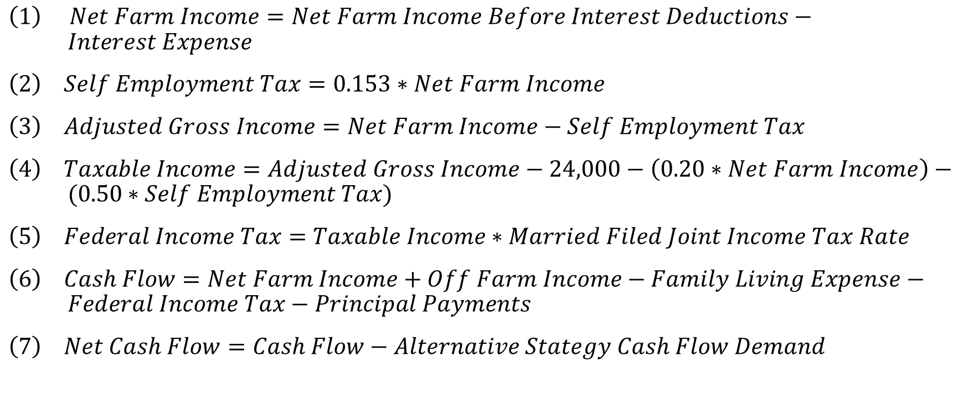
Equations
$\left(1\right) Net Farm Income=Net Farm Income Before Interest Deductions− Interest Expense$
$\left(2\right) Self Employment Tax=0.153∗Net Farm Income$
$\left(3\right) Adjusted Gross Income=Net Farm Income−Self Employment Tax$
$\left(4\right) Taxable Income=Adjusted Gross Income−24,000−\left(0.20∗Net Farm Income\right)− (0.50∗Self Employment Tax)$
$\left(5\right) Federal Income Tax=Taxable Income∗Married Filed Joint Income Tax Rate$
$\left(6\right) Cash Flow=Net Farm Income+Off Farm Income−Family Living Expense− Federal Income Tax−Principal Payments$
$\left(7\right) Net Cash Flow=Cash Flow−Alternative Stategy Cash Flow Demand$

Slide 37
Criteria
  If the debt to asset ratio ever reaches 0.60
  If the farm incurs three consecutive years of unpaid operating debt
  If the farm ever incurs any operating debt
  Only for scenario 5, if the cash reserves of Mom and Dad is ever less than 0

Slide 38
KFMA Income Data
  2005-2017 from KFMA Southeast Association
  Adjusted to real dollars using a CPI Index
  Coefficient of variation (relative variability): 0.4112
  Mean $100,000
  Standard Deviation: $41,118
Notes:
Standard deviation / mean = coefficient of variation

Slide 39
Monte Carlo Simulation
  Given the farm’s mean income and standard deviation, a Monte Carlo simulation is used
  Determines a normally distributed, random draw in farm income
  Applies variability and risk to farm income
  One 20-year planning horizon is 1 iteration
Notes:
Standard deviation / mean = coefficient of variation

Slide 40
Monte Carlo Simulation
  Each strategy is imposed on model farm
  Simulated 500 times
  Each failure within one 20-year iteration is reported by a 1, subject to the criteria
  Adding up the number of fails reported by a 1 and dividing by the total number of iterations provides the probability of failure
  Subtracting this number from 1 gives the probability of success
Notes:
Standard deviation / mean = coefficient of variation

Slide 41
Results

Slide 42
Results

Slide 43
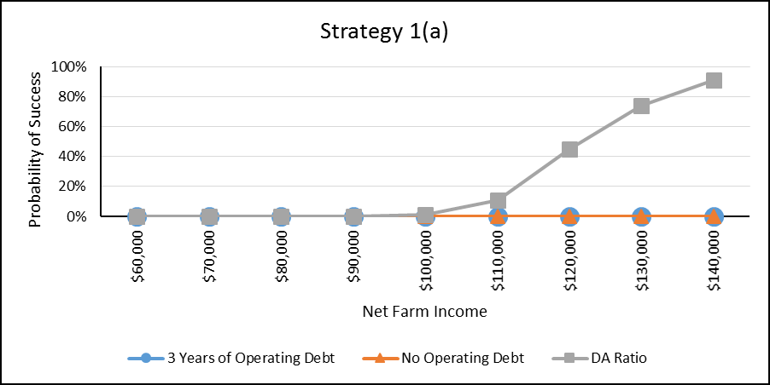
Strategy 1a: Commercial Loan
  Criteria
    1. 1% success
    2. 0% success
    3. 0% success

Slide 44
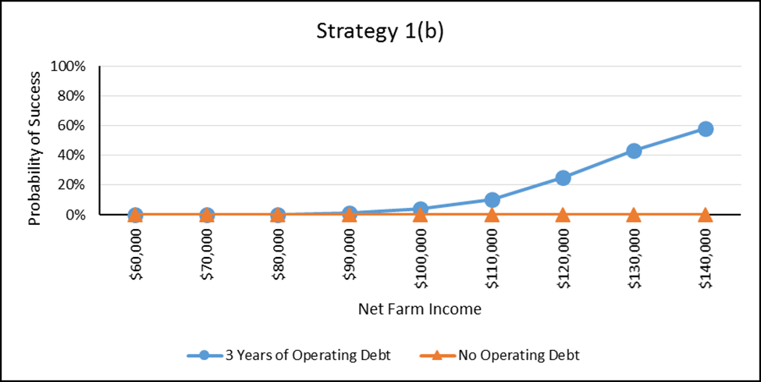
Strategy 1b: Seller Financing
  Criteria
    1. 100% success
    2. 4% success
    3. 0% success

Slide 45
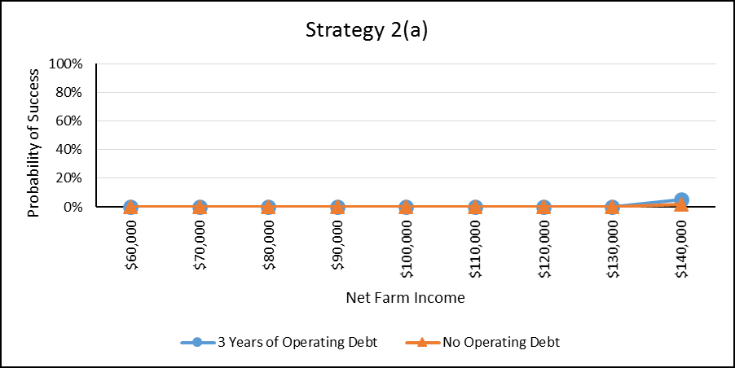
Strategy 2a: Sinking Investment Fund
  Criteria
    1. 100% success
    2. 0% success
    3. 0% success

Slide 46
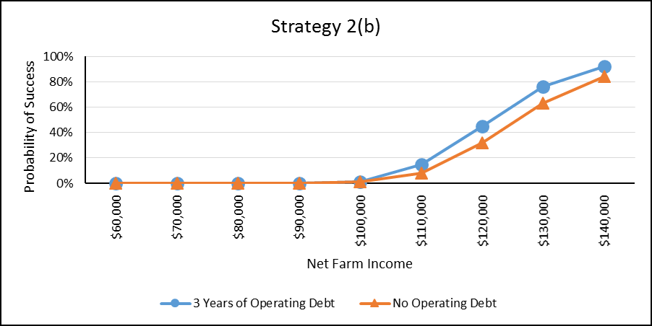
Strategy 2b: Life Insurance
  Criteria
    1. 100% success
    2. 1% success
    3. 1% success

Slide 47
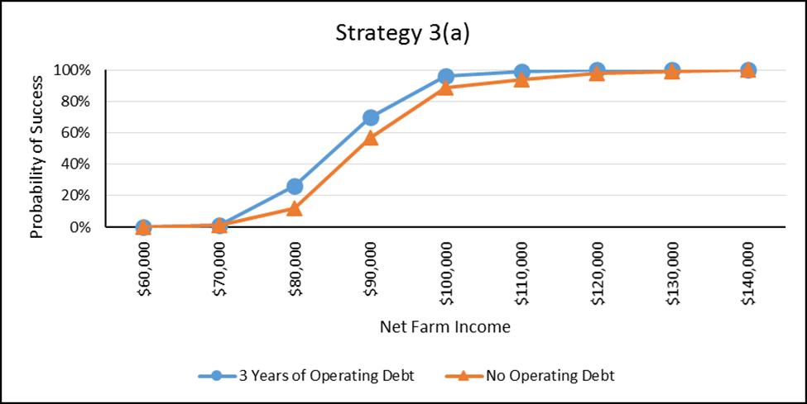
Strategy 3a: Sinking Investment Fund
  Criteria
    1. 100% success
    2. 96% success
    3. 89% success
  Met at $140,000

Slide 48
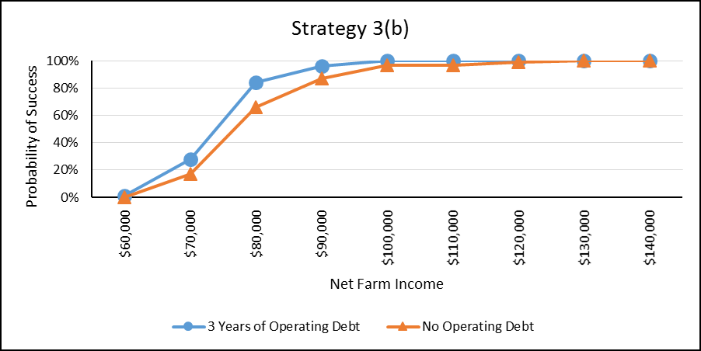
Strategy 3b: Life Insurance
  Criteria
    1. 100% success
    2. 100% success
    3. 97% success
  Met at $130,000

Slide 49
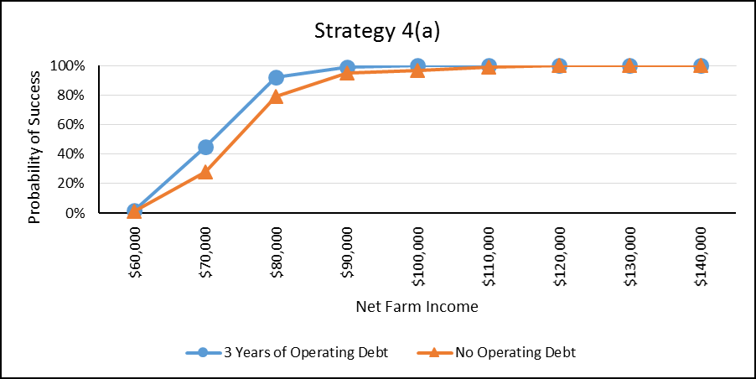
Strategy 4a: Sinking Investment Fund
  Criteria
    1. 100% success
    2. 100% success
    3. 97% success
  Met at $120,000

Slide 50
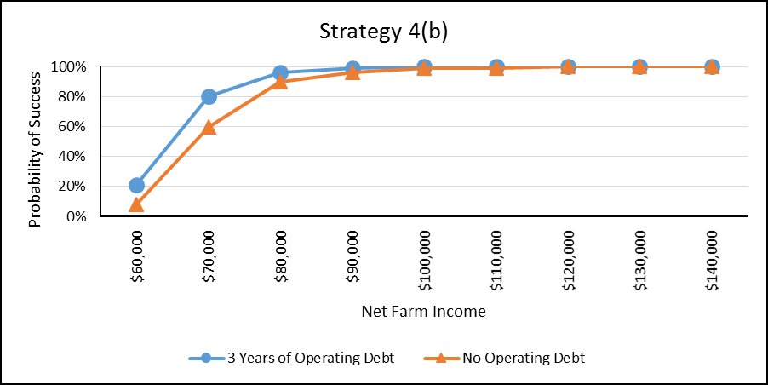
Strategy 4b: Life Insurance
  Criteria
    1. 100% success
    2. 100% success
    3. 99% success
  Met at $120,000

Slide 51
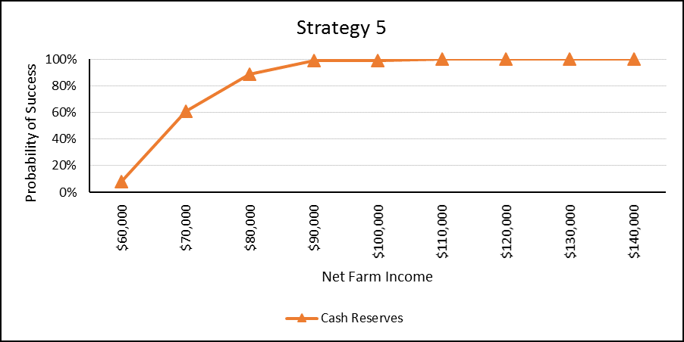
Strategy 5: Lifetime Farm Business Transfer
  Criteria
    1. 100% success
    4. 99% success
  Met at $110,000

Slide 52
Conclusions

Slide 53
Strategy 1: “Split Down the Middle”
  Not an advisable solution, no matter the variation
  Simulated this for two reasons:
    Modal strategy employed by farm families/treating heirs equally
    How NOT to transfer the farm
  When annual debt payments are more than annual income, it is destined for failure
  Such a large portion of the farm’s asset bases consists of land
  Extremely illiquid, generates low returns
Notes:
Legally, this is the default.
And some with an estate plan may actually have this written in to the plan.
Statistics may be even higher.
By not choosing, you have chosen.

Slide 54
Strategy 2: “Grow to Equal”
  Proves to be as challenging as Strategy 1
  Neither variation are advisable solutions
  Aggressive investment option and tremendous financial burden
  Due to trying to double the asset base
  Creating a financial asset that incorporates the land value is a challenge
  Perhaps invest more in growing the farm and making it more profitable?

Slide 55
Strategy 3: “Estate Balancing”
  Taking an approach that does not require a “repurchase” of land allows for a lower, more attainable cost
  Does not take into account Farm Heir’s contributions to grow the asset base over the years..
  However, it does have a higher probability of success
  For parents who equate “equal” being the same as “equitable,” this may be their preferred strategy if it aligns with their family and business goals

Slide 56
Strategy 4: “Sweat Equity Recognition/Discount”
  Recognition of Farm Heir’s contribution to the farm
  Distinction between “equal” versus “equitable” is explicitly made by the amounts of inheritance both heirs receive
  Off-Farm Heir’s inheritance may be discounted, but they receive a portion of rental payments
  Illustrates the cost reductions realized by not requiring a “repurchase” of a portion of the land assets from Off-Farm Heir
  Lowers the effective cost of paying to access the farm land

Slide 57
Strategy 5: “Lifetime Farm Business Transfer”
  Mom and Dad are slowly removing themselves from the operation
  Maintain a comfortable life and stream of income during retirement
  Gradual shift of management, institutional knowledge, and decision making while all parties are alive
  Off-Farm Heir receives a stream of payments from land entity and a portion of cash reserves
  Farm Heir has earned rights to the operating entity
Notes:
11.2 million unified credit/person 22.4 million couple
15K per person per year
(anything above the 15K is part of the 11.2)
278,212 Gift to Farm Heir
480,446 Cash Reserves
Each should receive 379,212
Farm Heir gets 101,117
Off-Farm Heir gets 379,319

Slide 58
Implications
  Time is on your side (if started early)
  Extended planning horizons allow for lower cost strategies
  Family needs agreed upon goals to work towards
  While the representative farm does not look like every farm in Oklahoma, it will hopefully be applicable to a broad range of farmers
  Developed for educational and extension purposes with the hope of seeing see a higher percentage of farm owners:
    Recognize the need to develop a comprehensive transition plan
    Take action by implementing the plan

Slide 59
Limitations
  If term lengths, interest rates, rates of return, health characteristics, age, or years of planning horizon change, so do the results
  If the farm used to build the model around changes, so do the results
  Some farms are more profitable, some are not
  Other sources of off-farm income may be available
  Time of death is not known

Slide 60
Limitations Provide Opportunities
  Vary number of heirs
  Make time of death random
  Include risk in rates of returns
  Create more user-defined inputs
  More than one Farm Heir?
  No heirs?
  Other strategies?

Slide 61
Questions?

