Slide 1
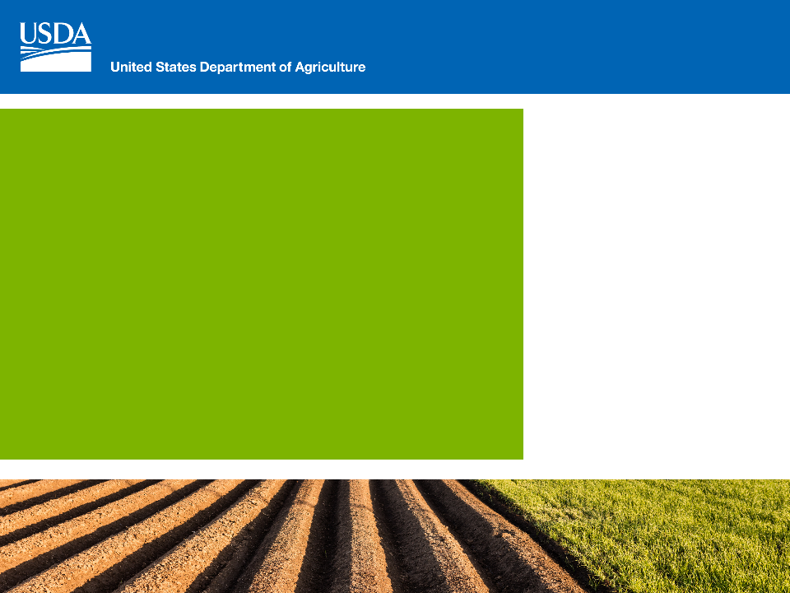
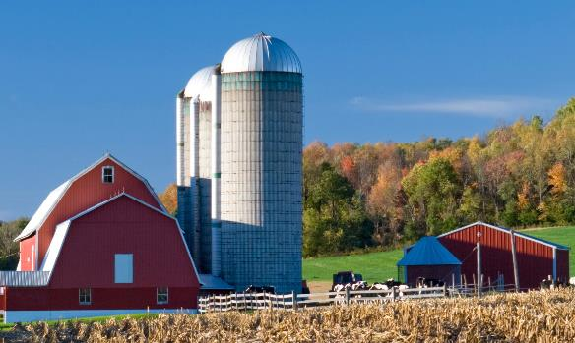
Farm Service Agency
Serving America’s
Agricultural Community
for More Than 80 Years
Presenter: Janlyn Hannah
Notes:
Good afternoon. My name is Janlyn Hannah and I am the Public Relations and Outreach Coordinator for Oklahoma. I would like to thank Oklahoma State University Extension for the opportunity to share information about disaster assistance available through Farm Service Agency.
As we proceed through our presentation, please keep in mind many of these programs were implemented through the 2014 Farm Bill, which expired on September 30, 2018. These programs may be extended or replaced by a future Farm Bill.

Slide 2
FSA PROGRAM PORTFOLIO
FARM LOANS
DIRECT EMERGENCY LOANS
FARM PROGRAMS
SAFETY NET PROGRAMS
CONSERVATION PROGRAMS
LIVESTOCK PROGRAMS
MARKET FACILITATION PROGRAM
Insert State Graphic/Image
Insert State-specific information/bullets that you want to share with your audience
Insert State Statistics/Facts
Notes:
FSA has two primary program portfolios which provide a comprehensive safety net for America’s farmers and ranchers:
Farm Programs
Farm Loan Programs
FSA’s Safety Net and Conservation programs sustain farm operations and preserve land for future generations.
FSA’s has a diverse loan portfolio to meet the needs of today’s agricultural community… from beginning farmers and ranchers who need access to capital to purchase land to start up and equip their operations, to established producers who want to expand their operations or take them in a different direction. We will focus on Emergency Loans today.

Slide 3
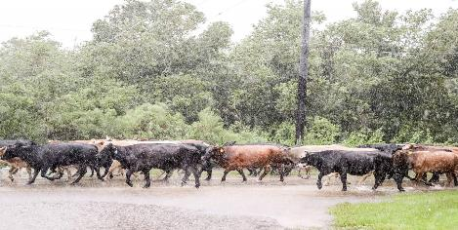
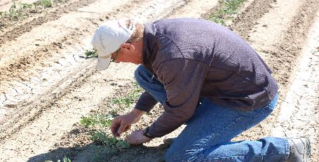
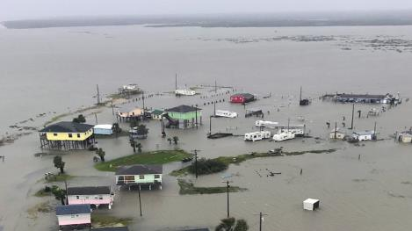
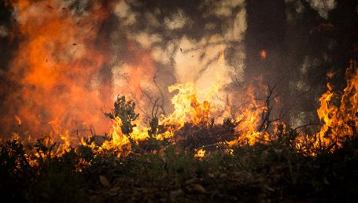
SAFETY NET PROGRAMS
ARC/PLC WHIP NAP LIP ELAP TAP MPP-Dairy
Notes:
Safety Net programs help producers withstand economic losses due to natural disaster, which may affect production and prices.
2017 was a challenging year weather-wise for many producers
FSA provided disaster assistance to help farmers recover from hurricanes, wildfires, droughts, tornadoes and floods, specifically in 2017.
Now we will break down the different disaster assistance programs.

Slide 4
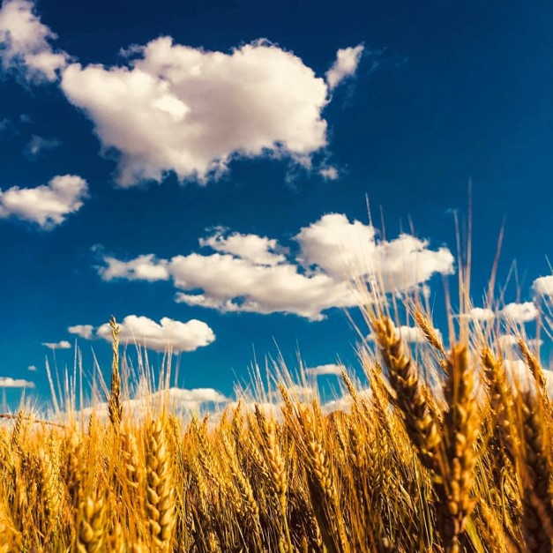
Market Facilitation Program (MFP)
Provides direct payments to producers who have been negatively impacted by foreign governments imposing tariffs on U.S. agricultural products
Provides direct payments producers who have been negatively impacted by foreign governments imposing tariffs on U.S. agricultural products
Notes:
In 2018, FSA is administering the Market Facilitation Program (MFP) to provide payments to producers who have been negatively impacted by foreign governments imposing tariffs on U.S. agricultural products, and disrupting the marketing of agricultural commodities beyond the control of producers.
For a person or legal entity, payments are limited to $125,000 in MFP payments issued for corn, cotton, sorghum, soybeans, and wheat; Another $125,000 for dairy and hog; and additionally $125,000 for shelled almonds and sweet cherries. Eligible persons or legal entities must also have an average adjusted gross income for tax years 2014, 2015, and 2016 of less than $900,000. Applicants must also comply with the provisions of the Highly Erodible Land and Wetland Conservation regulations.
The MFP payments are based on actual production so any failed or grazed out acreage is ineligible.
Producers have until January 15, 2019 to apply for the program.

Slide 5
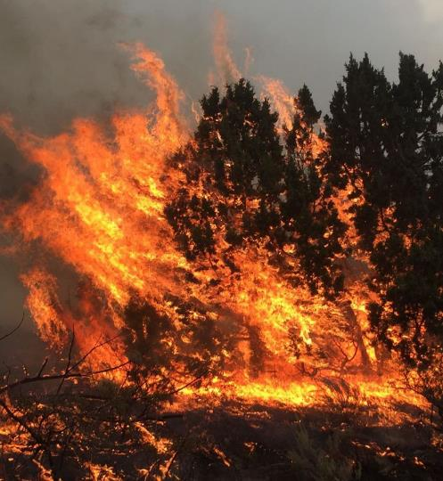
Emergency Conservation Program
(ECP)
ECP is subject to availability of funding, delivered by the county offices and authorized by the FSA national office. ECP is established to:
  Rehabilitate farmlands and conservation facilities damaged by wind and water erosion, floods, tornadoes
  Provide cost-share assistance to eligible agricultural producers during periods of severe drought to supply emergency water for eligible livestock and supply emergency water for existing irrigation systems serving orchards and vineyards
  Oklahoma: $8.7 million
Notes:
The Emergency Conservation Program (ECP) has been applied in the panhandle in the past few years for restoration purposes after wildfires. Southern Oklahoma has also tapped the ECP program for extreme flooding.
ECP cost-shares the replacement of boundary fencing, debris removal and grading and shaping to name a few.
The goal of ECP is to restore the land and farm to “pre-disaster” conditions.
Cost-share payments range from 50% to 70% of cost. The county committee determines if receipts show appropriate expenditures prior to reimbursement. Maintaining records and receipts is absolutely vital for participation in ECP.

Slide 6
SAFETY NET PROGRAMS
Agriculture Risk Coverage (ARC) & Price Loss Coverage (PLC)
Noninsured Crop Disaster Assistance Program (NAP)
NAP provides financial assistance to producers of non-insurable crops when low yields, loss of inventory, or prevented planting occur due to natural disasters;
In 2017, the last year full payment data is available, NAP made 15, 136 payments for over $162 million.
2017 Wildfires and Hurricanes Indemnity Program (2017-WHIP)
2017-WHIP provides disaster payments to agricultural producers to offset losses from hurricanes and wildfires during 2017. It is a short-term program designed to respond to 2017 or 2018 losses.
Congress has provided almost $2 billion for this program and another $340 million has been allocated to help the Florida citrus industry recover.
ARC/PLC programs provide payments to farmers when the actual revenue for a covered commodity falls below the expected revenue;
For the 2016 crop year, the last year that payment data was available, the ARC and PLC programs provided 2.3 million payments to producers totaling just over $7 billion.
Notes:
Agriculture Risk Coverage and Price Loss Coverage Program (ARC/PLC) allowed producers the opportunity to elect safety-net protection on either price or a price-production loss combination. Each farm can elect a program for each farm individually and coverage is based on a countywide average or a producer can chose to use his or her own production history. Signup for that program has closed for all commodities other than cotton seed base which has a signup deadline of December 7th.
The WHIP program was implemented by the Bipartisan Budget Act and allowed a one-time payment to producers affected by 2017 wildfires and hurricanes. Grazed crops were not applicable, so the program was a non-event in Oklahoma but very impactful in coastal states impacted by hurricanes and wildfires in California.
The NAP program offers low cost insurance to producers on grazed crops and other crops not covered by Federal Crop Insurance. This begins at 55/50 coverage with buy-up options on certain crops. The cost is $250 per crop. This program has been very active in the past several years with severe drought conditions across the state.

Slide 7
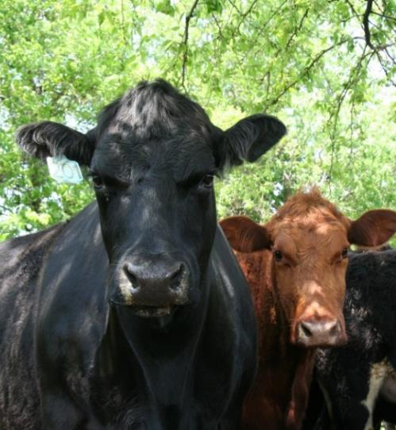
Livestock Forage Disaster Program
The 2014 Farm Bill made the Livestock Forage Disaster Program (LFP) a permanent program and provides retroactive authority to cover eligible losses. LFP provides compensation to eligible livestock producers who have suffered grazing losses due to drought (also fire on Federal lands only).
Oklahoma paid ranchers over $4 million in 2017
Notes:
Another popular disaster program is the Livestock Forage Program. This program began in 2011 and is part of permanent legislation. The program offers a payment based on drought intensity as determined by the U.S. Drought Monitor. Eligibility is on a county-by-county basis. The goal of the program is to supplement feed costs lost to drought conditions.
Signup for the 2018 crop year ends 30 days after the end of the calendar year which is January 30, 2019.
Eligible livestock include, beef and dairy cattle, bison, buffalo, sheep, goats, just to name a few.

Slide 8
SAFETY NET PROGRAMS (continued)
Livestock Indemnity Program (LIP)
LIP pays livestock producers for livestock deaths in excess of normal mortality or injury to livestock caused by an eligible adverse weather event or attacks by animals reintroduced into the wild by the Federal Government.
Emergency Assistance for Livestock, Honey Bees, and Farm-raised Fish (ELAP)
ELAP pays producers for losses due to disease, certain adverse weather events or conditions, including blizzards and wildfires, as determined by the Secretary.
Tree Assistance Program (TAP)
TAP provides financial assistance to eligible orchardists and nursery tree growers to replace or rehabilitate eligible trees, bushes and vines lost to natural disasters, including hurricanes and wildfires;
Margin Protection Program (MPP-Dairy)
MPP-Dairy is a voluntary risk management program for dairy producers. It offers protection when the difference between the all milk price and the average feed cost (the margin) falls below a certain dollar amount selected by the producer.
Notes:
The Livestock Indemnity Program pays on livestock deaths due to natural disaster. In 2017 wildfires, the program was updated to pay producers for damaged livestock. Those burned animals sold for less than market value and a supplemental payment was possible through the LIP program. A vital element for LIP is keep a beginning and ending inventory as well as documentation of losses. Signup for 2018 ends January 30, 2019.
The Emergency Assistance Program (ELAP) and Tree Assistance Program (TAP) each pay on losses as well. Unlike LIP- losses will be on honey bees, farm-raised fish, trees, vines and bushes. In Oklahoma, catfish farms, pecans and grapes are most covered for these programs.
The Margin Protection Program (MPP) assists dairymen with price protection. When the difference between the all milk price (including fluid milk) and the average feed cost falls below the margin, a payment is generated. Producers are required to submit production records so the payments can be made by production hundred weight (CWT).

Slide 9
FARM LOAN PROGRAMS
Emergency Loans
Help farmers and ranchers recover from production and physical losses due to drought, flooding, other natural disasters or quarantine.
Borrowers may use Farm Ownership and Operating Loans instead of Emergency Loans due to reduced paperwork and lower interest rates.
Notes:
Finally, Emergency Loans are available through FSA. Once again, these have been unfortunately popular in recent years. Floods and wildfires have devastated farms and ranches in Oklahoma. FSA offers low interest loans to producers impacted by natural disaster. The program is triggered by a Secretarial or Presidential disaster declaration.
Currently, the Emergency Loan rate is 3.75%.
Producers can determine their eligibility by contacting their local FSA office.

Slide 10

Notes:
This year, USDA unveiled Farmers.gov, an interactive one-stop website designed by farmers, for farmers, to make it easier for producers to get the help they need and do business with USDA.
How Does It Work:
Farmers.gov is mobile device-friendly. Features include:
Local office locator;
An interactive calendar with an online appointment feature;
Farming success stories;
Digital forms;
A business data dashboard;
A Disaster Assistance Discovery Tool:
Customers can easily locate resources to help them bounce back when a natural disaster occurs.
Users are connected to the appropriate recovery program for information regarding crop insurance, assistance eligibility, and on-the-ground rehabilitation; and

Slide 11
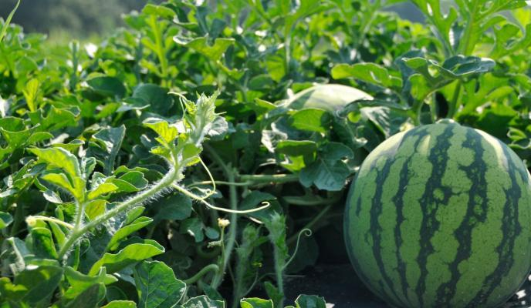
Questions?
Janlyn Hannah
Public Relations / State Outreach Coordinator
Oklahoma Farm Service Agency
100 USDA, Suite 102
Stillwater, OK 74074
Phone: (405) 742-1041
Fax: (855) 416-9557
Notes:
Thank you very much for allowing me to speak with you today.
My contact information is above. Please feel free to reach out to me if I can assist you further.

