Slide 1
Understanding Contracts
Or: 9 credit hours of law school in 30 minutes
Dr. Shannon L. Ferrell
Associate Professor
Department of Agricultural Economics

Slide 2
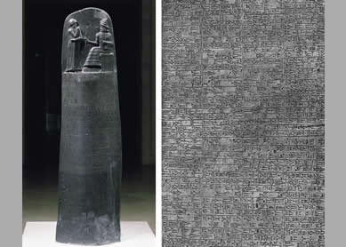
Lawyer cliché time
READ EVERYTHING
GET EVERYTHING IN WRITING

Slide 3
What is a “contract?”
An agreement between two or more parties consisting of a promise or set of promises which the law will enforce.
Just remember, not all “agreements” are “contracts,”
but a “contract” must first be an “agreement.”

Slide 4
…and why are they so important?
They enable private parties to create legal obligations among themselves.
Having a legal obligation then gives you a right to engage the legal system to enforce the obligation.

Slide 5
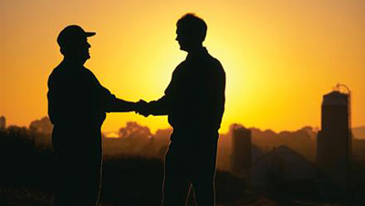
Is a handshake a contract?

Slide 6
The five elements of a contract
Legally competent parties
(Is it fair to hold the parties to it?)
Proper subject matter
(Is this something the law should enforce?)
Offer
Acceptance
Consideration
Was an agreement between two willing parties reached?

Slide 7
Now, food for thought…
Two drunk farmers are in a bar talkin’ smack to each other.
Drunk Farmer A, thinking to himself that Drunk Farmer B is too broke to do anything about it, writes “We hereby agree to sell to Farmer B the Ferguson Place complete for $50,000, title satisfactory to buyer.”
Farmer B then tells Farmer A to get his wife to sign it, and she does.
Farmer B then picks up the napkin, offers Farmer A $5 to seal the deal, and leaves the bar.
Did Farmer B leave the bar with a binding contract to buy the Ferguson Place?

Slide 9
Back to that handshake thing
The following types of contracts must be in writing and signed by the party against which enforcement is sought in order to be enforceable:
  Agreements that cannot be performed within one year of the making of the contract.
  A promise to answer for the debt, default, or miscarriage of another.
  “An agreement made upon consideration of marriage.”
  A contract for the sale of goods $500.
  Agreements involving an interest in land.

Slide 10
The Statute of Frauds:
Agreements involving an interest in land.
Covers a broad range of interests, including:
  The sale of real estate
  Leases (more than 1 year)
  Easements
  Restrictions on the property
  “Profits” from the land
WHAT MATTERS IS THE TYPE OF INTEREST IN THE LAND, NOT THE AMOUNT OF PROPERTY INVOLVED!!!
EXAM QUESTION

Slide 11
What goes into a contract?
A lot of:
  thought
  what iffing
  discussion
  clarity and specificity

Slide 12
What goes into a contract?
Full legal identifiers for the parties
Definitions of all critical terms
Description of what is at issue
  The property being exchanged
  The services being provided
  What’s NOT being done

Slide 13
What goes into a contract?
What each party is
  Required to do
  Allowed to do
  Prohibited from doing
Defining when the parties’ obligations start and end
Defining payment
  If?
  When, where, how
  Calculation

Slide 14
What goes into a contract?
Notices
  Emergency contacts
  Legal, written notices
What constitutes a “material breach?”
Right to cure
Dispute resolution
  Negotiation
  Mediation
  Arbitration
  …required prior to litigation?

Slide 15
Sources of the Law Governing Contracts
Uniform Commercial Code (UCC) - a set of “uniform laws” adopted by virtually all the states to harmonize the law applying to the most common types of transactions. This is why the UCC is important.

Slide 16
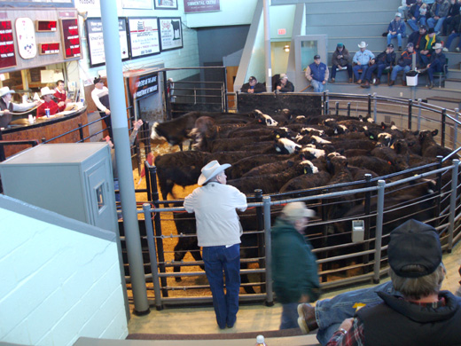
The Uniform Commercial Code
Article 2
Deals with sale of “goods.”
"Goods" means all things (including specially manufactured goods) which
are movable at the time of
identification to the contract for sale
"Goods" also includes the unborn young of animals and growing crops

Slide 17
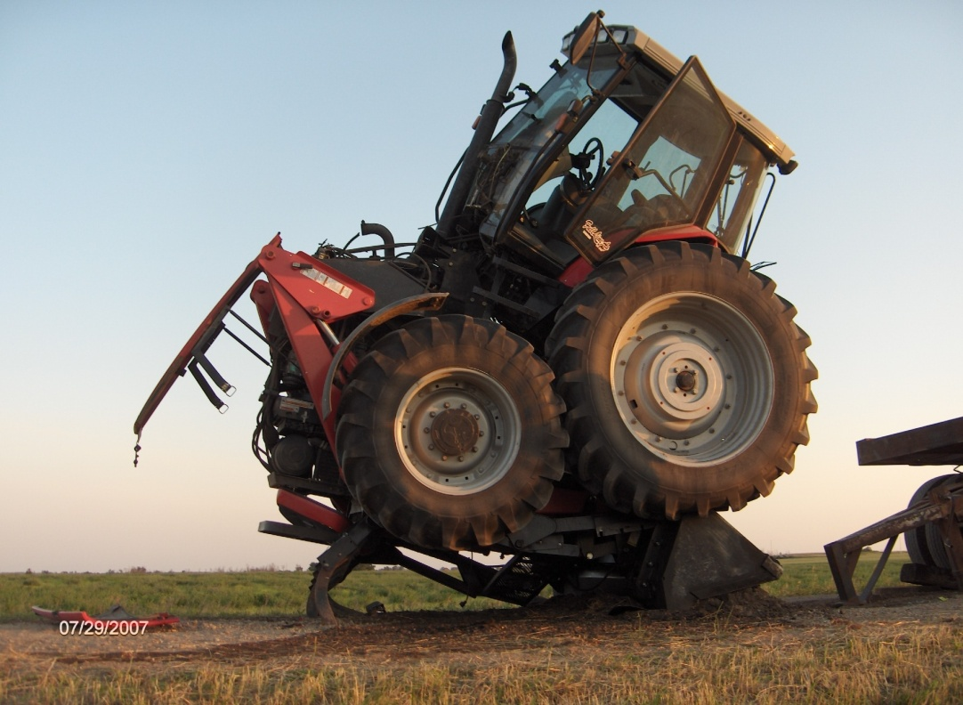
The implied warranty of merchantability
UCC Article 2

Slide 18
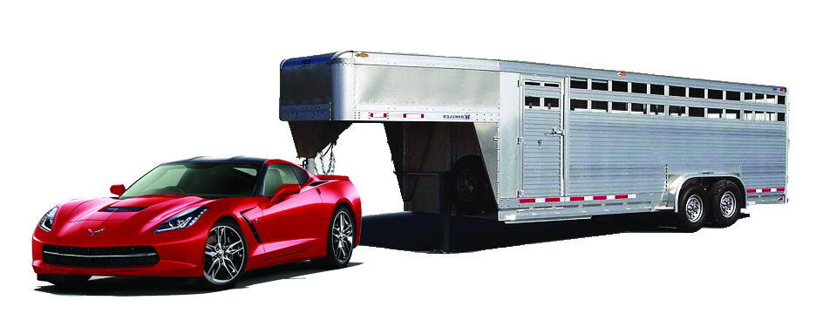
The implied warranty of fitness for a particular purpose
UCC Article 2

Slide 19
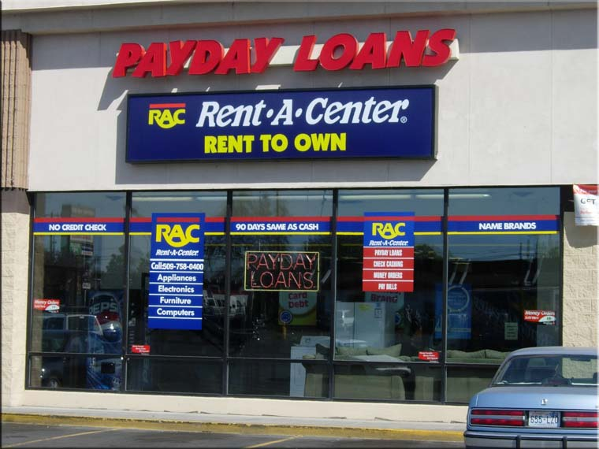
The Uniform Commercial Code
Article 2A
Deals with leases.
Lease: “a transfer of the right to possession and use of goods for a term.”

Slide 20
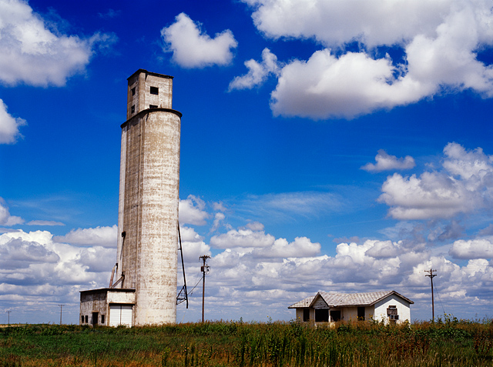
The Uniform Commercial Code
Article 7
Deals with “warehouse receipts,” “bills of lading,” and “other documents of title.”
In other words – the rules governing transactions where you place your goods in the care of
someone else.
  Grain elevators
  Feedlots
  Truckers

Slide 21
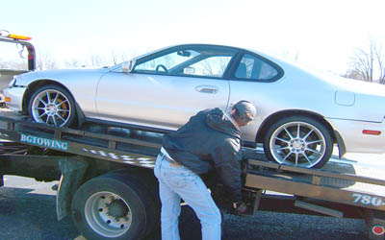
The Uniform Commercial Code
Article 9
Deals with SECURED TRANSACTIONS
What the heck is a secured transaction?
  A transaction where a debtor agrees to turn over possession of something in the event that the debtor defaults on their obligation.
  NOTE: While Article 9 applies to more than just goods (for example, it includes “intangible property”), it DOES NOT apply to real property –
  if the collateral is real
  property, then you have a
  MORTGAGE.

Slide 22
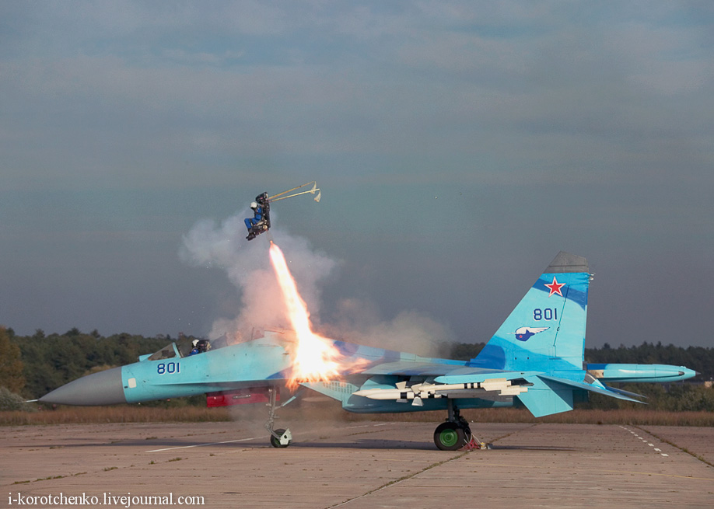
What happens if the contract is breached?
We won’t allow punitive damages for breach of contract – damages in contracts cases are meant to compensate, not punish.

Slide 23
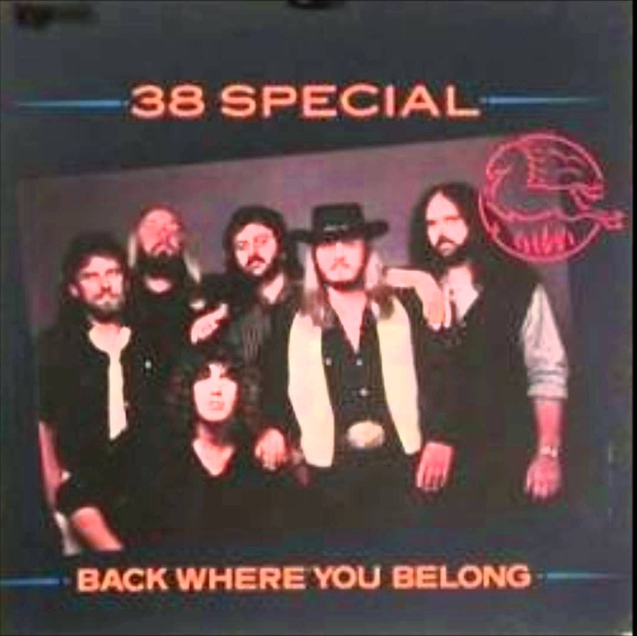
What happens if the contract is breached?
Most common measure of damages in contracts is “expectation damages.” Definition: a sum that leaves an injured party in as good a position as full performance.

Slide 24

What happens if the contract is breached?
Incidental damages: costs reasonably incurred in arranging a replacement deal (making phone calls, delivery fees, etc.)

Slide 25
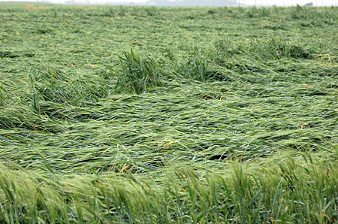
What happens if the contract is breached?
Consequential damages: special damages reasonably foreseeable by the breaching party at the time of the contract. LOTS of contracts will specifically exclude these damages.

Slide 26
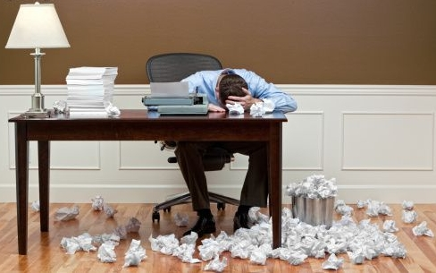
What if we need to change something?
If you want to make a modification:
  Minor: Strike out, write new
  provision, and have both parties
  initial.
  Major:
    Start over
    Have a separate document
    “rider,” “amendment,” or
    “exhibit” attached with reference.
  BOTH parties need to acknowledge

Slide 27
If I had to go into court and prove
Prove there was a contract
Prove what was required by it
Prove that I did what was required
Prove they did not do what was required
… how would you do it?

Slide 28
Don’t forget
READ EVERYTHING
GET EVERYTHING IN WRITING

Slide 29
Many thanks!
Shannon L. Ferrell
Oklahoma State University
Dept. of Agricultural Economics
shannon.l.ferrell@okstate.edu

