Slide 1
Impact of Section 199A on Grain Producers
Phil Kenkel
Bill Fitzwater Cooperative Chair

Slide 2
Key Aspects of the Tax Cuts and Jobs Act
Reduced the top corporate tax rate to 21%
Eliminated the Section 199 Domestic Production Activities Deduction (DPAD)
Created a new Section 199A
  This provision became controversial and was revised
The structure of the revised Section 199A has created questions as to whether tax impacts should or will effect decisions on where to deliver grain

Slide 3
Overview of Cooperative Taxation
For federal income tax purposes a cooperative calculates its taxes similar to other corporation but can exclude certain distribution of member’s profits from taxable income.
Cooperative members include distributed profits in their taxable income
This creates a pass through taxation structure and because of that structure cooperatives do not substantially benefit from a reduction in the corporate rate.
This was the argument for creating a Section 199A deduction at the cooperative level

Slide 4
The Old Section 199 (DPAD)
Originated out of the American Jobs Creation Act of 2004
Applied to domestic manufacturing firms which was eventually interpreted to include farmers
The deduction was phased in but in 2010 it was calculated as the lesser of 9% of qualified production activities income or 50% of W-2 wages associated with the qualified production activities income.
Cooperatives could retain the deduction or pass some or all of it on to members

Slide 5
More on the Old Section 199 (DPAD)
Marketing cooperatives could structure commodity payments such that the cooperative was considered to be collectively producing commodities on behalf of its members.
Many cooperatives re-characterized commodity payments as per unit retains paid in money (PURPIMs) which are not considered cost of goods sold and did not reduce qualified income
Due to W-2 wage limitation it was generally more advantageous to calculate DPAD at the cooperative level

Slide 6
Section 199A (after revision)
All producers except those farming as a C-corporation get a 20% pass through entity deduction from qualified income.
Marketing cooperatives can receive a deduction at the cooperative level which they can keep or pass on.
Farmers marketing commodities through cooperatives face a potential offset in their 20% pass through deduction.
The offset is based on farm level calculations and is not linked to the actual pass through they received (or didn’t receive) from their cooperative.

Slide 7
The Section 199A Cooperative Level Deduction
9% of qualified production income less the costs of goods sold and other expenses associated with that income.
Cooperative level deduction is capped at 50% of cooperative’s W-2 wages associated with commodity sales
The cooperative can retain the deduction or pass some or all of it on to the members

Slide 8
The Cooperative Level Deduction: PURPIMS
Just like with DPAD cooperatives will need to re-characterize commodity payments as per unit retains paid in money (PURPIMs) which are not considered cost of goods sold, to get a significant Section 199A deduction

Slide 9
Producer’s 20% Deduction
All producers doing business in a form other than a C-corporation receive a deduction equaling 20% of their net income from commodity sales but not exceeding their taxable income. The deduction phases out when taxable income exceeds $157,000.
Producers marketing commodities through a cooperative face a possible offset in the deduction.
The offset is not linked to the amount of the cooperative deduction that is passed through

Slide 10
Offset for Cooperative Delivering Producers
Reduced by the lesser of 9% of the producer’s income from commodity sales plus patronage or 50% of the producer’s W-2 wages.
The producer’s offset has a similar structure to the cooperative’s deduction but are calculated on different bases.
A producer with no W-2 wages faces no offset but a producer with high W-2 wages could theoretically have their 20% deduction reduced to 11%

Slide 11
Comparison for Producers Marketing through Cooperatives or Independents
Independent delivering producers retain their 20% deduction but have no potential for a pass through deduction or profit distribution from the grain handler.
Cooperative delivering producers face potential offset of their 20% deduction but have the potential for a pass through deduction and patronage from the cooperative
The advantage or disadvantage of delivering to a cooperative depends on the balance of those two factors.

Slide 12
Lots of “Poor” Information Out There
“Large producers are better off delivering to independents”
“Producers possible deductions range from 11% to 29%”
Some examples are based on cooperatives with almost no W-2 wages and farms with very high W-2 wages. Both of those are very unusual.

Slide 13
A Realistic Comparison
Most recent (2016) data to determine sales, margin, local savings, labor expense and potential Section 199A cooperative level deduction for representative grain marketing cooperative
Most recent (2013) USDA ERS statistics to determine total revenue, yield and wage expense for representative Southern Plains grain farm

Slide 14
Section 199A and Patronage
Cooperative
Patron
Labor: $0.15/bu.
Savings $0.079/bu.
9% of QPI: $0.33
50% W-2 Wages: $0.073
Section 199A deduction:$0.073
Pass through to producer 75%: $0.055
Cash patronage (50%): $0.036/bu.
9% of income + patronage: $.32/bu.
50% W-2 Wages: $0.061/bu.
Offset per bushel: $0.061
Cooperative pass through: $0.055
Cash patronage: $0.036/bu.
Net change in tax deduction: $0/bu. (actually: -$0.006)
Net change with patronage:$0.03/bu.

Slide 15
Impact on Producers Delivering to Cooperatives
“Representative” cooperative needs to pass on 75% of cooperative level Section 199A Deduction to keep a cooperative delivering (representative) producer equivalent to an independent delivering producer.
Would need to pass on 40% if patronage is factored in.
Producers with below average W-2 wages would be equivalent at lower pass through while those with higher W-2 wages would require higher pass through

Slide 16
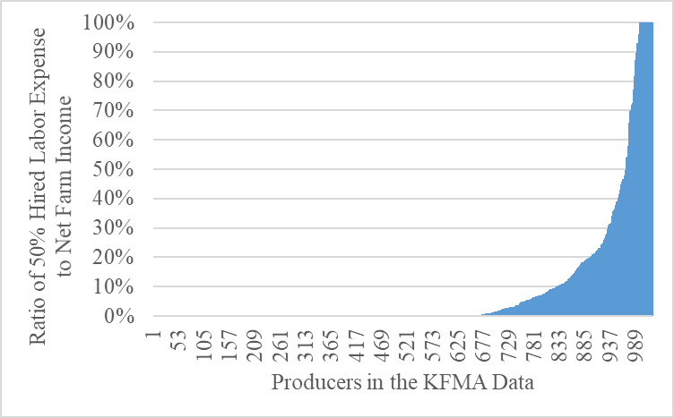
Approximately 20% of grain producers have sufficient W-2 wages to make the 9% of qualified income the binding offset
Figure 1. Histogram of Labor-to-Income Ratio for Producers in the Kansas Farm Management Association Data – 2016
For the average producer wages represent 3.3% of qualified income.
When W-2 wages exceed 9% of income the 9% threshold becomes the binding
Factor in the offset calculation

Slide 17
Who Are These “High Wage Producers”?
$4M in assets
$1M in commodity sales
11% are organized as C-Corporations and are not eligible for the 20% deduction unless they change business type
(information from Kansas Farm Management Association database 1980 to present)

Slide 18
Bottom Line for Cooperative Board’s and CEOs
The cooperative will need to pass a portion of their Section 199A deduction to eliminate a tax penalty from marketing through the cooperative.
Cooperatives that did not take the previous DPAD deduction cannot afford to ignore the Section 199A deduction.
The Section 199A deduction is similar to the decision on cash patronage. It is a balancing act between the cooperative’s needs and the patron’s needs and it is determined at year end, long after the grain is delivered.

Slide 19
Bottom Line for Grain Producers
Many producers have little or no W-2 wages and will face no offset to their 20% deduction.
The deduction is based on 20% of qualified income but is capped at taxable income. Some producers won’t have enough taxable income to use all of their 20% deduction.
Cooperative boards will obviously have the need to pass through a portion of the Section 199 deduction on their radar and are likely to pass through an appropriate amount.
The best advice is to continue to do business with the agribusinesses that provide the best service and value package. For most producers tax effects should not be a major consideration.

Slide 20
Questions?
Phil Kenkel
Regents Professor and Bill Fitzwater Cooperative Chair
Department of Agricultural Economics
Oklahoma State University
405-744-9818
Phil.kenkel@okstate.edu
OSU Fact Sheet
AGEC 1076 Impact of Revised Section 199 A on Grain Producers
http://factsheets.okstate.edu/documents/agec-1076-impact-of-revised-section-199a-on-grain-producers/

