Slide 1
The Economy and Agricultural Policy
Outlook Update
Spring 2018
Larry D. Sanders & Dave Shideler

Slide 2
Economic indicators | Most recent measurement
GDP Growth Rate | 2.5 %
Unemployment Rate | 4.1 %**
Inflation Rate | 2.2 %
Interest Rate | 1.75x
Balance of Trade (monthly) | -56.6 bil.xx
Govt. Debt/GDP | 105.4%xxx
x 9-yr high
** 17-yr low
xx 10 yr hi
xxx 1946: hi 118.9%

Slide 3
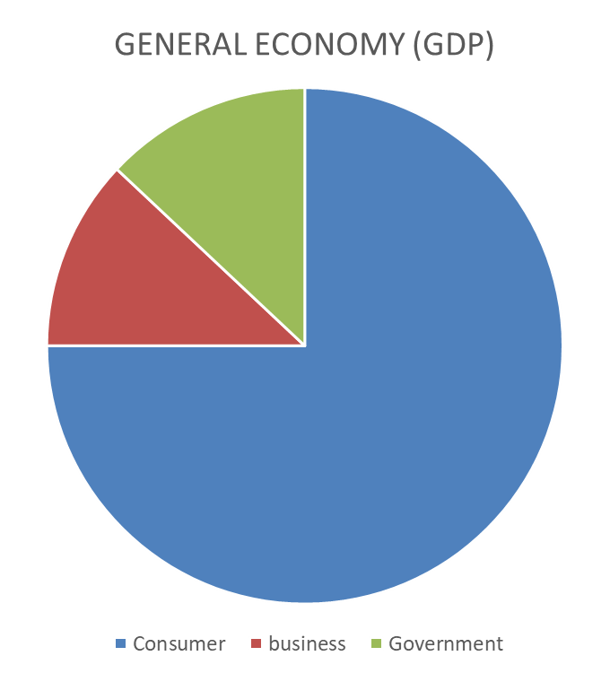
What makes the economy work?
Government spending (2009 hi; 6% below)
Business investment (2015 hi; 19% below)
Consumer spending (record hi)
--Unemployment (4.1 %)
--wages (4.6%)
--savings rate (3.2%)

Slide 4
Theory and research suggest:
--Little/no economic growth
--Increased inflation
--Federal deficit & debt will increase
Tax Cuts?
Tax cuts mean less investment in:
--infrastructure
--social programs
--farm programs
Currently:
--Economy doing relatively well
--Not a reasonable time for tax cuts and increasing deficit

Slide 5
TRADE AGREEMENTS & TARIFFS
US Agriculture has 50-yr history of benefitting from trade agreements & bringing down tariffs
Tariffs generally do more harm than good
Trump tariffs likely to hurt US consumers and farmers
Tariffs may produce short term gains for targeted sectors
Lose-Lose in long term

Slide 6
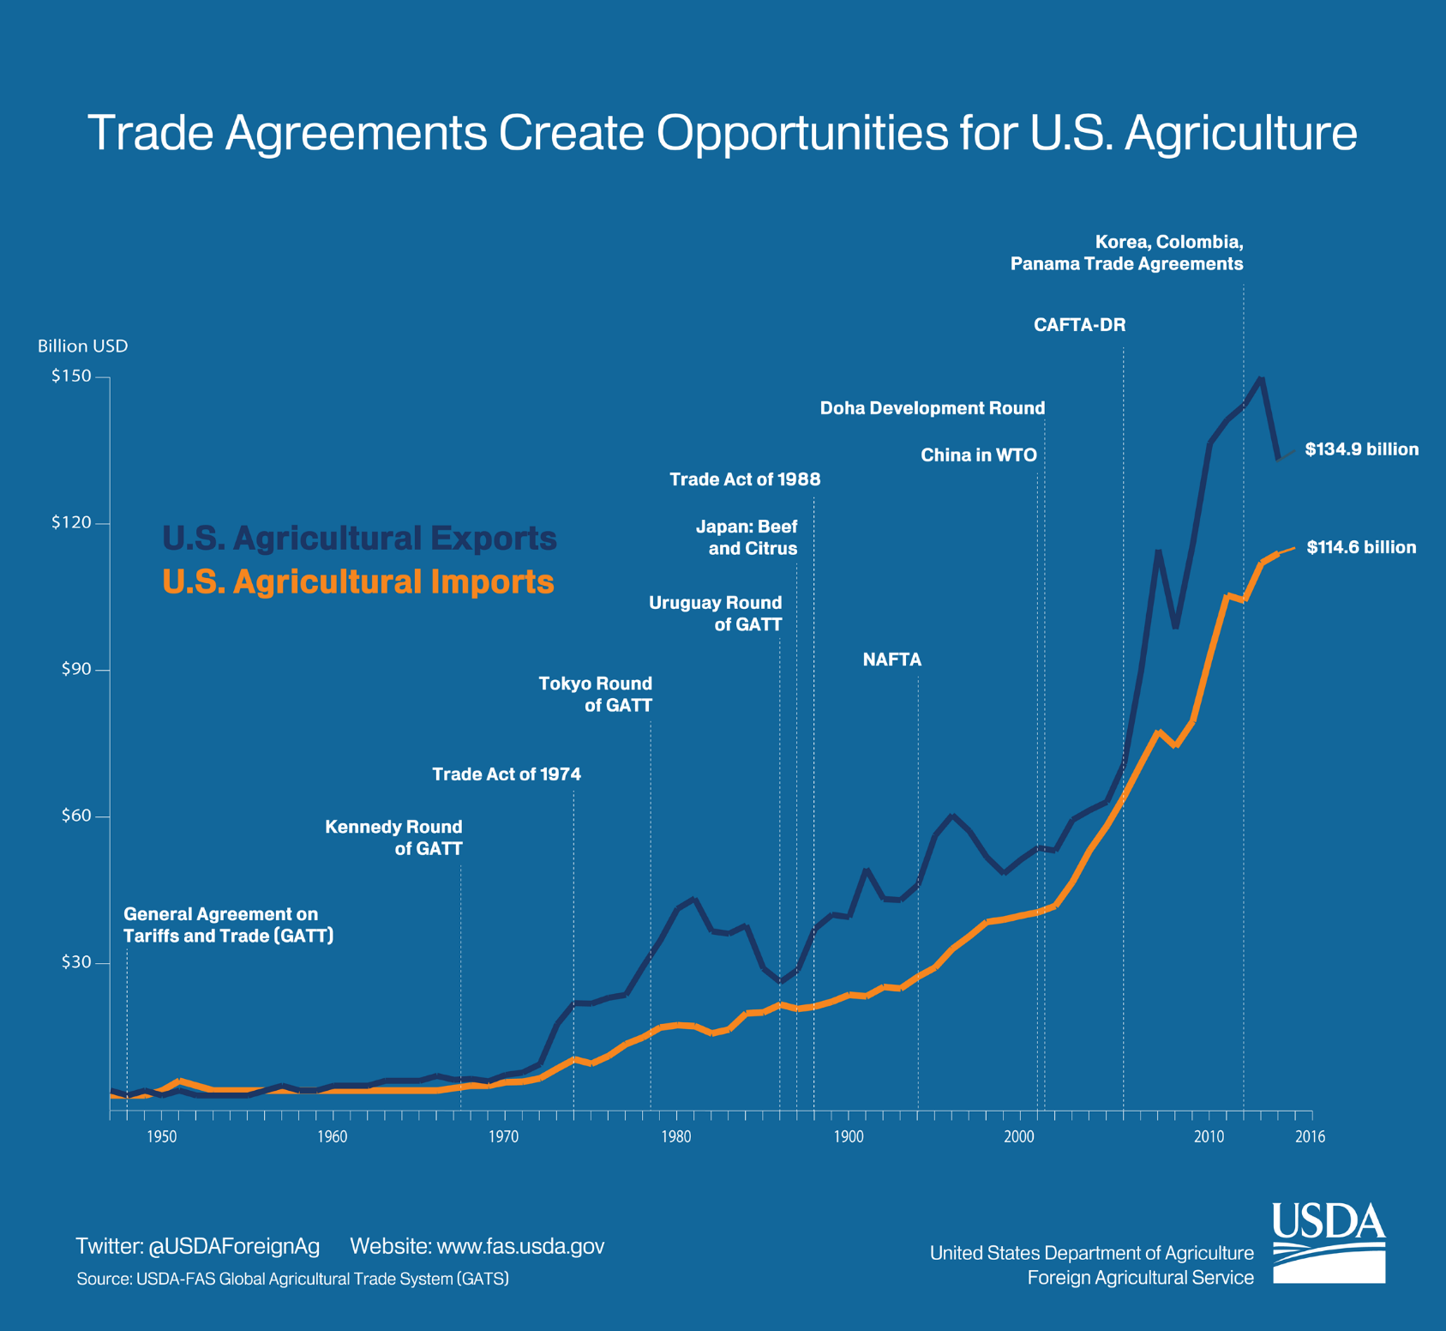
https://www.fas.usda.gov/sites/default/files/2017-05/graphic_2_1.png

Slide 7

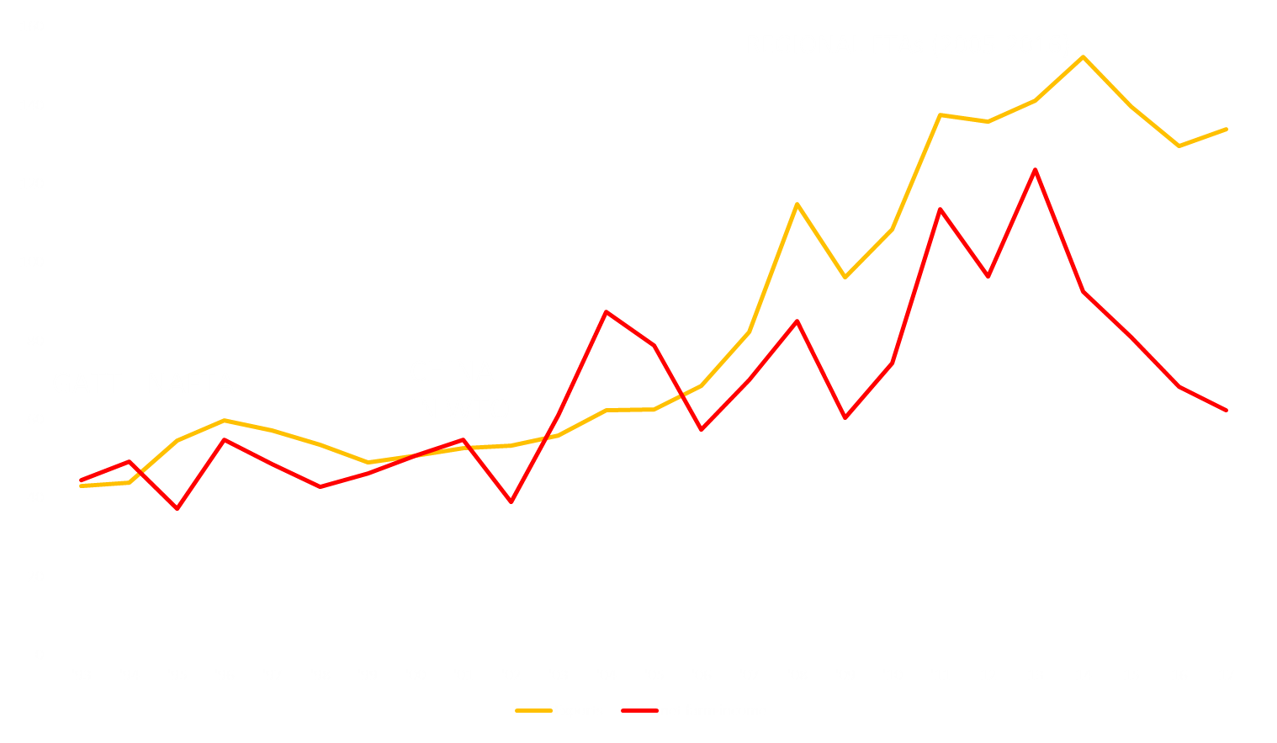
US Agricultural Exports & Net Farm Income, 1993-2017 ($ billion)
FAS Office of Global Analysis; USDA ERS

Slide 8




The next farm bill… 2018…2019…2020…???
2014 farm bill was a 5-yr bill expected to last thru 2018
Discussions ongoing; some drafts
Risk management continues to be the framework--crop insurance focus
Maintain omnibus concept or split off food programs?
Specialty crops and conservation as compromise issues?
Food Stamps (SNAP) may stall progress
The “Team” that will write/move the farm bill
SENATE
HOUSE
Pat Roberts
(R-KS)
Michael Conaway
(R-TX)
Debbie Stabenow
(D-MI)
Collin Peterson
(D-MN)

Slide 9
Politics & Policy
Trump thrives on management by disruption
Congress not likely to reverse Tariffs
Short run gains in hopes that importing countries will reduce offenses
Risk is that trade wars ensues (recent gains from Pac-Rim now at risk)
Value of $ & US economic growth critical in gambit working

Slide 10
Turning to Oklahoma

Slide 11
In thousands
Source: BLS, State and Area Employment; http://www.bls.gov, accessed on accessed March 16, 2018 8:45 pm
Notes:
Employment in OK peaked in May 2008 and in Oct 2012, employment exceeded this threshold. 53 months.
Nonfarm Employment has recovered from the recession, having grown by approximately 50,000 jobs more than in 2008.

Slide 12
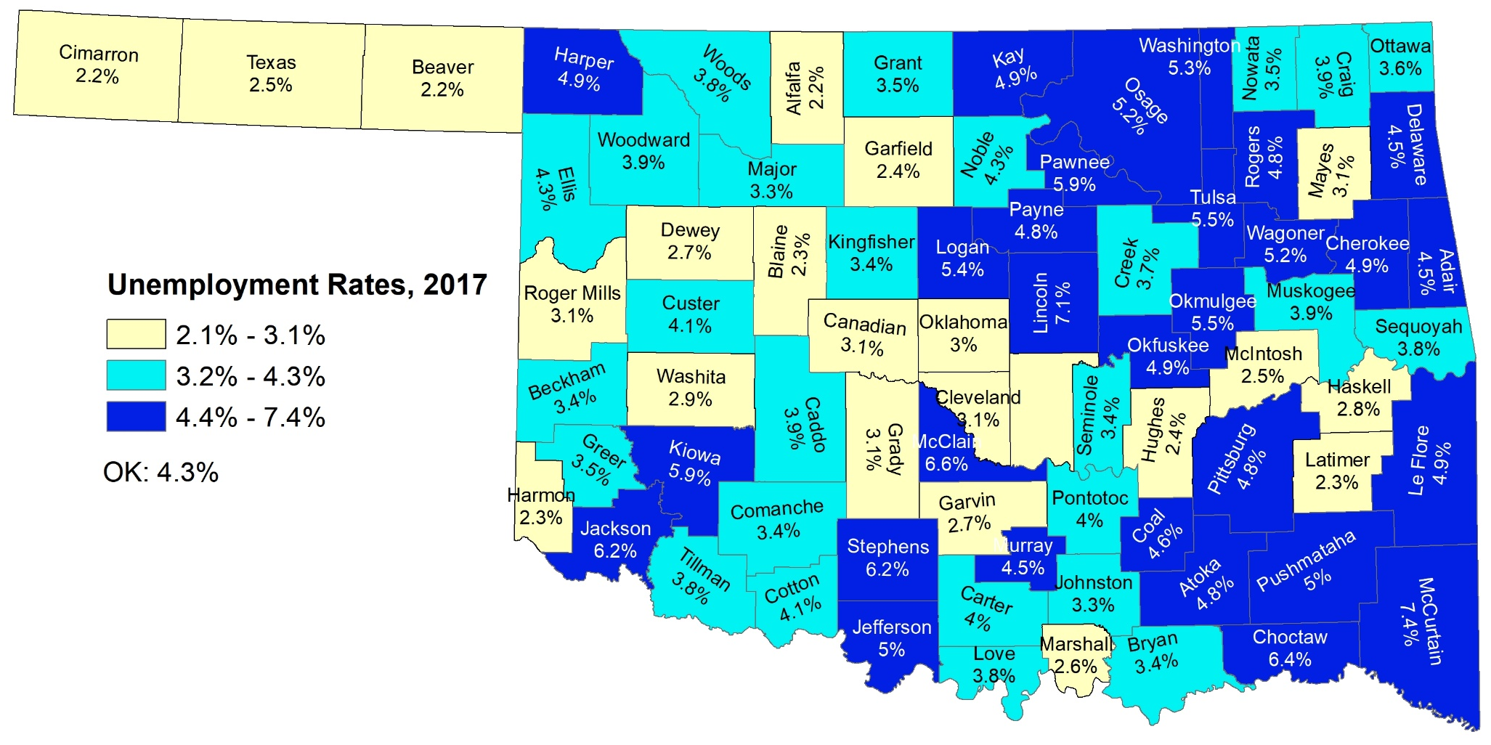
Unemployment Rates, 2017
Source: Oklahoma Employment Security Commission County Unemployment Rates; downloaded March 6, 2018 @ 1:32 pm
Notes:
Interesting to note that with the exception of Marshall County, all counties with employment growth had unemployment rates less than the US; the remaining would like see rising unemployment rates

Slide 13
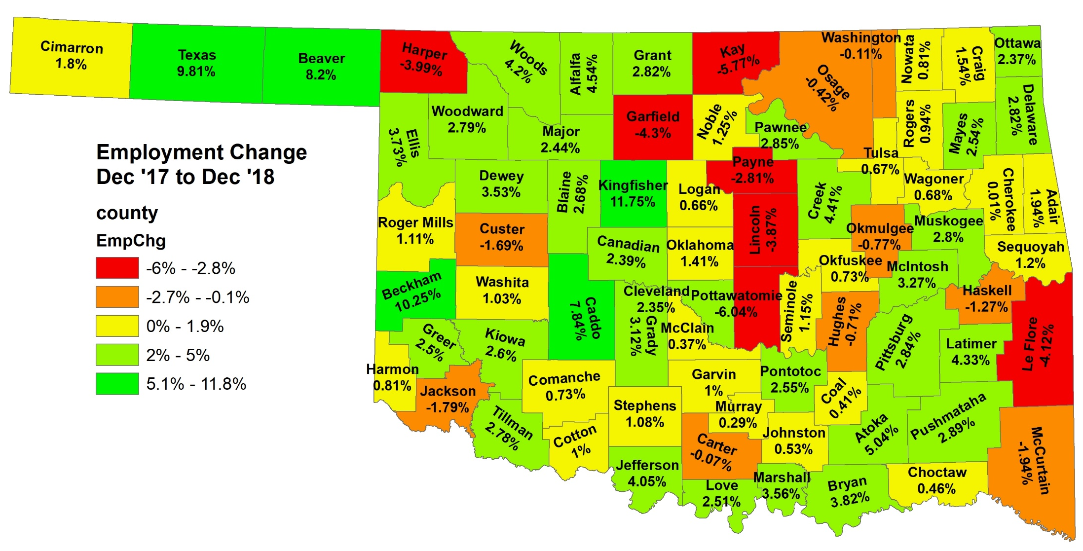
Employment Growth
Source: Oklahoma Employment Security Commission County Unemployment Rates; downloaded March 6, 2018 @ 1:32 pm

Slide 14
Oklahoma Economy by Industry, 2016
Source: BEA, Gross Domestic Product by State, Real GDP; http://www.bea.gov, accessed on accessed March 16, 2015 @ 5:32 pm
Notes:
OK’s economy is diversified around energy/mining, government, finanical activities and manufacturing – 53% of the economy.

Slide 15
Location Quotients, 2016, and Real GDP Growth Rates, United States and Oklahoma, 20059-2016
Source: BEA, http://www.bea.gov/; accessed March 16, 2018 @ 5:32 pm
Industry | LQ | % Total GSP, 2016 | % Chg GSP, ‘09-’16
Agriculture | 1.6 | 1.5% | 70.4%
Mining | 7.3 | 10.2% | -1.4%
Utilities | 1.6 | 2.4% | 23.3%
Construction | 1.0 | 4.3% | 17.4%
Durable Manuf. | 0.8 | 5.1% | -1.0%
Nondurable Manuf. | 0.8 | 4.4% | 0.2%
Wholesale Trade | 1.0 | 5.7% | 43.9%
Retail Trade | 1.1 | 6.3% | 14.2%
Transp. & Warehousing | 1.7 | 5.3% | 106.4%
Information | 0.5 | 2.5% | -2.2%
Financial Serv. | 0.7 | 14.1% | 15.0%
Prof. & Bus. Serv. | 0.7 | 8.4% | 15.7%
Educational Serv. | 0.5 | 0.5% | 5.3%
Health Care | 1.0 | 7.3% | 14.5%
Arts, Entert. & Rec. | 0.7 | 0.7% | 42.8%
Accomm. & Food Serv. | 0.9 | 2.8% | -1.7%
Other Serv. | 1.0 | 2.2% | 11.1%
Government | 1.3 | 16.2% | 2.1%
Notes:
OK’s comparative advantage rests in Ag, Mining, Utilities, Transp & warehousing , Government.
Only one of these sectors, Government, is one of the top 5 employment sectors (roughly 1/5 of employment)
Looking at growth, however, Mining, Utilities had the highest rates of growth in the state, followed by Construction, Educ/Health Care, Leisure/Hospitality

Slide 16
Employment Gains and Losses
(Feb. ’17 – Feb. ‘18)
Job Gaining Industries (Top 5 in descending order of jobs gained) | Job Losing Industries (Top 5 in ascending order of jobs lost)
Accommodation and Food Services (6,100; 4.1%) | Non-durable Manufacturing (-1,800;-4.4%)
Mining and Logging (5,300; 11.8%) | Retail Trade (-1,200; -0.7%)
Durable Manufacturing (4,000; 4.5%) | Information Supersector (-1,100; -5.3%)
Admin & Waste Mgt (3,600; 3.8%) | Federal Government (-400; -0.8%)
Health Care and Social Assistance (2,600; 1.2%)
Source: Compiled from OESC Economic Research and Analysis, “Oklahoma Employment Report,” Feb 2018; https://www.ok.gov/oesc_web/documents/lminr03232018.pdf, accessed on March 23, 2018 at 3:30 pm
Notes:
Focusing on just the last year, we see that Health Care and Leisure/Hospitality still growing; manufacturing growing (reversing the trend?)
In terms of jobs lost over the last year, Information continues to lose jobs (national trend); decline in Transp – one of our comparative industries. Also, losing relatively high paying/stable jobs, while gaining lower wage jobs – As Larry mentioned in the national overview

Slide 17
Source: BLS, State and Area Employment; http://www.bls.gov, accessed on accessed April 8, 2016 @ 10:45 am

Slide 18
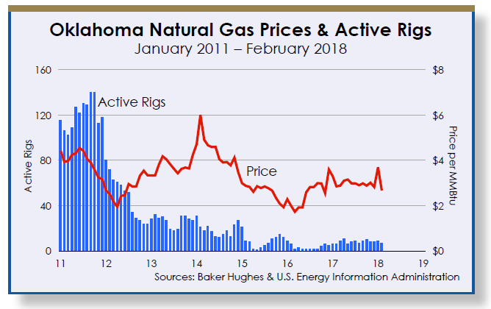
Source: Office of the State Treasurer. Oklahoma Economic Report, February 2018. https://www.ok.gov/treasurer/documents/Feb-18_OER.pdf

Slide 19
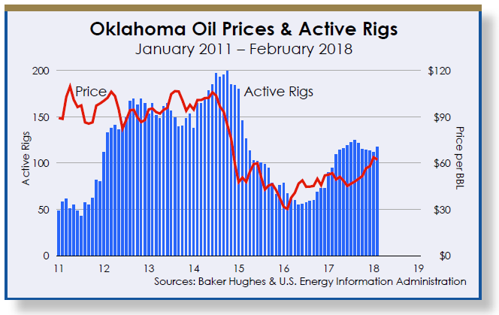
Source: Office of the State Treasurer. Oklahoma Economic Report, February 2018. https://www.ok.gov/treasurer/documents/Feb-18_OER.pdf

Slide 20
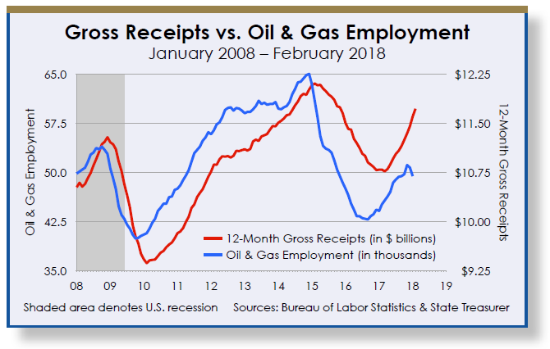
Source: Office of the State Treasurer. Oklahoma Economic Report, February 2018. https://www.ok.gov/treasurer/documents/Feb-18_OER.pdf

Slide 21
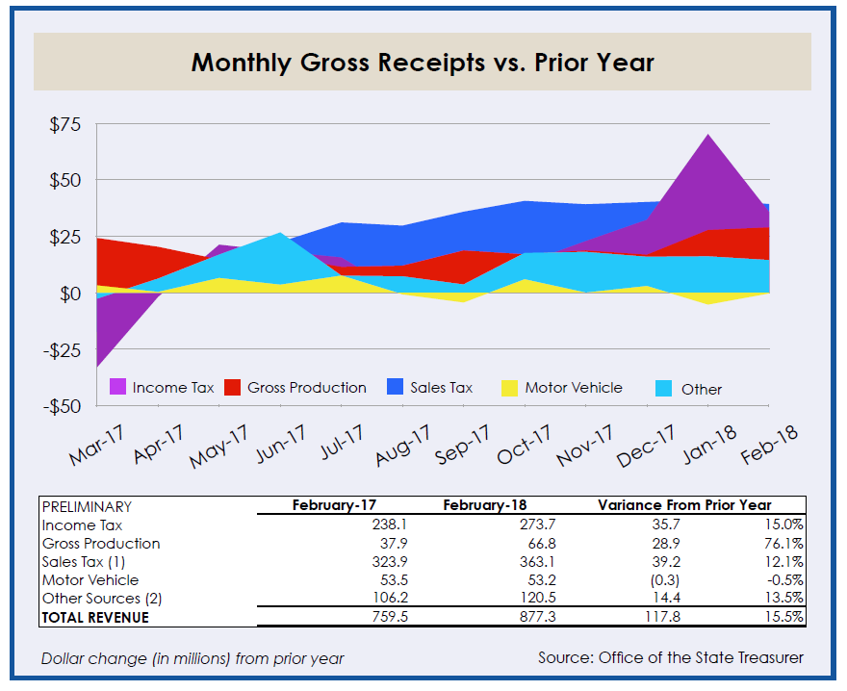
Source: Office of the State Treasurer. Oklahoma Economic Report, February 2018. https://www.ok.gov/treasurer/documents/Feb-18_OER.pdf

Slide 22
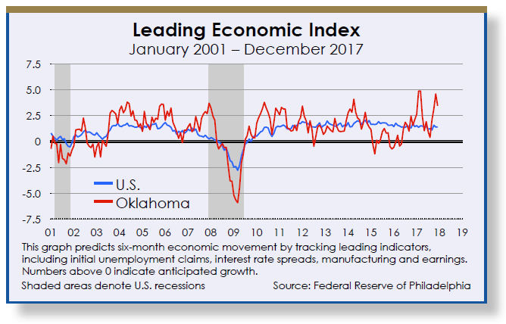
Source: Office of the State Treasurer. Oklahoma Economic Report, February 2018. https://www.ok.gov/treasurer/documents/Feb-18_OER.pdf

Slide 23
Source: Federal Reserve Bank of Kansas City Manufacturing Survey; https://www.kansascityfed.org/~/media/files/publicat/research/indicatorsdata/mfg/2018/pr_2018-02-19-table2-2018-02-19_17-35-01.xls?la=en, accessed on March 16, 2018 @ 9:53 pm

Slide 24
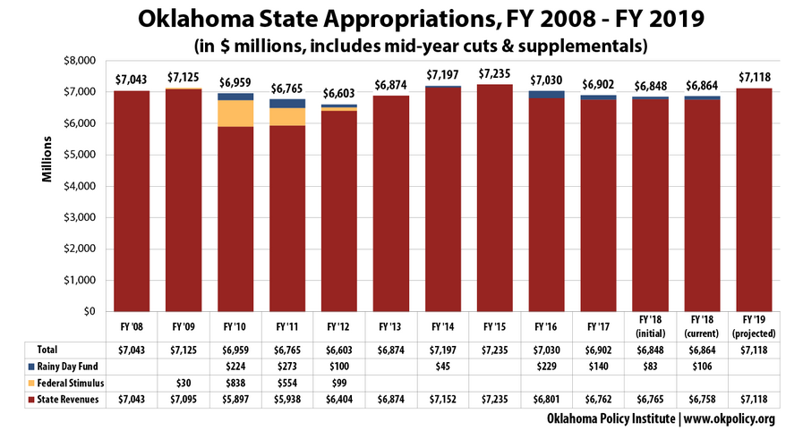

Slide 25
State Conclusions
State economy is growing
  Growth in employment across sectors
  Coincides with growth in oil and gas production
Labor force is growing leading to higher unemployment rates in some parts of the state
General economic conditions, and manufacturing specifically, both point to additional growth in next 6-12 months
Some uncertainty exists due to federal trade policy implications

Slide 26
Thanks for your participation!
Please follow the link below to complete the evaluation of this program:
https://okstatecasnr.az1.qualtrics.com/jfe/form/SV_3L5rMKjeo0Un8UJ

Slide 27
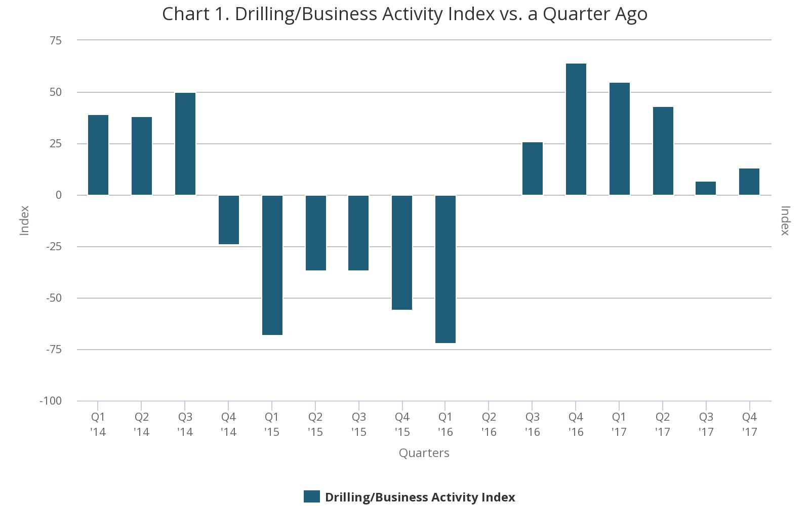
Tenth District Energy Survey
Source: Tenth District Energy Survey; https://www.kansascityfed.org/research/indicatorsdata/energy/articles/2017/fourth-quarter-energy-survey accessed on March 16, 2018 @ 10:02 pm

Slide 28
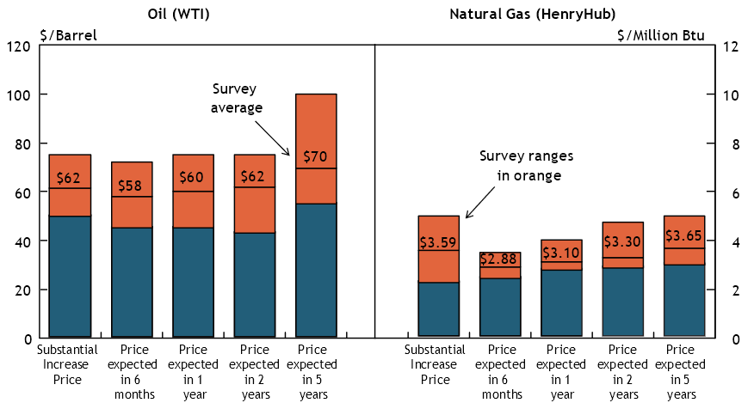
Tenth District Energy Survey
Source: Tenth District Energy Survey; https://www.kansascityfed.org/research/indicatorsdata/energy/articles/2017/fourth-quarter-energy-survey accessed on March 16, 2018 @ 10:02 pm

Slide 29
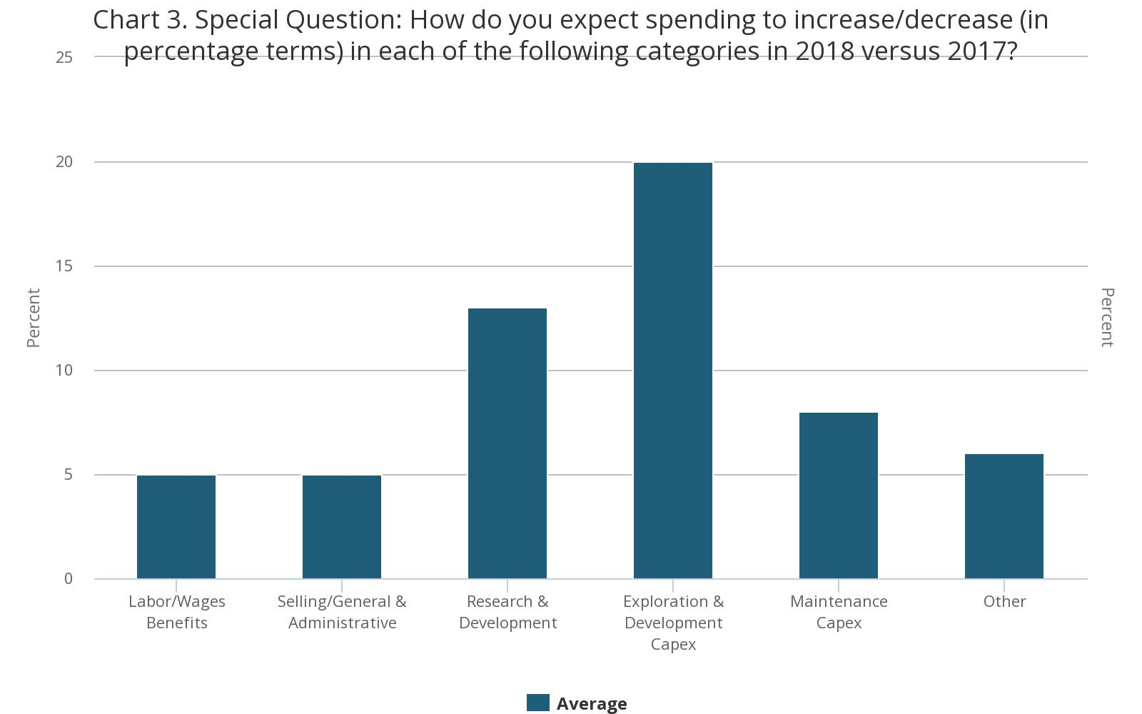
Tenth District Energy Survey
Source: Tenth District Energy Survey; https://www.kansascityfed.org/research/indicatorsdata/energy/articles/2017/fourth-quarter-energy-survey accessed on March 16, 2018 @ 10:02 pm

