Slide 1
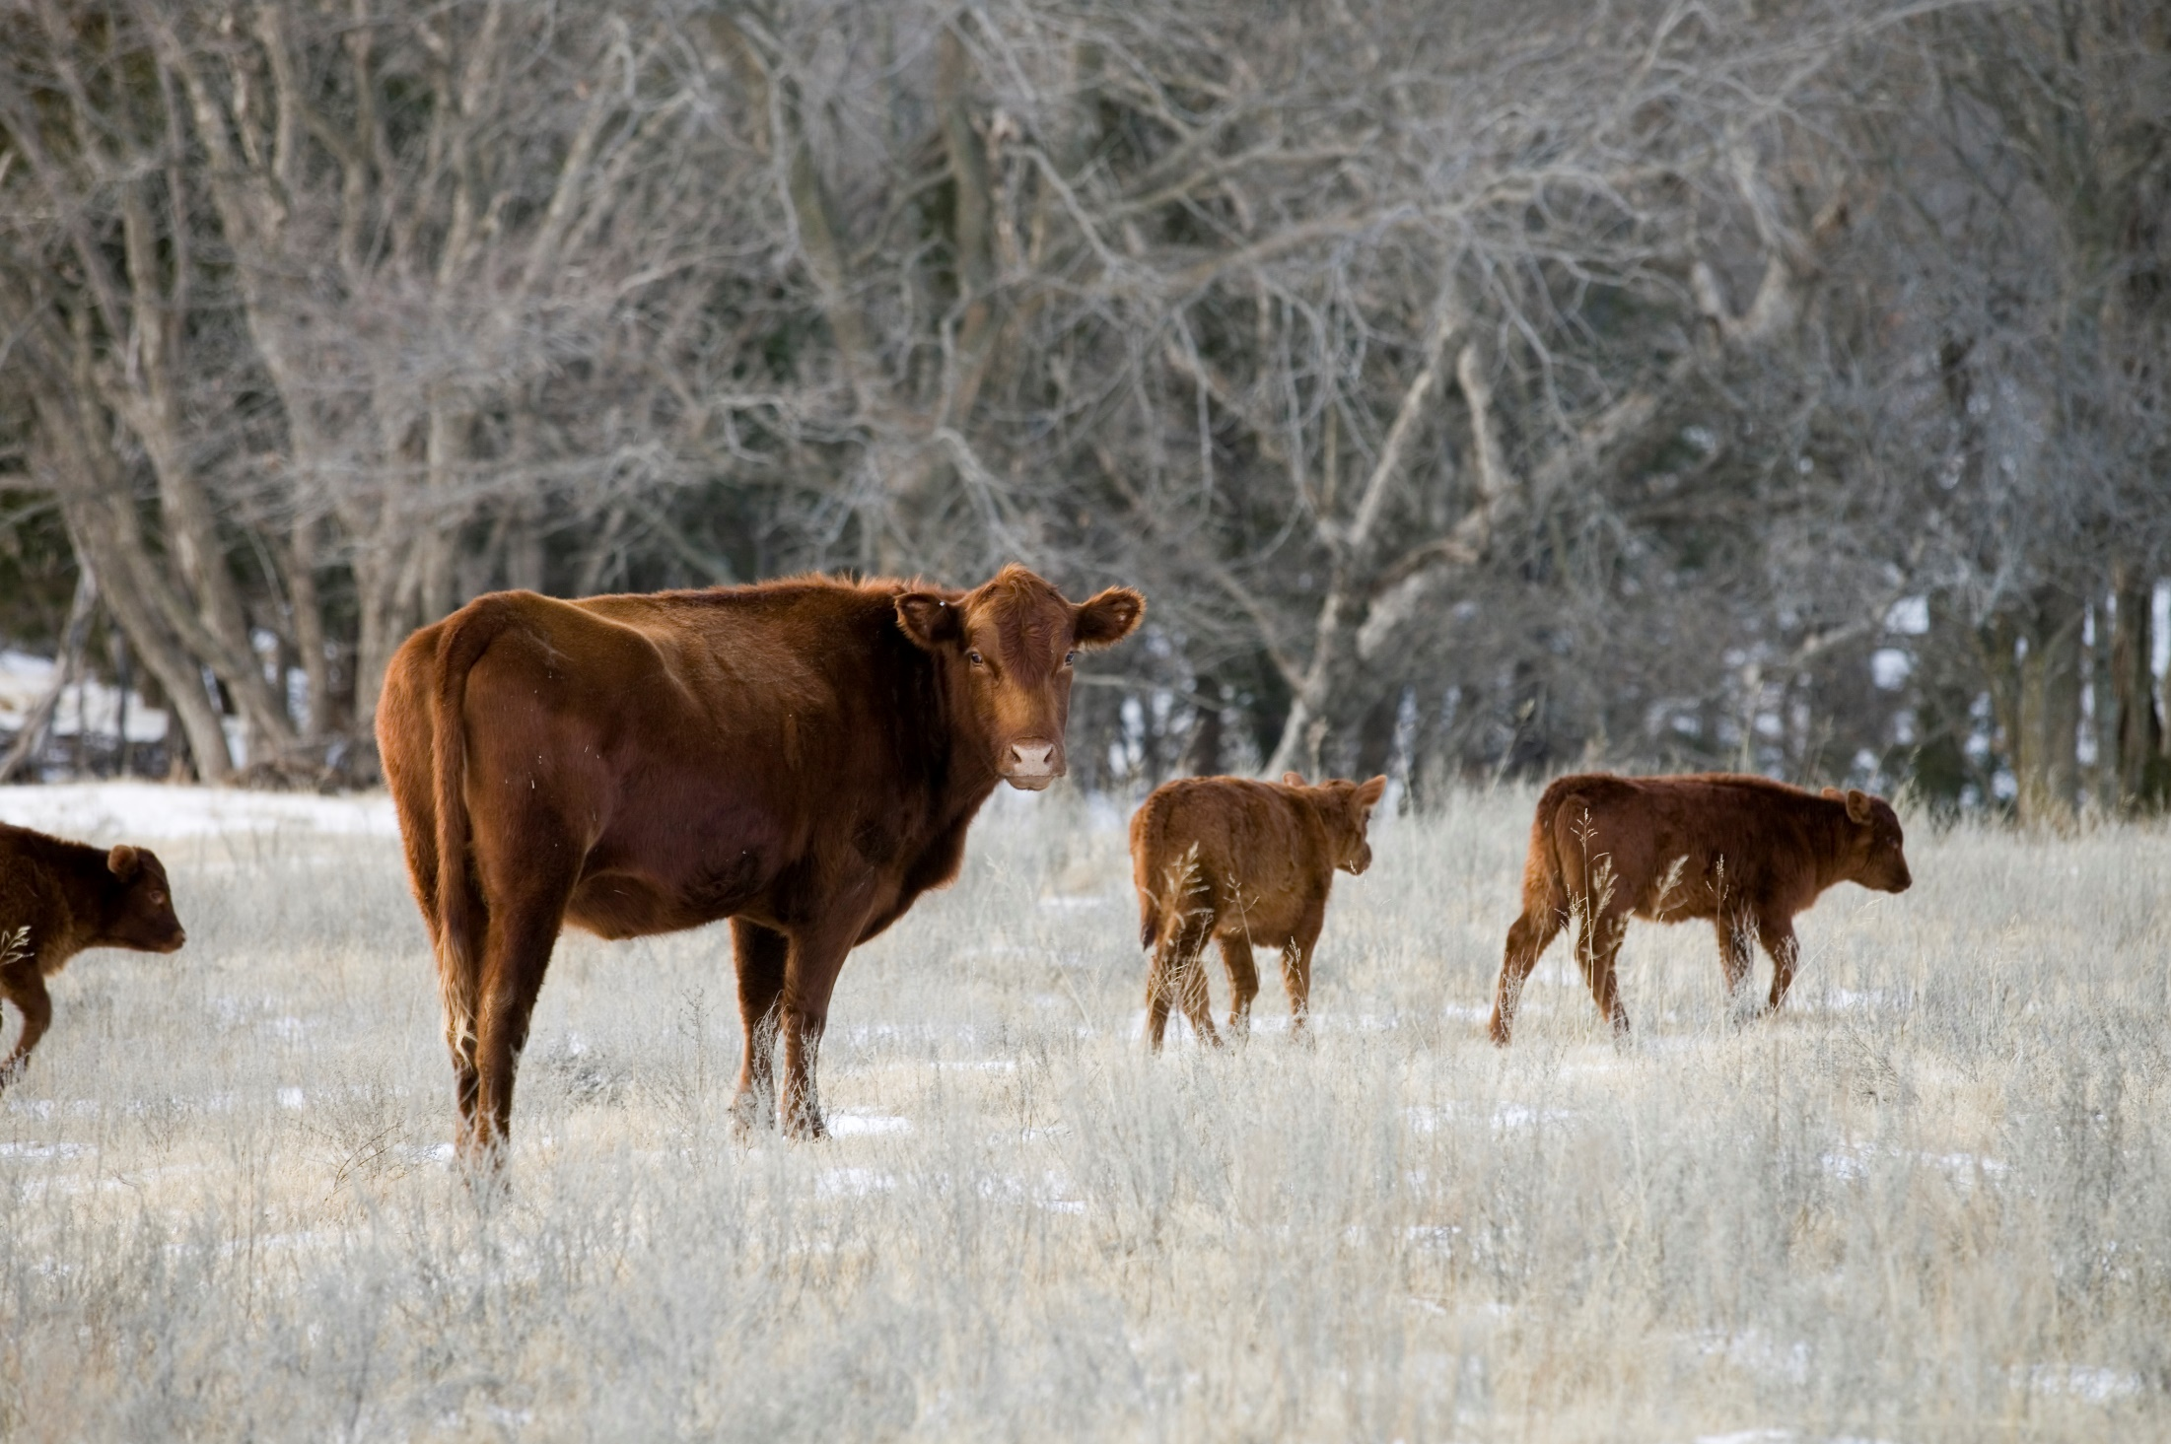

Oklahoma Agricultural Land Value Update
Roger Sahs, Extension Specialist
OSU Department of Agricultural Economics

Slide 2
Oklahoma Agricultural Real Estate Trends

Slide 3
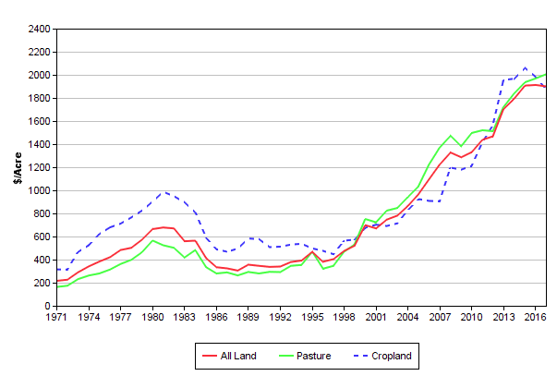
Oklahoma Cropland vs Pastureland Prices*
Sizable increase in statewide values in recent years. Have values peaked? Probably, but it depends on your location…
*Cropland and pasture tracts defined as having 85%+ cropland and pasture utilization, respectively.
Source: www.agecon.okstate.edu/oklandvalues

Slide 4
OK Land Values by Region, 2017*
www.agecon.okstate.edu/oklandvalues
Panhandle
Tracts 37
Size 424
$/Acre $778
% Chg -5.9
West-Northwest
Tracts 143
Size 194
$/Acre $1,597
% Chg +5.1
North Central
Tracts 210
Size 135
$/Acre $1,938
% Chg -9.5
Northeast
Tracts 266
Size 169
$/Acre $2,219
% Chg +1.0
East-Northeast
Tracts 57
Size 205
$/Acre $2,414
% Chg -6.3
State Averages
Tracts 1,269
Size 183
$/Acre $1,900
% Chg -0.6
Southeast
Tracts 155
Size 162
$/Acre $2,059
% Chg +3.3
Southwest
Tracts 226
Size 190
$/Acre $1,355
% Chg -2.2
South Central
Tracts 175
Size 176
$/Acre $2,247
% Chg +3.5
*Tracts >= 40 Acres and <= $6000/Acre

Slide 5
Recent Trends in Oklahoma Land Values
District | 2017 | Since 2016 | Since 2013 | Since 2007
 | $/ac | Change in percent
Panhandle* | 778 | -5.9 | -1.5 | 90.8
West-NW | 1,597 | 5.1 | 4.4 | 70.5
Southwest | 1,355 | -2.2 | 0.1 | 61.3
N Central | 1,938 | -9.5 | -0.7 | 72.5
S Central | 2,247 | 3.5 | 28.4 | 58.7
Northeast | 2,219 | 1.0 | 21.4 | 50.9
East-NE* | 2,414 | -6.3 | 25.4 | 31.7
Southeast | 2,059 | 3.3 | 21.4 | 45.4
Cropland | 1,870 | -5.6 | -4.3 | 106.6
Pasture | 2,006 | 1.9 | 16.4 | 46.2
All tracts | 1,900 | -0.6 | 11.4 | 55.1
*Fewer than 100 sale tracts included. www.agecon.okstate.edu/oklandvalues

Slide 6
Regional Annual Average Values

Slide 7
3-year Weighted Regional Average Values

Slide 8
USDA and OSU Cropland Values

Slide 9
USDA and OSU Pastureland Values

Slide 10
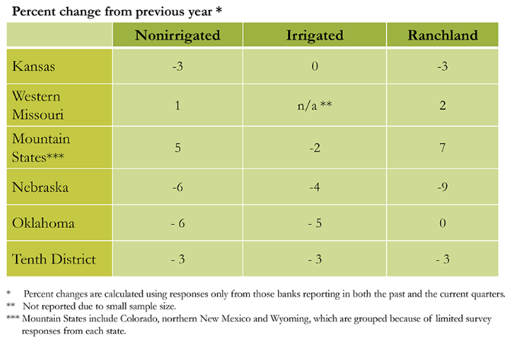
Tenth District Farmland Values by State, 1st Quarter 2018
Source: Kansas City Federal Reserve, May 2018

Slide 11
What’s driving these trends?

Slide 12
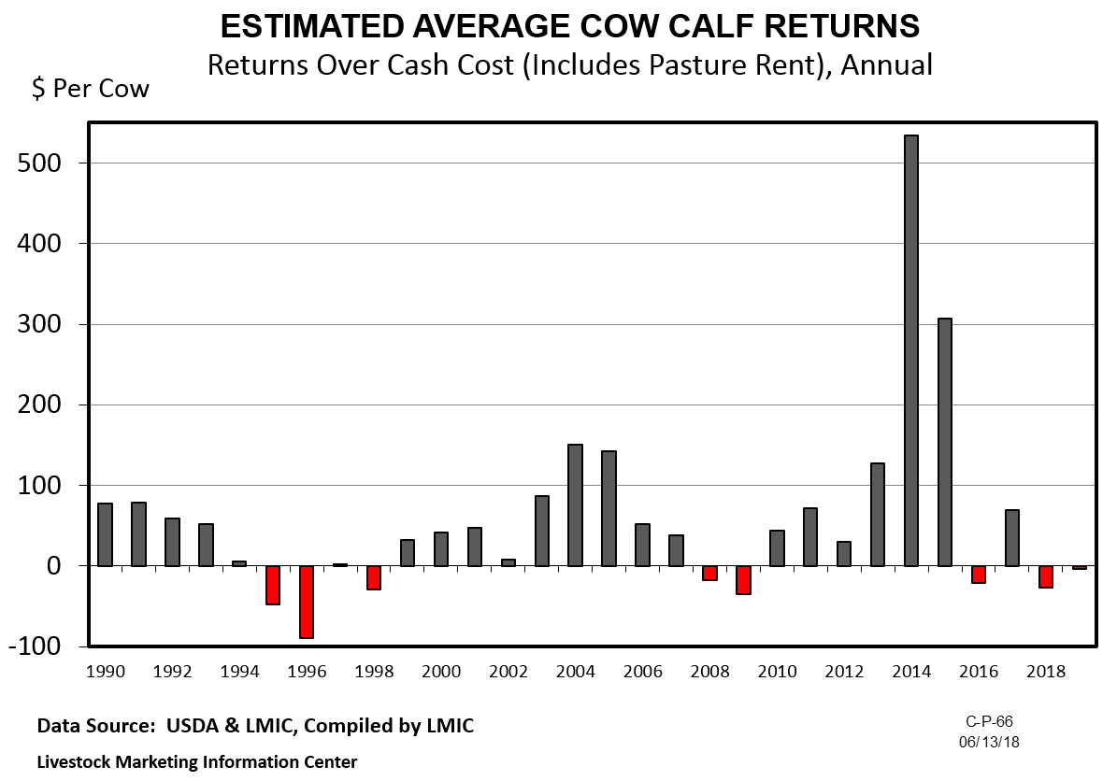

Slide 13
Wheat – Monthly Average Price
Received by Oklahoma farmers during the marketing year
Source: USDA-NASS

Slide 14
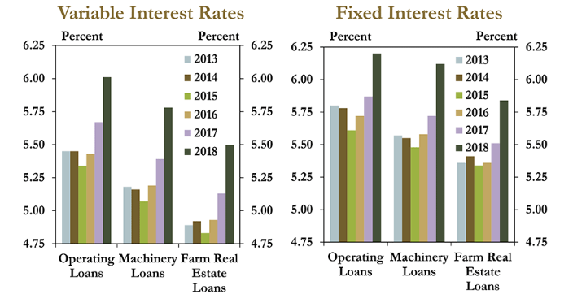
Tenth District Average Interest Rates, First Quarter 2018
Source: KC Federal Reserve Bank, May 2018

Slide 15
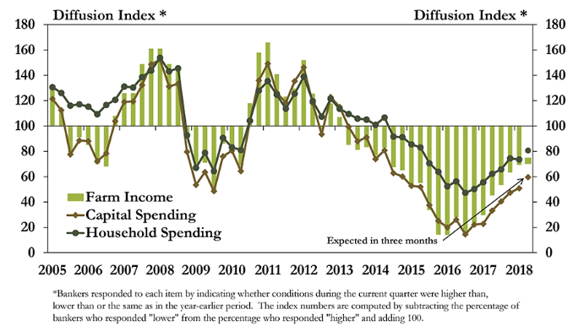
Tenth District Farm Income and Spending
Source: Kansas City Federal Reserve, May 2018

Slide 16
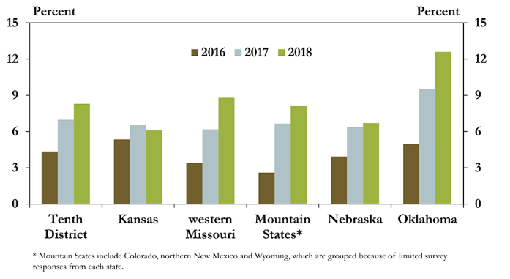
Farm Loan Requests Denied Due to Customer Cash Flow Shortages
Source: Kansas City Federal Reserve, May 2018

Slide 17
In Summary….
Appears that the peak is in for Oklahoma.
◦ Cropland: ‐5% Pasture: +2% All tracts -1% in 2017. A continued mostly sideways trend is likely through 2018.
◦ Commodity prices and resulting farm income, interest rate levels, and financial health of current buyers will all determine future trends.
A majority of farmland is still purchased by active farmers and ranchers!
◦When farmers are reluctant to buy, demand falls and isn’t likely to be sufficiently supported by outside investors.
◦Even though the farm economy has shown signs of stabilizing, the turnaround in land values won’t happen until projections for net farm income rebound and credit conditions improve.

Slide 18
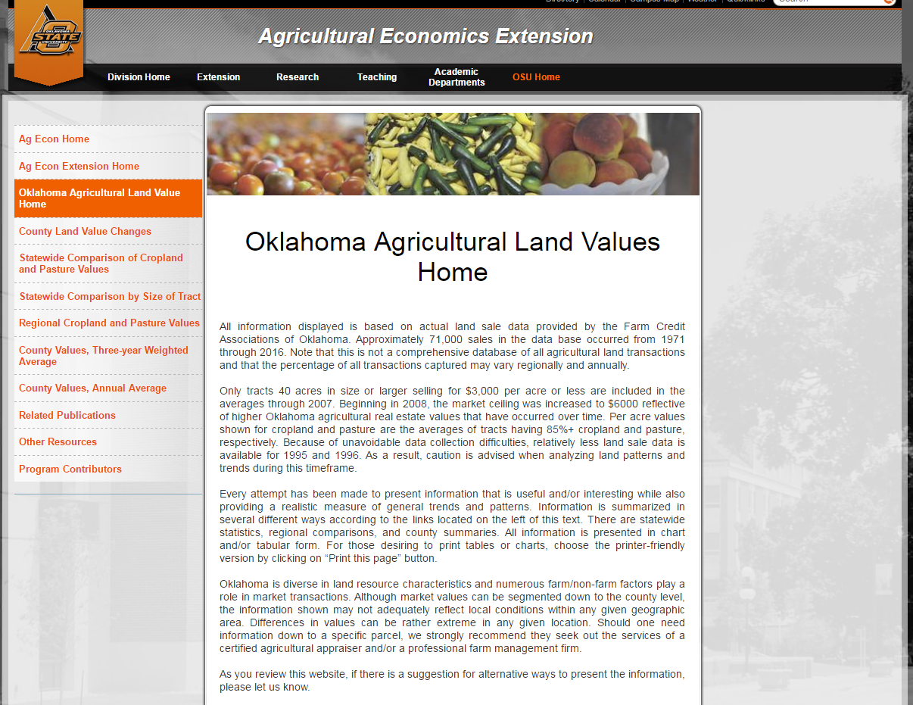
www.agecon.okstate.edu/oklandvalues

Slide 19
Other Resources
Kansas City Federal Reserve Bank
  http://www.kc.frb.org/
  Choose Ag in Economy section, then Current Survey
USDA Ag Land Value Data and Reports
  http://www.nass.usda.gov/
  Choose Economics and Prices Link, then Agricultural Land Values in Reports section

Slide 20
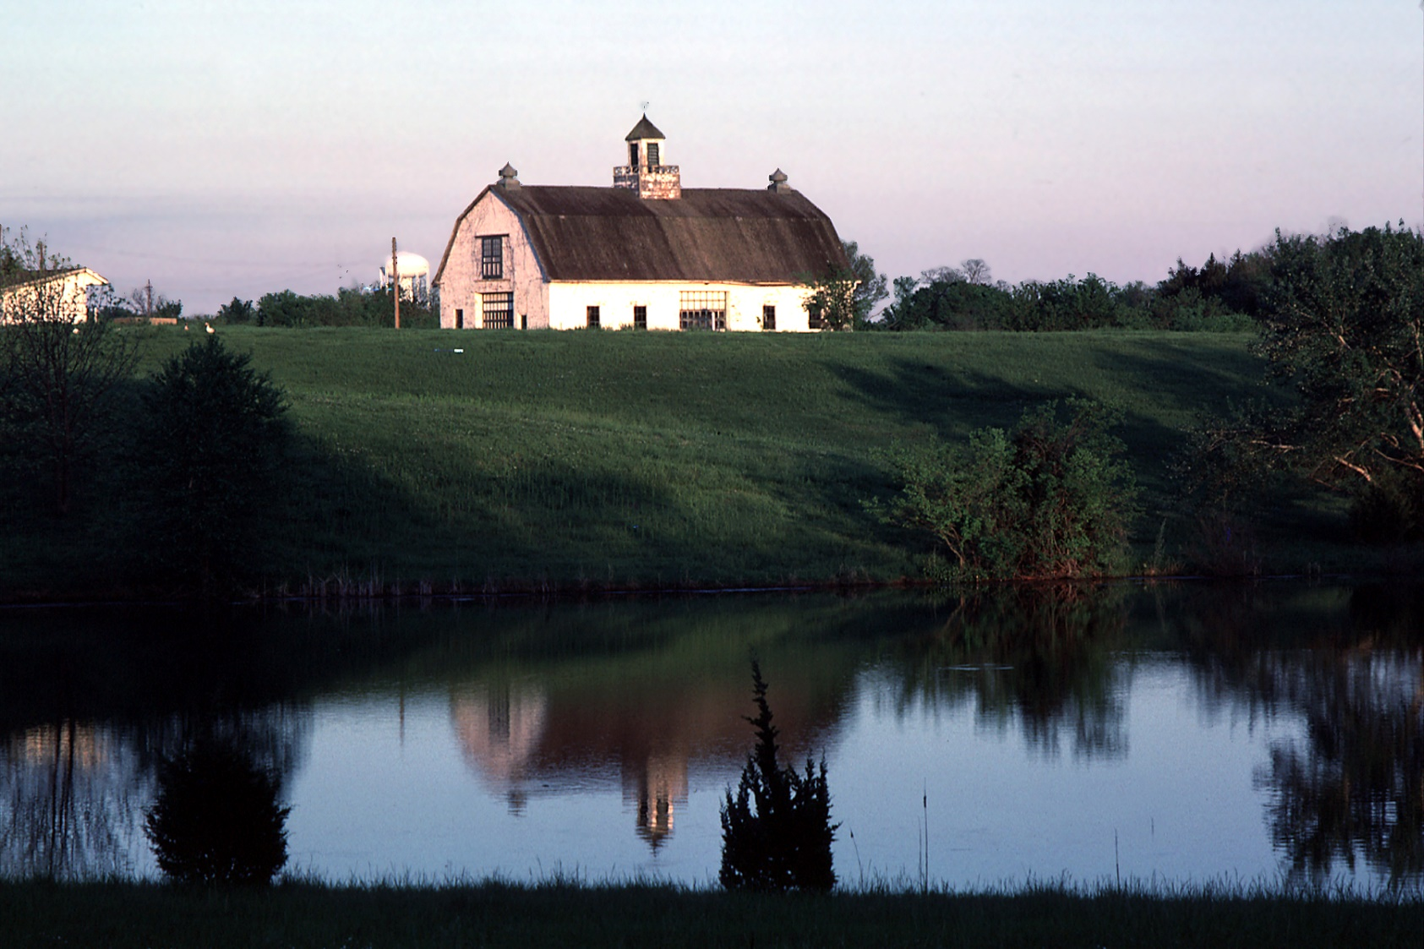
Thanks for tuning in!

