Slide 1
Quicken® 2018 for Farm Financial Records: What’s New?
Damona Doye
damona.doye@okstate.edu
agecon.okstate.edu/quicken
Rainbolt Chair of Agricultural Finance
Extension Economist and Regents Professor
OSU Agricultural Economics Department
Notes:
Note: A narrated version of this PPT is posted on our website: agecon.okstate.edu/quicken under Videos. The website also provides answers to frequently answered questions and links to related publications such as our Quicken fact sheet (http://pods.dasnr.okstate.edu/docushare/dsweb/Get/Document-1799/CR-324.pdf), some of which is copied to the notes pages for this slide show.
Mention of commercial products or trade names is made with the understanding that no discrimination is intended and no endorsement by the Cooperative Extension Service is implied.

Slide 2
New features
Subscription based
Ongoing updates of features
2 year option
Access to 11,000+ online billers, improved bill center dashboard, bill PDF downloads
Expanded custom report layout options
Direct Excel report
5 GB of online backup for Quicken files with Dropbox
Notes:
Quicken® has dominated the personal finance software market for many years. It has proven to be a versatile tool for agricultural producers as well. Software created specifically for agriculture is often expensive or cumbersome. Quicken® is a popular commercial record-keeping package that is:
• Very user friendly. Quicken® is easy for people unfamiliar with accounting terms to use, making it a good place to start when changing from a hand-kept cash accounting system to computerized records.
• Inexpensive and readily available. The Deluxe version does everything that we cover in our basic instructions for agriculture and can be purchased for around $60 when a new version is released in the fall. It can be purchased online or at a variety of retail stores, including Wal-Mart, Staples, etc. As the time for a new release approaches, the current version may be discounted.
• Flexible, allowing record-keeping for a wide variety of agricultural and non-ag business enterprises.
• User-friendly and widely used. Users can compare notes with neighbors on its application and use. Quicken saves data automatically and also has a default schedule for backing up the file.

Slide 3
Notes:
Several versions of Quicken® are available. Quicken® Deluxe has standard features to record transactions, run reports, print graphs, and reconcile your checkbook. In addition, there are time-saving entry features, account-tracking alerts, and online banking features. Payroll features can be added if you have Internet service and pay a tax table subscription. The Premier product includes the Quicken® Deluxe features, plus additional tools, information, and advice for investment decisions with its online features. This includes tax advice, alerts, and a capital gains estimator to evaluate stock purchases and sales for tax liability. The Premier Home and Business product adds features for small business use such as invoices, estimates, accounts payable and receivable tracking, and business reports. Access to the web within any of the versions is an optional feature with the necessary computer hardware.
The Deluxe version includes all features we cover in our basic instructions. I encourage people to look closely at this checklist to see if they expect to gain much from the more expensive versions.

Slide 4
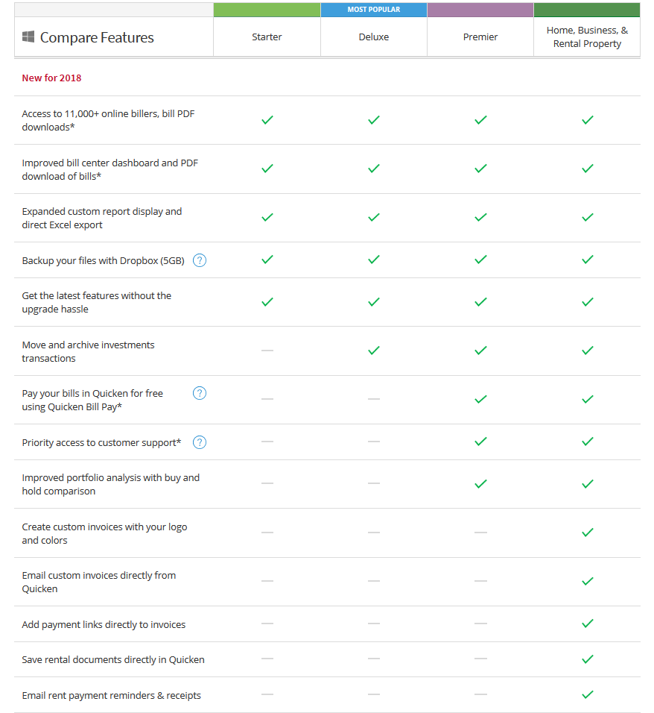

Slide 5
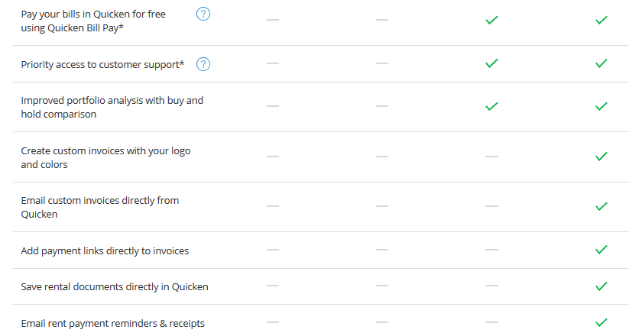

Slide 6
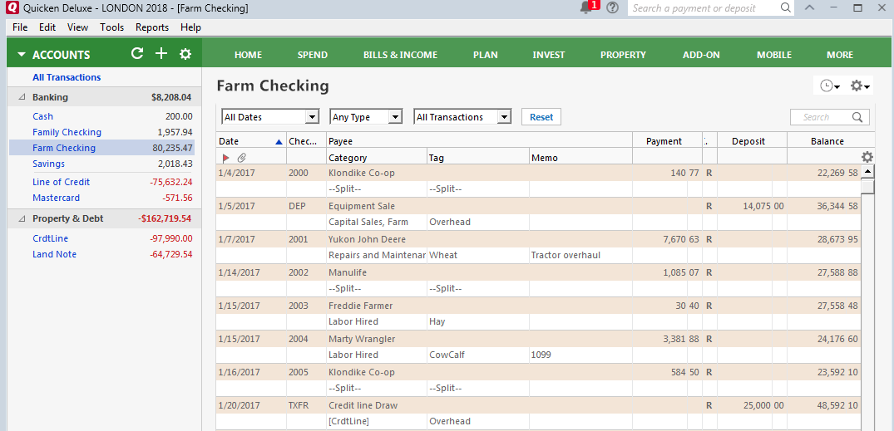
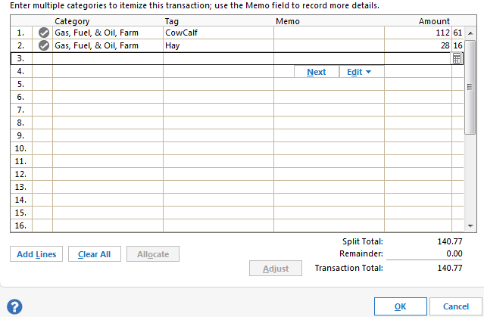
Notes:
I show the screen capture to point out where they will spend most of their time and walk through the menus, the ways to navigate and several sample transactions. For example, in the main menu line, File is the choice you make to access File operations such as import/export, backup, etc. Under Edit, you can change preferences. Reports provides quick links to many standard reports and graphs, e.g. cash flow, income/expense summaries, account balance. You can navigate to different accounts at left, access the financial calculators under Planning, use Account Actions button at the right to Reconcile your bank checking account, etc.

Slide 7
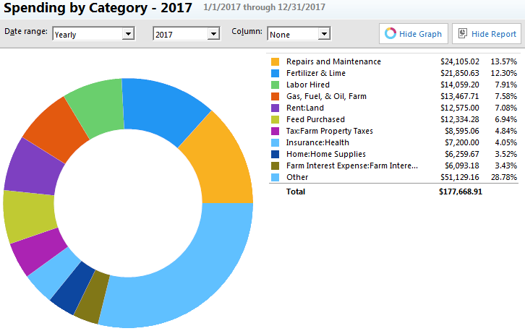
Quicken reports and graphs
Cash flow
Tax schedule
Transactions
Account balances
Comparison
Filtered
Memorized
Balance sheet
Notes:
This list of the kinds of default reports demonstrates the variety of things that can be generated with a couple of clicks of the mouse. In addition to the tables of numbers that you can generate, I also like the income and expense bar charts and this pie chart showing the top 10 expense categories for our sample file (the remainder are lumped together in the other, but when in Quicken you can click on the piece of the pie with your mouse and view the next 10).

Slide 8
OSU Quicken resources
Print materials plus video on-line at www.agecon.okstate.edu/quicken
$25 for printed notebook and CD with sample files
Quarterly Quick Tips farm management newsletter

Slide 9
Questions?

