Slide 1
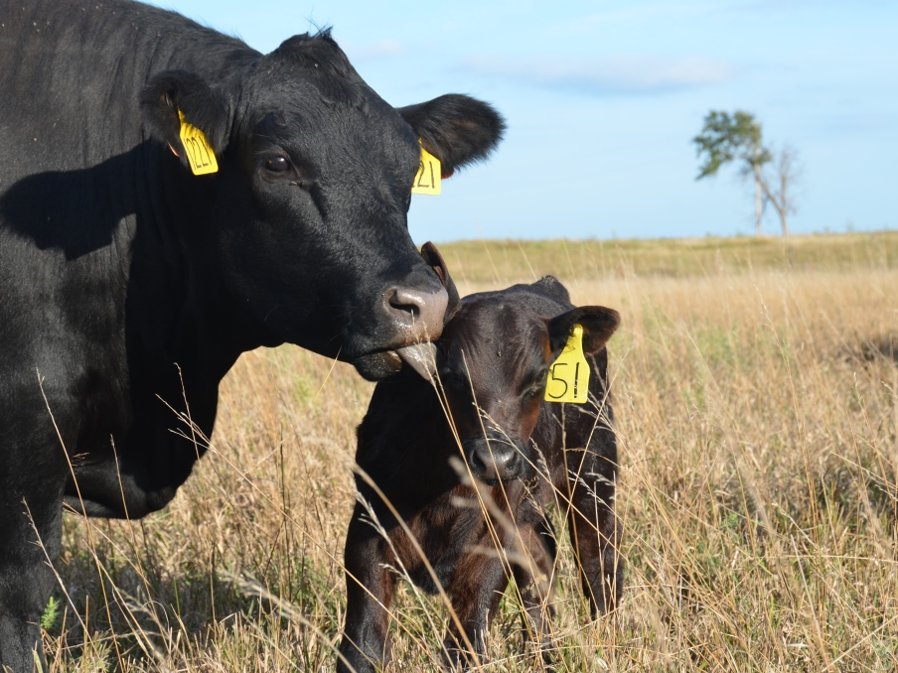

Cattle Market
Update
Derrell S. Peel
Breedlove Professor of Agribusiness and Extension Livestock Marketing Specialist
Oklahoma State University

Slide 2
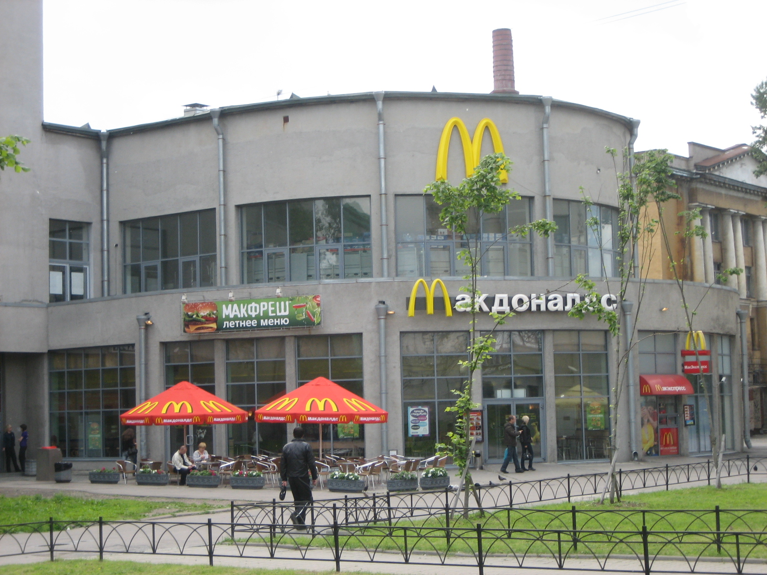
2018 Market Setting
Global
U.S. Economy
Agriculture
Cattle Industry

Slide 3

Global and Macroeconomic Environment
Changes
  Political
  Policy
Uncertainty
  Global Economy
  U.S. Economy
  Trade
    Exchange Rates
Volatility
  Markets
  Futures

Slide 4
Major Beef Market Factors
Cattle Inventory and Beef Production
Beef Demand
International Trade
Feed and Input Markets
Forage Conditions

Slide 5
Data Source: USDA-AMS
Livestock Marketing Information Center

Slide 6
Data Source: USDA-AMS
Livestock Marketing Information Center

Slide 7
Data Source: USDA-AMS
Livestock Marketing Information Center

Slide 8
Data Source: USDA-AMS
Livestock Marketing Information Center

Slide 9
Data Source: USDA-AMS
Livestock Marketing Information Center

Slide 10
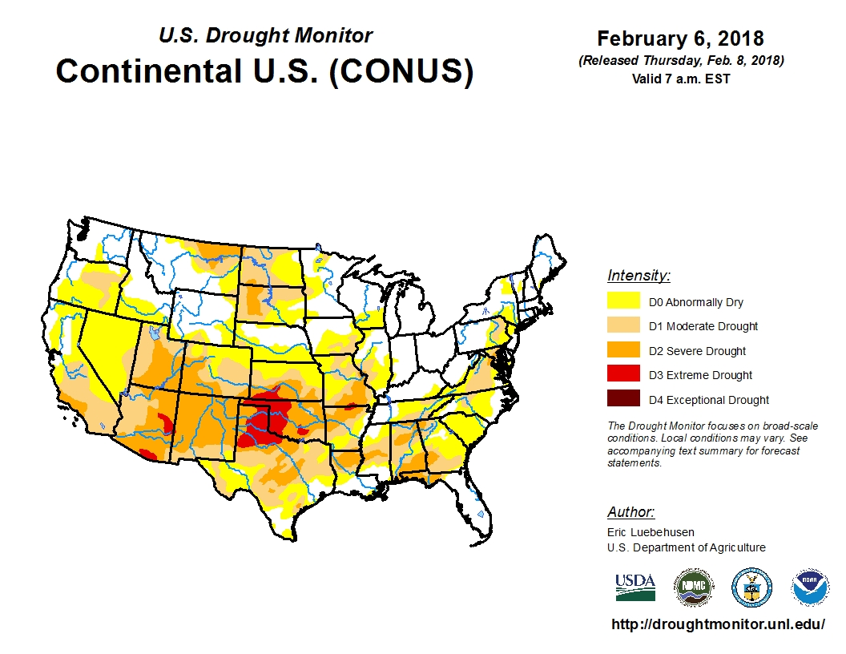

Slide 11
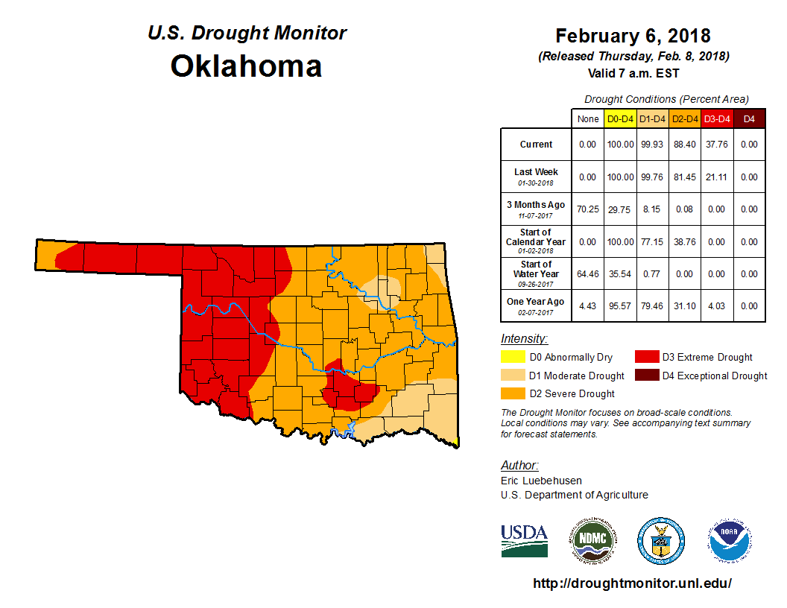

Slide 12
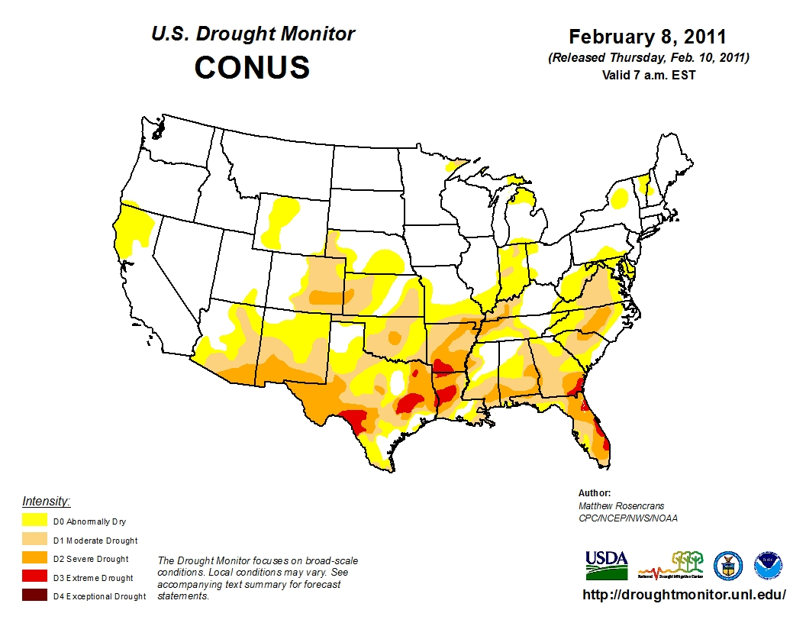

Slide 13
Summary
ENSO Alert System Status: La Niña Advisory
La Niña conditions are present.*
Equatorial sea surface temperatures (SSTs) are below average across the central and eastern Pacific Ocean.
La Niña is likely (~85-95%) through Northern Hemisphere winter, with a transition to ENSO-neutral expected during the spring.*
* Note: These statements are updated once a month (2nd Thursday of each month) in association with the ENSO Diagnostics Discussion, which can be found by clicking here.

Slide 14
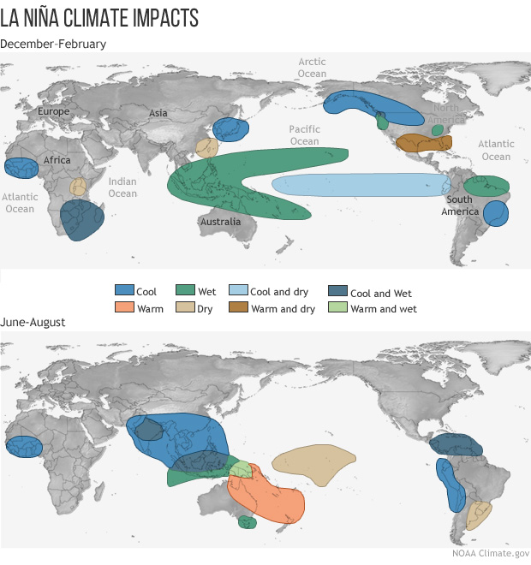

Slide 15
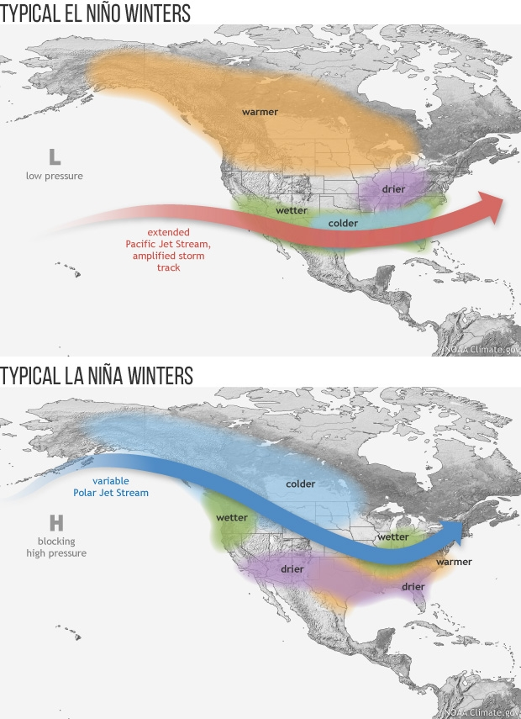

Slide 16
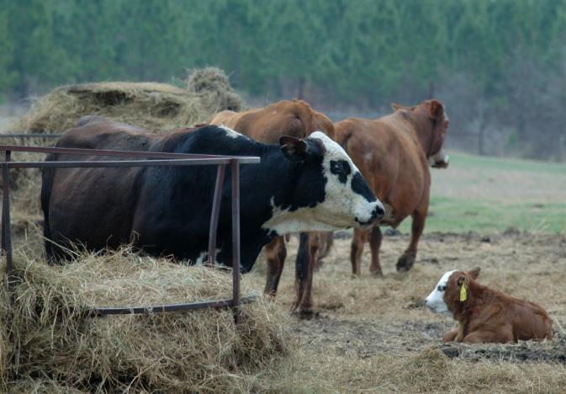
Hay Stocks, December 1
YOY Change
OK -15.8 %
TX -27.0 %
KS -15.1 %
AR -7.7 %
MO -4.7 %
U.S. -10.0 %

Slide 17
All Cattle and Calves, U.S.
Since 1867

Slide 18
U.S. Beef Cow Inventory
1955-2017

Slide 19
Data Source: USDA-NASS, Analysis by LMIC
Livestock Marketing Information Center

Slide 20
Beef Cow Inventory by Cycle
U.S., January 1
Livestock Marketing Information Center
Data Source: USDA-NASS, Compiled & Analysis by LMIC

Slide 21
U.S. Cattle Inventory
January 1
 | 2016 | 2017 | 2018 | % Change
 | 1000 Head | 1000 Head | 1000 Head
All Cattle and Calves | 91918 | 93704.6 | 94399.2 | +0.7
Beef Cows | 30165.8 | 31213.2 | 31723.0 | +1.6
Dairy Cows | 9310.4 | 9346.0 | 9399.6 | +0.6
Beef Replacements | 6340.2 | 6368.2 | 6131.2 | -3.7
Dairy Replacements | 4814.0 | 4754.0 | 4781.3 | +0.5
Feeder Supply | 25988.2 | 26712.6 | 26105.3 | -2.3
Cattle on Feed | 13157 | 13067.0 | 14006.4 | +7.2
 | 2015 | 2016 | 2017
Calf Crop | 34086.7 | 35092.7 | 35808.2 | +2.0

Slide 22
Data Source: USDA-NASS
Livestock Marketing Information Center

Slide 23
Beef Replacement Heifers as % of Beef Cows, January 1

Slide 24
Data Source: USDA-NASS
Livestock Marketing Information Center

Slide 25
Oklahoma Cattle Inventory
January 1
 | 2016 | 2017 | 2018 | % Change
 | 1000 Head | 1000 Head | 1000 Head
All Cattle and Calves | 4800 | 5000 | 5100 | +2.0
Beef Cows | 1923 | 2095 | 2131 | +1.7
Dairy Cows | 37 | 35 | 39 | +11.4
Beef Replacements | 460 | 435 | 410 | -5.7
Dairy Replacements | 25 | 20 | 25 | +25.0
Feeder Supply | 1930 | 1945 | 2010 | +3.3
Cattle on Feed | 280 | 310 | 330 | +6.5
 | 2015 | 2016 | 2017
Calf Crop | 1760 | 1870 | 1950 | +4.3

Slide 26
Oklahoma and U.S. Cattle Cycles:
Beef Cow Inventory, January 1

Slide 27
CHANGE IN BEEF COWS NUMBERS 2008 TO 2018
(1000 Head)
-36
-1
-6
61
-32
5
-2
-59
50
15
1
-2
-5
-9
-4
0
27
5
57
1
0
0
0
5
-27
85
-30
-26
2
0
-59
-2
96
-126
-169
-2
3
-8
-37
78
-19
-18
2
47
-68
-565
-40
-1
-54
-760 to -33
-33 to -10
-8
-10 to 6
6 to 105
Livestock Marketing Information Center
Data Source: USDA-NASS

Slide 28
January 1, 2018
1000 Head (% of last year)
All Cattle and Calves Cattle on Feed
1 TX 12,500 (102)
2 NE 6,800 (105)
3 KS 6,300 (98)
4 CA 5,200 (101)
5 OK 5,100 (102)
6 MO 4,450 (102)
7/8 IA 4,000 (103)
7/8 SD 4,000 (104)
9 WI 3,500 (99)
10 CO 2,850 (100)
1 NE 2,770 (112)
2 TX 2,650 (109)
3 KS 2,450 (107)
4 IA 1,260 (109)
5 CO 1,000 (106)
6 CA 490 (114)
7 SD 430 (113)
8 MN 395 (105)
9 OK 330 (106)
10 WI 280 (104)

Slide 29
Cattle on Feed Inventory
January 1

Slide 30
January 1, 2018
1000 Head (% of last year)
Beef Cows Beef Heifers
1 TX 4,585 (103)
2 MO 2166 (105)
3 OK 2,131 (102)
4 NE 1,910 (99)
5 SD 1,801 (108)
6 KS 1,507 (96)
7 MT 1,497 (101)
8 KY 1,033 (101)
9 ND 985 (103)
10 IA 970 (101)
1 TX 800 (99)
2 SD 435 (110)
3 OK 410 (94)
4 MT 390 (92)
5 NE 375 (100)
6 MO 365 (99)
7 KS 280 (90)
8 ND 191 (93)
9 CO 180 (95)
10 IA 165 (89)

Slide 31
January 1, 2018
1000 Head (% of last year)
Feeder Supply Stocker Ratio
1 TX 3,360 (96)
2 OK 2,010 (103)
3 KS 1,675 (89)
4 MO 1,585 (101)
5 NE 1,560 (105)
6 CA 1,325 (98)
7 IA 1,180 (101)
8 SD 1,060 (92)
9 WI 850 (96)
10 KY 793 (98)
0.764
1.031
1.171
0.793
0.918
0.705
1.083
0.576
0.594
0.801
Stocker Ratio = Feeder Supply / Calf Crop:
U.S. Ave. = 0.729

Slide 32
Data Source: USDA-NASS
Livestock Marketing Information Center

Slide 33
Data Source: USDA-NASS
Livestock Marketing Information Center

Slide 34
Data Source: USDA-NASS, Compiled by LMIC
Livestock Marketing Information Center

Slide 35
Data Source: USDA-NASS
Livestock Marketing Information Center

Slide 36
Livestock Marketing Information Center
Data Source: USDA-NASS, Compiled & Analysis by LMIC

Slide 37
Livestock Marketing Information Center
Data Source: USDA-NASS, Compiled & Analysis by LMIC

Slide 38
Monthly Placements and Cattle on Feed
12 Month Moving Ave.

Slide 39
Cattle Slaughter
Federally Inspected, 1000 Head
 | 2016 | 2017 | % Change 2016 to 2017 | % Change 2017 to 2018
Steers | 16495 | 16771 | +1.7
Heifers | 7698 | 8611 | +11.9
Dairy Cows | 2886 | 2988 | +3.6
Beef Cows | 2543 | 2784 | +9.5
Bulls | 494 | 550 | +11.4
Total | 30115 | 31771 | +5.3
Latest data: Annual 2017

Slide 40
Steer to Heifer Slaughter Ratio
12 month MA
Latest: November 2017

Slide 41
Data Source: USDA-AMS & USDA-NASS
Livestock Marketing Information Center

Slide 42
2018 Meat Production and Consumption
 | Production |  |  |  |  | Consum. Change | Consum. Per Capita | Consum. Change
 | 2016 | 2017 | 2016-2017 | 2018 | 2017- 2018 | 2016-2017 | 2018 | 2017-2018
 | Million lbs. | Million lbs. | % Change | Million lbs. | % Change | % Change | Retail Lbs. | % Change
Beef | 25221 | 26173 | +3.8 | 27417 | +4.8 | +2.5 | 58.3 | +2.3
Pork | 24941 | 25581 | +2.6 | 26511 | +3.6 | +0.4 | 51.0 | +1.4
Broilers | 40261 | 41213 | +2.4 | 42612 | +3.4 | +1.3 | 94.1 | +3.4
Total | 97193 | 99717 | +2.6 | 103141 | +3.4 | +1.3 | 221.8 | +2.2
2018 forecast
LMIC, January 30, 2018

Slide 43
Data Source: USDA-AMS, Compiled by LMIC
Livestock Marketing Information Center

Slide 44
Data Source: USDA-ERS

Slide 45
Livestock Marketing Information Center
Data Source: USDA-AMS & USDA-NASS, Compiled & Analysis by LMIC
November, 2017

Slide 46
Commercial Beef Production >>>
Beef Cow Inventory >>>
Livestock Marketing Information Center
Data Source: USDA-NASS, Compiled & Analysis by LMIC and Derrell Peel
2017 Beef Production projected;
2018 Production & Inventory forecast

Slide 47
Data Source: USDA-NASS, Compiled & Analysis by LMIC
Livestock Marketing Information Center

Slide 48
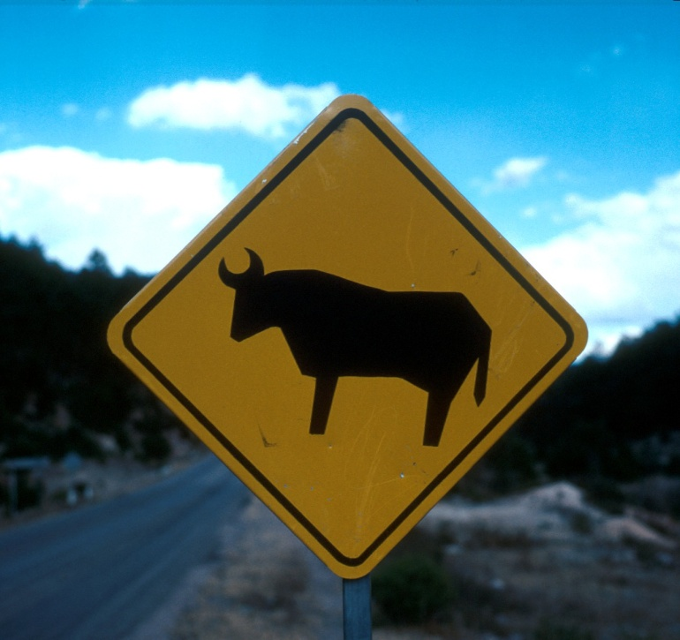

Slide 49
Major Beef Producing and Consuming Countries, 2018 Projected
PRODUCTION
USA
Brazil
EU
China
India
Argentina
Australia
Mexico
Pakistan
Turkey
CONSUMPTION
USA
China
Brazil
EU
Argentina
India
Mexico
Russia
Pakistan
Turkey
Source: USDA-FAS, Oct 2017

Slide 50
Data Source: USDA-FAS
Livestock Marketing Information Center

Slide 51
Major Beef Trading Countries,
2018 Projected
EXPORTS
India
Brazil
Australia
USA
New Zealand
Canada
Uruguay
EU
Paraguay
Argentina
IMPORTS
USA
China
Japan
South Korea
Russia
Hong Kong
EU
Chile
Egypt
Canada
Source: USDA-FAS, Oct 2017

Slide 52
Data Source: USDA-FAS

Slide 53
India: Beef Exports

Slide 54
Mexico: Beef Exports

Slide 55
China: Beef Imports

Slide 56
Data Source: USDA-FAS

Slide 57
U.S. Beef Exports
 | 2015 (1000 lbs.) | % Change 2014 to 2015 | 2016 (1000 lbs.) | % Change 2015 to 2016 | % of Total Exports | YTD % Of 2016
Japan | 538353 | -18.7 | 655516 | +21.7 | 28.9 | +26.1
Mexico | 363023 | -16.6 | 393811 | +8.6 | 14.7 | +6.2
Hong Kong | 315784 | -24.1 | 293693 | -6.9 | 11.7 | +14.3
Canada | 323774 | -11.1 | 308234 | -4.7 | 10.9 | +1.2
S. Korea | 318809 | +5.9 | 454680 | +42.6 | 16.5 | +3.0
Total | 2265950 | -11.9 | 2549810 | +12.6 |  | +12.0
YTD: Jan-Dec

Slide 58
U.S. Beef Exports
Major Markets

Slide 59
Data Source: USDA-ERS & USDA-FAS, Compiled and Forecasts by LMIC
Livestock Marketing Information Center

Slide 60
Data Source: USDA-AMS
Livestock Marketing Information Center

Slide 61
U.S. Beef Imports
 | 2015 (1000 lbs.) | % Change 2014 to 2015 | 2016 (1000 lbs.) | % Change 2015 to 2016 | % of Total Imports | 2017 YTD % of 2016
Australia | 1258266 | +16.2 | 767142 | -39.0 | +23.2 | -9.4
Canada | 628397 | +4.4 | 718063 | +14.3 | +24.7 | +3.2
New Zealand | 661287 | +10.7 | 613121 | -7.3 | +18.6 | -9.1
Mexico | 391937 | +26.4 | 493446 | +25.9 | +19.2 | +16.2
Brazil | 149580 | +83.6 | 152142 | +2.1 | +4.6 | -9.3
Total | 3370484 | +14.4 | 3015673 | -10.5 |  | -0.7
YTD: Jan-Nov

Slide 62
U.S. Beef Imports
Major Markets

Slide 63
Data Source: USDA-ERS & USDA-FAS, Compiled and Forecasts by LMIC
Livestock Marketing Information Center

Slide 64
Data Source: USDA-ERS & USDA-FAS
Livestock Marketing Information Center

Slide 65
Data Source: USDA-ERS & USDA-FAS
Livestock Marketing Information Center

Slide 66
Data Source: USDA-AMS, Compiled and Forecasts by LMIC
Livestock Marketing Information Center

Slide 67
2018 Cattle Price Forecasts
 |  | Feeder Steer Price (Southern Plains) |  |  |  | Fed Steer
 |  | 5-600 lb. ($/cwt.) | % chg from Last Year | 7-800 lb. ($/cwt.) | % chg from Last Year | 5-mkt avg. ($/cwt) | % chg from Last Year
2017 | III | 165.47 | +5.3 | 153.36 | +6.4 | 112.47 | -0.7
 | IV | 170.66 | +23.3 | 157.13 | +21.2 | 117.88 | +9.2
 | Annual | 166.00 | 0.0 | 148.17 | +2.1 | 121.52 | +0.5
2018 | I | 168-172 | +8.0 | 148-151 | +12.5 | 120-122 | -1.6
 | II | 166-171 | -1.2 | 145-149 | -1.5 | 121-124 | -7.7
 | III | 159-165 | -2.1 | 140-145 | -7.1 | 107-111 | -3.1
 | IV | 151-158 | -9.5 | 138-144 | -10.3 | 110-116 | -4.1
 | Annual | 161-167 | -1.2 | 143-147 | -2.1 | 115-118 | -4.1
LMIC, February 7, 2017

Slide 68
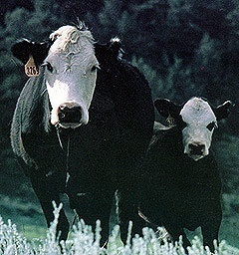

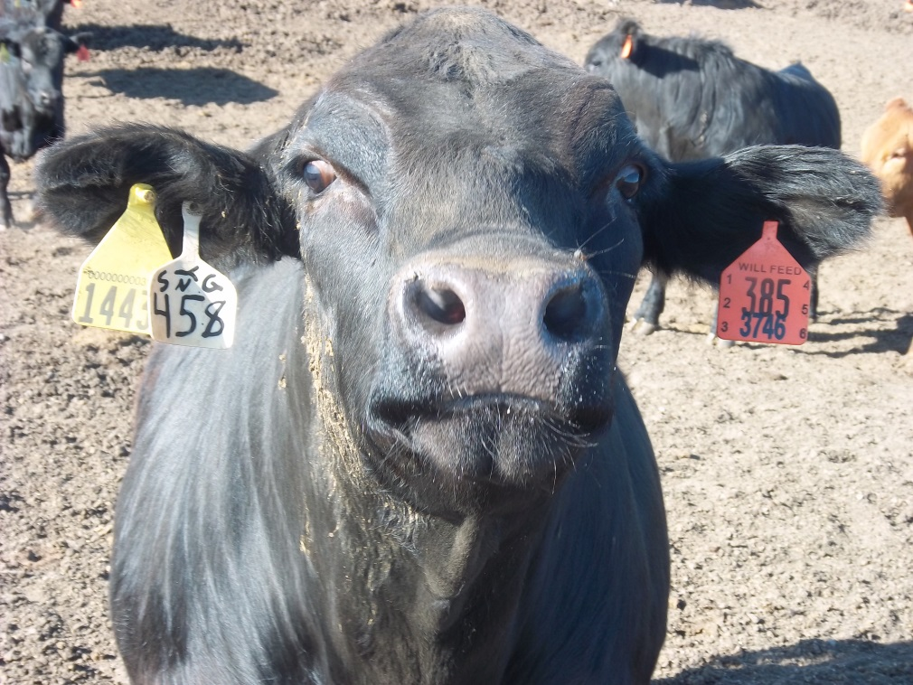
The Weekly Email Newsletter
From OSU Animal Science and Agricultural Economics
Send Email to derrell.peel@okstate.edu

Slide 70
Price-Weight Relationship
Medium/Large No. 1 Steers, Oklahoma

Slide 71
Steer Price, Total Value and Value of Gain
December 8, 2017, 7 Mkt. Ave., Oklahoma
Weight (lbs) | Average Price ($/cwt.) | Total Value ($/hd) | VOG 400 lb. Beg. Weight ($/lb.) | VOG 450 lb. Beg. Weight ($/lb | VOG 500 lb. Beg. Weight ($/lb.) | VOG 550 lb. Beg. Weight ($/lb.) | VOG 600 lb. Beg. Weight ($/lb.) | VOG 650 lb. Beg. Weight ($/lb.)
400 | $191.45 | $766
450 | $184.46 | $830 | $1.28
500 | $177.78 | $889 | $1.23 | $1.18
550 | $167.09 | $919 | $1.02 | $0.89 | $0.60
600 | $161.75 | $970 | $1.02 | $0.94 | $0.82 | $1.03
650 | $159.77 | $1,039 | $1.09 | $1.04 | $1.00 | $1.20 | $1.36
700 | $156.35 | $1,094 | $1.10 | $1.06 | $1.03 | $1.17 | $1.24 | $1.12
750 | $154.03 | $1,155 | $1.11 | $1.08 | $1.07 | $1.18 | $1.23 | $1.17
800 | $151.38 | $1,211 | $1.11 | $1.09 | $1.07 | $1.17 | $1.20 | $1.15
850 | $148.68 | $1,264 | $1.11 | $1.08 | $1.07 | $1.15 | $1.17 | $1.13
900 | $148.38 | $1,335 | $1.14 | $1.12 | $1.12 | $1.19 | $1.22 | $1.19

Slide 72
Price-Weight Relationship
Medium/Large No. 1 Steers, Oklahoma

Slide 73
Steer Price, Total Value and Value of Gain
August 11, 2017, 7 Mkt. Ave., Oklahoma
Weight (lbs) | Average Price ($/cwt.) | Total Value ($/hd) | VOG 400 lb. Beg. Weight ($/lb.) | VOG 450 lb. Beg. Weight ($/lb | VOG 500 lb. Beg. Weight ($/lb.) | VOG 550 lb. Beg. Weight ($/lb.) | VOG 600 lb. Beg. Weight ($/lb.) | VOG 650 lb. Beg. Weight ($/lb.)
400 | $180.95 | $724
450 | $178.59 | $804 | $1.60
500 | $170.91 | $855 | $1.31 | $1.02
550 | $161.93 | $891 | $1.11 | $0.87 | $0.72
600 | $158.36 | $950 | $1.13 | $0.98 | $0.96 | $1.19
650 | $155.49 | $1,011 | $1.15 | $1.04 | $1.04 | $1.20 | $1.21
700 | $152.03 | $1,064 | $1.13 | $1.04 | $1.05 | $1.16 | $1.14 | $1.07
750 | $146.46 | $1,098 | $1.07 | $0.98 | $0.98 | $1.04 | $0.99 | $0.88
800 | $141.97 | $1,136 | $1.03 | $0.95 | $0.94 | $0.98 | $0.93 | $0.83
850 | $139.41 | $1,185 | $1.02 | $0.95 | $0.94 | $0.98 | $0.94 | $0.87
900 | $134.18 | $1,208 | $0.97 | $0.90 | $0.88 | $0.91 | $0.86 | $0.79

Slide 74
Price-Weight Relationship
Medium/Large No. 1 Steers, Oklahoma

Slide 75
Steer Price, Total Value and Value of Gain
November 3, 2017, 7 Mkt. Ave., Oklahoma
Weight (lbs) | Average Price ($/cwt.) | Total Value ($/hd) | VOG 400 lb. Beg. Weight ($/lb.) | VOG 450 lb. Beg. Weight ($/lb | VOG 500 lb. Beg. Weight ($/lb.) | VOG 550 lb. Beg. Weight ($/lb.) | VOG 600 lb. Beg. Weight ($/lb.) | VOG 650 lb. Beg. Weight ($/lb.)
400 | $192.70 | $771
450 | $181.75 | $818 | $0.94
500 | $173.82 | $869 | $0.98 | $1.02
550 | $167.02 | $919 | $0.99 | $1.01 | $0.99
600 | $164.21 | $985 | $1.07 | $1.12 | $1.16 | $1.33
650 | $163.04 | $1,060 | $1.16 | $1.21 | $1.27 | $1.41 | $1.49
700 | $162.83 | $1,140 | $1.23 | $1.29 | $1.35 | $1.47 | $1.55 | $1.60
750 | $163.30 | $1,225 | $1.30 | $1.36 | $1.42 | $1.53 | $1.60 | $1.65
800 | $161.23 | $1,290 | $1.30 | $1.35 | $1.40 | $1.48 | $1.52 | $1.53
850 | $157.80 | $1,341 | $1.27 | $1.31 | $1.35 | $1.41 | $1.42 | $1.41
900 | $152.96 | $1,377 | $1.21 | $1.24 | $1.27 | $1.31 | $1.30 | $1.27

Slide 76
Price-Weight Relationship
Medium/Large No. 1 Steers, Oklahoma

Slide 79
Heifer Discount to Steer Price
2000-2016, Oklahoma Auctions

Slide 80
Heifer Discount to Steer Price
Average by Month, Oklahoma Auctions, 2000-2016

Slide 82
Feeder Price Slide
% by Weight

Slide 83
Price Slide Example
  475 lb. Steer = $170/cwt.
  Price Slide = 9 %
  $170 x .09 = $15.3/cwt.
  Price adjustment for 505 lbs. or 30 lbs. heavier
    $15.3 x .30 = $4.59/cwt.
    505 lb. Steer price = $170 - $4.59 = $165.41/cwt.

Slide 84
Price Slide Variation by Price
475 lb. Steers
  Price Slide = 9 %
  $125/cwt. Price Slide = $11.25/cwt.
  $175/cwt. Price Slide = $15.75/cwt.
  $225/cwt. Price Slide = $20.25/cwt.

