Slide 1
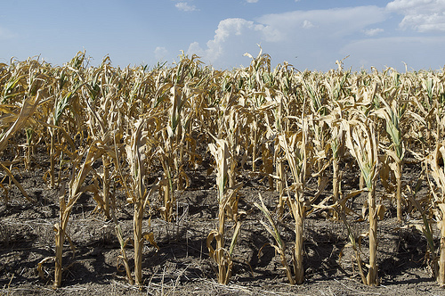
Drought Response Webinar
Trent Milacek
NW Area Ag Econ Specialist

Slide 2
Rely on Assistance
Take advantage of government programs
ARC, PLC, SCO, STAX, NAP, Cost-Share, etc. –Programs may change in new farm bill
FSA, NRCS, OSU are there to help
Utilize crop insurance to the fullest extent, a good agent can help minimize premiums while maximizing coverage

Slide 3
Take Stock of Your Operation
Many of the goals and preventative measures apply to cropland just like livestock
Conduct a SWOT analysis of your operation
Drought conditions require adaptation
Develop budgets for new crop enterprises and discuss goals with stakeholders

Slide 4
Likely Occurrences
Decreased profitability due to lower yields (prices can go up)
Change in crops (what is your learning curve?)
Increased LOC requirements
Farmland that may become increasingly unprofitable

Slide 5
Need for Caution
Adopting new cropping practices can reduce overall revenue
Be vigilant in attempting to maximize revenue across the entire operation
Take advantage of things like milo stalks for extra income
Budget in order to discuss your plan with the banker

Slide 6
Examples of crop rotation
Wheat → Canola → Wheat → Grain Sorghum → Wheat → Soybeans
Wheat → Soybeans → Wheat → Grain Sorghum → Graze Stalks
Grazeout → Sesame → Grain Sorghum → Graze Stalks
Grazeout → Grain Sorghum → Grazeout → Sesame → Wheat
Grazeout → Cotton → Grain Sorghum → Graze Stalks → Sesame

Slide 7
Crop Rotation Goals
Reduce water requirements
Distribute income generation over more of the growing season
Reduce LOC draws
Increase income opportunities in the face of lower production

Slide 8
OSU Enterprise Budgeting and Resources
http://agecon.okstate.edu/budgets/
http://www.agecon.okstate.edu/budgets/sample_pdf_files.asp
http://pods.dasnr.okstate.edu/docushare/dsweb/Get/Document-6752/CR-205%202017-2018web.pdf
http://aglandlease.info/

Slide 9
Grasp the Advantages
Soil Sampling is essential to determine what nutrients are left over
Opportunities for curbing problem weed outbreaks –be aware of possible herbicide carryover in drought conditions
https://www.ag.ndsu.edu/drought/crops/herbicide-concerns-after-a-drought
Prices could increase giving opportunities to market stored commodities or to adjust stocking rates

Slide 10
Final Thoughts
Planning for a crop is like trying to plan a disaster
Use marginal budgeting to mitigate adverse effects
It is very difficult to plan more than a year ahead
Adaption and a strong liquidity position will make it easier

Slide 11
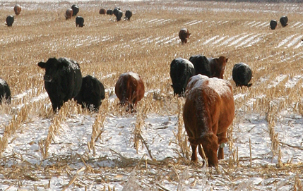
Questions?
Link to Survey
https://okstatecasnr.az1.qualtrics.com/jfe/form/SV_emueRQmka5prH1z

