Slide 1
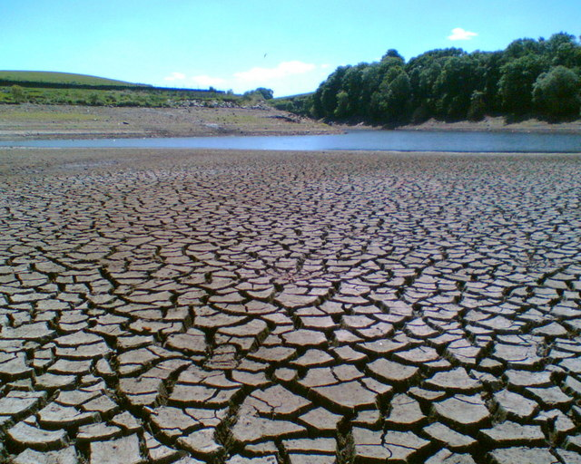
Drought Preparedness
Being ready for one
before one happens

Slide 2
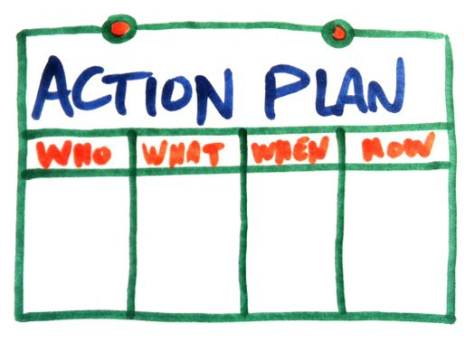
Drought Preparedness
The best way to survive a drought is to make a plan not be forced into one.

Slide 3
Everyone’s Situation is Different
Pasture condition & Hay supplies
Financial Status
  Money available
  Loan payments associated with the operation
  Loan payoffs
  Ability to borrow
Amount of risk
  Personally
  Financially

Slide 4

Before You Choose A Plan?
Must determine five aspects of your operation
  Financial Situation?
    Current cost of production
    Money available for drought plan
    Financing available if needed
  How much can you afford?
    How much are you willing to spend
    Ties back to cost of production
  What are your goals?
  Ability to tolerate risk?
    Financial
    Personal

Slide 5

Ability to Tolerate Risk
Personally
  Time
    Hunt for hay & feed
    For the extra management required
  Tolerance
    Darkest before the dawn
Financially
  How long?
  How much?

Slide 6
Data Source: USDA & LMIC, Compiled by LMIC
Livestock Marketing Information Center

Slide 7
PERCENT CHANGE DECEMBER 1 HAY STOCKS
(2016-2017)
-23%
45%
-10%
-29%
-19%
-37%
20%
-26%
-15%
-17%
8%
20%
11%
-11%
-17%
25%
-8%
-14%
9%
15%
0%
19%
7%
0%
-4%
6%
0%
35%
-15%
9%
-9%
0%
-5%
-3%
-2%
-27%
-3%
-22%
0%
-16%
-8%
3%
8%
48%
31%
-27%
-21%
-11%
-100% to -15%
-15% to -3%
-3% to 9%
9% to 49%
Livestock Marketing Information Center
Data Source: USDA-NASS

Slide 8
Drought Management Example
Cow/Calf Operation
700 ac Pasture 200 ac Bermuda 500 ac Native
175 ac Hay Bermuda
100 Cows English x Continental 1100 lbs
85% Calf Crop Buy Replacements
Spring Calving
Weaning Weights Steers – 500lbs Heifers – 475 lbs
Feeding Period Nov 1 – April 1

Slide 9
Situation
Hay shortage
Only expect 45% of normal production.
Normal 700 bales
Expected 315 bales
Shortage
Pasture Shortage
No pasture past October 1.
Hay needed
110 bales
385 bales
Total hay needed:
+
=
495 bales
Total cost of hay:
495 bales
x
$45/bale
=
$22,275 or $223/cow

Slide 10

Other Thoughts
At today’s cull cow prices one 1100 lbs. cow will pay for the hay of 3 cows.
  A simple reduction of 25% may pay for the plan
  Loan and tax considerations will have to be evaluated.
A decrease of 1 calf, costs the producer the value of that calf plus the annual cow cost.
  Today’s market for 500 lbs. steer $830 + $700 = $1,530
What now!

Slide 11
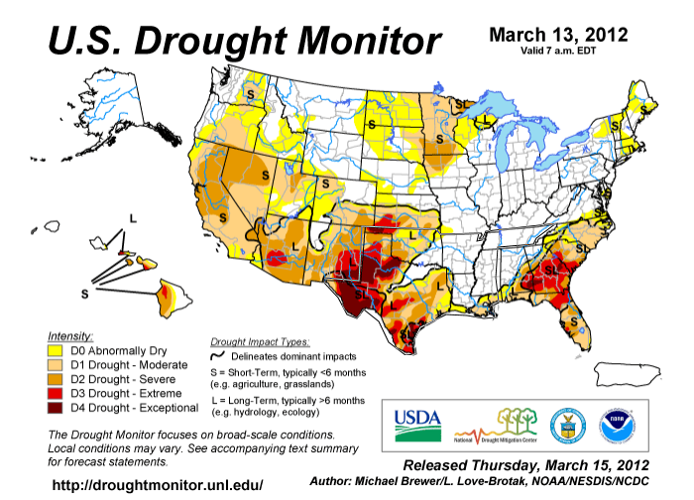
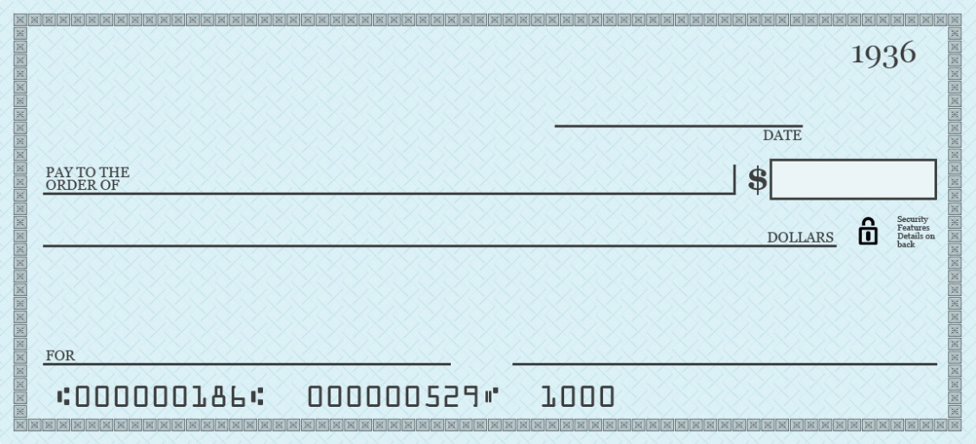
Livestock Forage Disaster Program (LFP)
Covers grazing losses due to drought, as determined by the intensity level of the U.S. Drought Monitor
  Payments are 1, 2, or 3 monthly payments, depending on the intensity of the drought
Rate is 60% of the lesser of
  Feed grain equivalent (See Chart)
  Monthly feed cost based on normal grazing land carrying capacity (2-3 acres/animal unit)
Eligible drought must occur during eligible growing periods for the type of pasture provided.
  Warm season – April 15 to November 14
  Cool season – November 15 to April 14
USDA
2018
Oklahoma Livestock Producer
$$$$$$
More Money, More Money, More Money
Federal Government

Slide 12

Eligible Producers
Own, cash or share lease, or be a contract grower of eligible livestock for 60 days before beginning date of qualifying drought.
Provide pasture for eligible livestock, including cash-rented pastures that is either
  Located in county affected by qualifying drought
  Rangeland managed by a federal agency
Certify that they have suffered a grazing loss
Timely file an acreage report for all grazing land for which a loss of grazing is being claimed.
Payment Limits
  Payments are limited to $125,000 for LFP, Emergency Assistance
  for Livestock, Honeybees and Farm-Raised Fish Program (ELAP)
  and Livestock Indemnity Program (LIP) combined

Slide 13
Drought Loss Categories
Payments are based upon different levels or drought severity.
Drought Level | Time Period¹ | Payment/Animal Unit^{2,3,4}
D2 – Severe Drought | 8 Consecutive Weeks | 1 Month
D3 – Extreme Drought | Any Time | 3 Months
D3 – Extreme Drought | 4 Weeks | 4 Months
D4 – Exceptional Drought | Any Time | 4 Months
D4 – Exceptional Drought | 4 Weeks | 5 Months
1 – Drought must occur during the forage types defined growing season. Summer Forage – April 15 to Nov 14 Winter Forage – November 15 to April 14 2 – Monthly payment amount as determined by USDA. 3 – Animal units can not exceed USDA allowable stocking rates. 4 – Payment is 60% of USDA estimated feed costs.

Slide 14
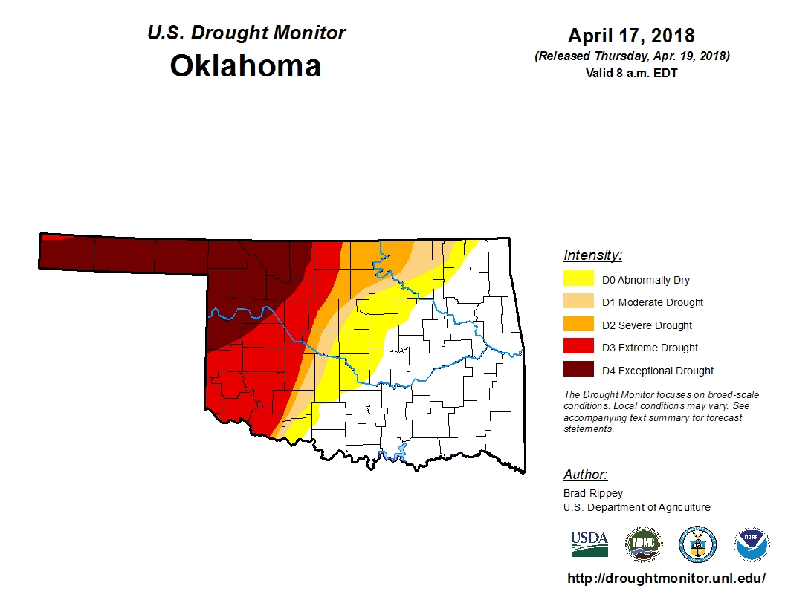

Slide 15
Kind | Type | Weight Range | Payment Rate Per Head
 |  |  | 2013 | 2014 | 2015 | 2016 | 2017
Beef | Adult | Bull, Cows | $57.27 | $52.26 | $40.79 | $32.36 | $30.00
 | Non Adult | 500 lbs. or more | $42.96 | $39.42 | $30.59 | $24.27 | $22.50
Dairy | Adult | Bull, Cows | $148.90 | $136.66 | $106.05 | $84.14 | $78.00
 | Non Adult | 500 lbs. or more | $42.96 | $39.42 | $30.59 | $24.27 | $22.50
Sheep | All |  | $14.32 | $13.14 | $10.20 | $8.09 | $7.50
Goats | All |  | $14.32 | $13.14 | $10.20 | $8.09 | $7.50
Equine | All |  | $42.38 | $38.90 | $30.18 | $23.95 | $22.20
Payment Rate is 60% of these estimates.
For example the payment for adult beef cows for 2017 would be $30 X .6 = $18.00/month/cow
Payment rate for 2018 is expected to be at or just below 2017.
Payment also limited to approved stocking rates
Stocking rate is 2 to 3 acres per animal unit
Minimum Maximum
$18 cow $90 cow

Slide 16
Drought Tax Options
There are two tax options available to producers who are forced to sell livestock because of a drought.
451 (e) – Allows producers to defer the revenue from the sale of any type of livestock for one year.
  Example: Normally one calf crop per year. Because of drought sold two calf crops. Can defer the sell of the second calf crop for one tax year.
1033 (e) – Allows producers to postpone the revenue from selling breeding animals until the tax year that those animals are replaced.
  Producers typically have 2 years to replace sold breeding animals, but can be extended to 4 if drought persists.
  Must buy same like kind

