Slide 1
Tariffs &
Trade-related Issues
Larry D. Sanders
Spring 2018

Slide 2
Tariffs
Government-imposed taxes on selected imported goods
  Imported goods are what we buy from other countries
Usually intended to protect selected domestic markets

Slide 3

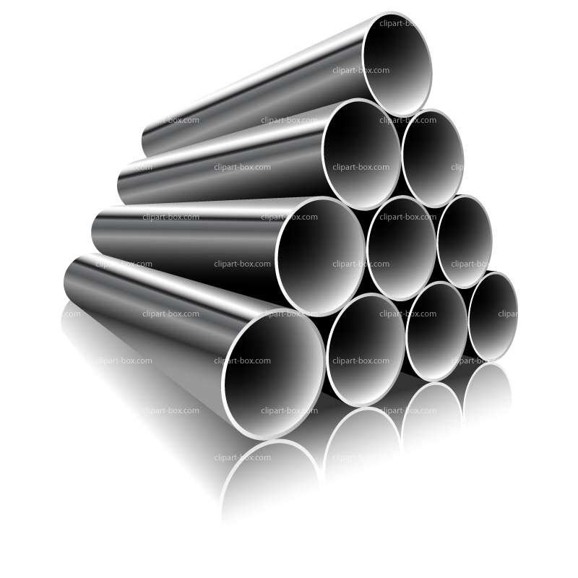
Tariff-free (tax-free) exchanges…
$$$$$$

Slide 4


Market with
Protective
tariffs
???
$$$
$$$
$$$$

Slide 5




Retaliation:
Trade Wars
$$$
$$$$

Slide 6
Protectionism failed to live up to promise of better times for farmers in early 20th century
Dems for free trade; Repubs for tariffs (hope of higher farm prices and more govt revenue)
1928 Hoover campaigned to raise tariffs on farm commodities
  kept domestic prices higher than world prices
  “Price supports without production controls”
1930 Smoot-Hawley Tariff Act spread tariffs across industrial spectrum (1921-25 average rate on imports 15%; 1931-35= 50%; exports dropped from $5.2 b. 1929 to $1.7 b. 1933; wheat, cotton, tobacco, lumber hit hardest)
Retaliation by other countries made depression worse
1934 Reciprocal Trade Agreement Act cut tariffs w/countries in bilateral trade agreements

Slide 7
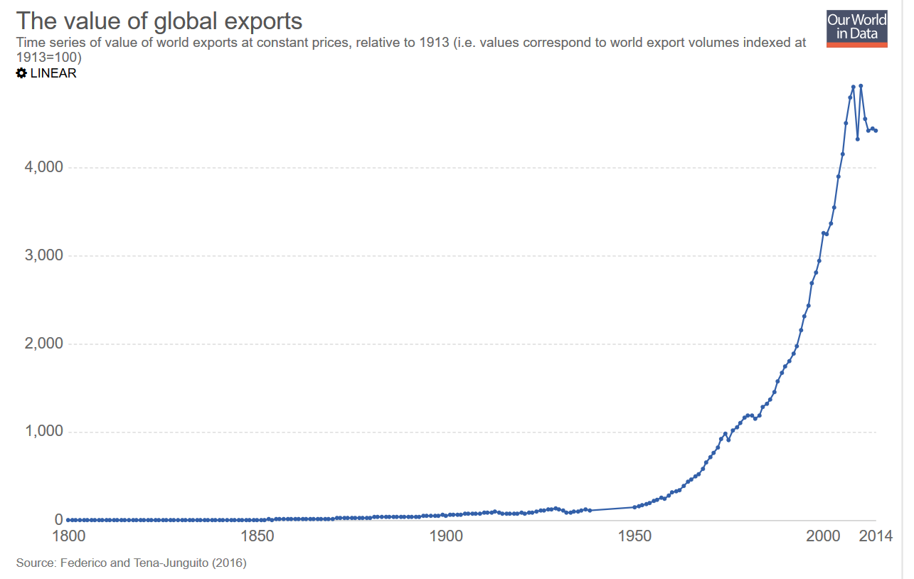
GATT began to cut tariffs world-wide

Slide 8
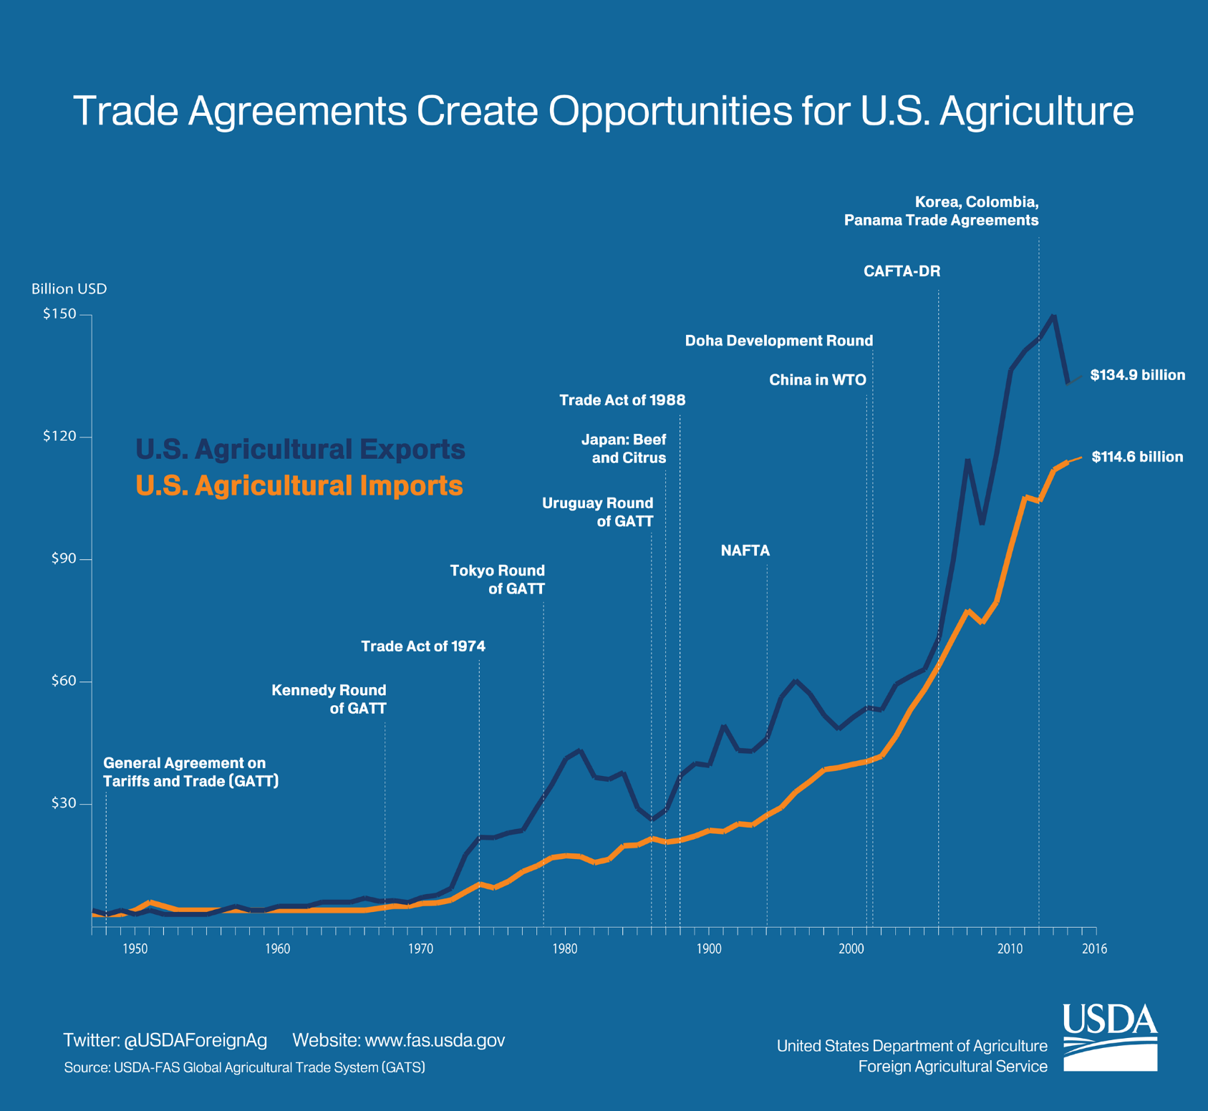
https://www.fas.usda.gov/sites/default/files/2017-05/graphic_2_1.png

Slide 9
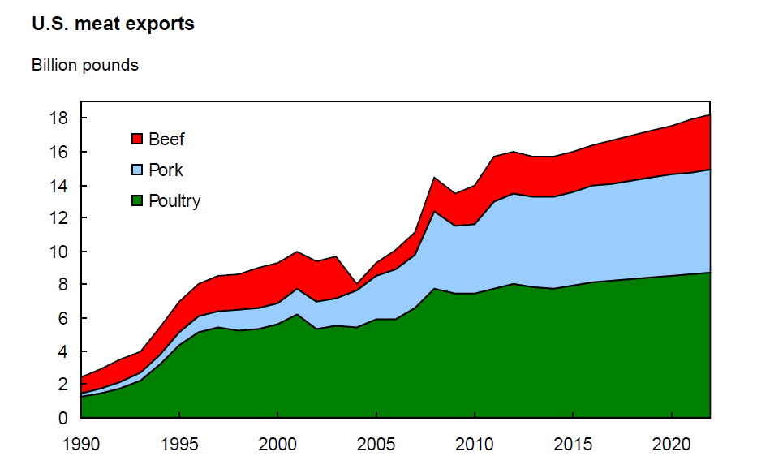
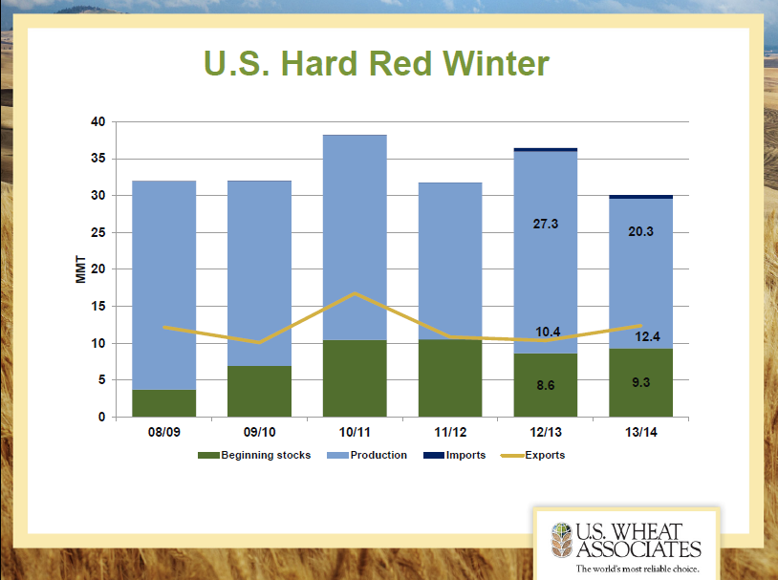
Source: Mickey Paggi, CSU-Fresno

Slide 10
TRADE AGREEMENTS & TARIFFS
US Agriculture has a 50-year history of benefitting from trade agreements and reducing tariffs
Tariffs generally do more harm than good
Trump tariffs likely to hurt US consumers and farmers
Tariffs may produce short term gains for targeted sectors
Lose-Lose in long term

Slide 11
Tariff Issues: 2 sets of tariffs
First: Trump announced tariffs on steel and aluminum
  Exempts Canada (#1 source of steel /aluminum) & Mexico (#4 source of steel); some others
  Tariffs are a tax on what we buy from other countries
  Intention is to protect US industries

Slide 12
Tariff Issues: 2 sets of tariffs
Second: Trump announced tariffs on China because of intellectual property theft/abuse by Chinese companies
  $50 bil. In Chinese imports
    Consumer electronics
    Tires/rubber
    Automotive parts
    Machinery (tools, etc.)

Slide 13
US Ag Exports to China
China proposes to levy retaliatory tariffs (15-25%) on $3 bil. In US food/ag exports:
Pork/products
Horticultural products (fresh/dried fruits; tree nuts)
Wine
Ginseng
Denatured ethanol
Key exports | 2017 ($ mil.)
Soybeans | 14653
Forest products | 3001
Fish products | 1146
Hides/skins | 962
Cotton | 953
Coarse grains | 872
Pork/products | 676
Dairy | 548
Wheat | 373
Hay | 353
Feeds | 278
Fresh fruit | 232
Total ag exports | 26159

Slide 14
Potential impact of Trump tariffs on US agriculture/agribusiness
Oklahoma exports about 50% to steel-producing countries (US 33%)
Oklahoma exports about 20% to aluminum-producing countries (US 39%)
Soybeans
Pork
Chicken/parts
Domestic Canned foods
Domestic Beverages

Slide 15
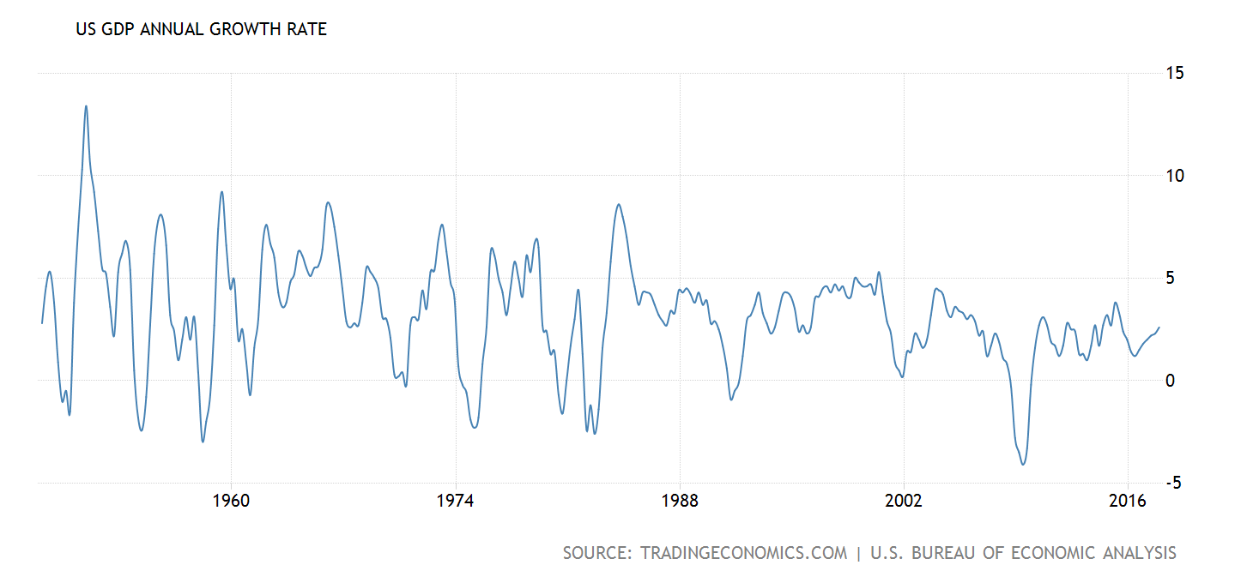
1964-65 | 1980-81 | 2009-10 | 2012-13 | 2018-19
1.6% | 2.9% | 1.9% | 1.8% | 1%
6.7-10.7% | 9.6-9.7% | 0.1-4.6% | 3..2-4.3% | 4-?%

Slide 16
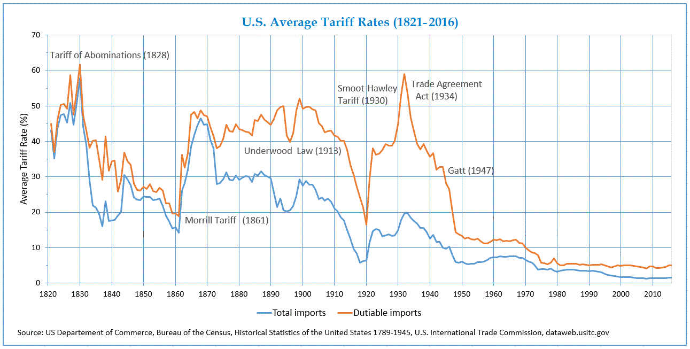
1930: Smoot-Hawly Tariff (50%)
1962: Trade Expansion Act (threat of 80% tariffs led to GATT breakthrough agreement to reduce member tariffs)
2011: Obama tariff on Chinese tires
2017-2018: Trump uses Trade Expansion Act of 1962 to announce tariffs on steel/aluminum
1950 | 1960 | 1970 | 1980 | 1990 | 2000 | 2010 | 2018
4.5% | 7.3% | 6.0% | 2.9% | 2.8% | 1.6% | 1.3% (2011 tire tariff) | 25% steel/10% aluminum

Slide 17
Impacts
Winners
  Steel & Aluminum corporations
  Steel & Aluminum company-related workers
  In & out marketing chains, unless they rely on imported steel/aluminum
  Some federal revenue increase
Losers
  Consumers
  Import-related Americanworkers (docks, shipping, etc.)
  Processing companies who rely on imported steel/aluminum (autos, beverages, appliances, etc.) & other Chinese imports
  Importing countries
  Farmers

Slide 18
Potential for Trade Wars
Winners
Losers
Short-run: targeted sectors & their labor
Farmers (targeted—China, EU, S.Korea)
  loss of markets;
  increased cost of imported inputs
Consumers (targeted)
Trade deficit worsens

Slide 19
US Tariff impacts on US economy
Generic response: protected industry gains in short run
--losses likely in rest of the economy
--some federal revenue from tariff
--more severe losses in retaliatory targets
Examples:
  Smoot-Hawley 1930 (retaliation; US ag export losses; ag income declines
  W. Bush 2002 (steel; net job loss; retaliation; US ag export losses)
https://www.dailyfx.com/forex/fundamental/daily_briefing/daily_pieces/top_fx_headlines/2018/03/02/The-Impact-of-Tariffs-and-Trade-Wars-on-the-US-Economy-and-the-Dollar.html

Slide 20

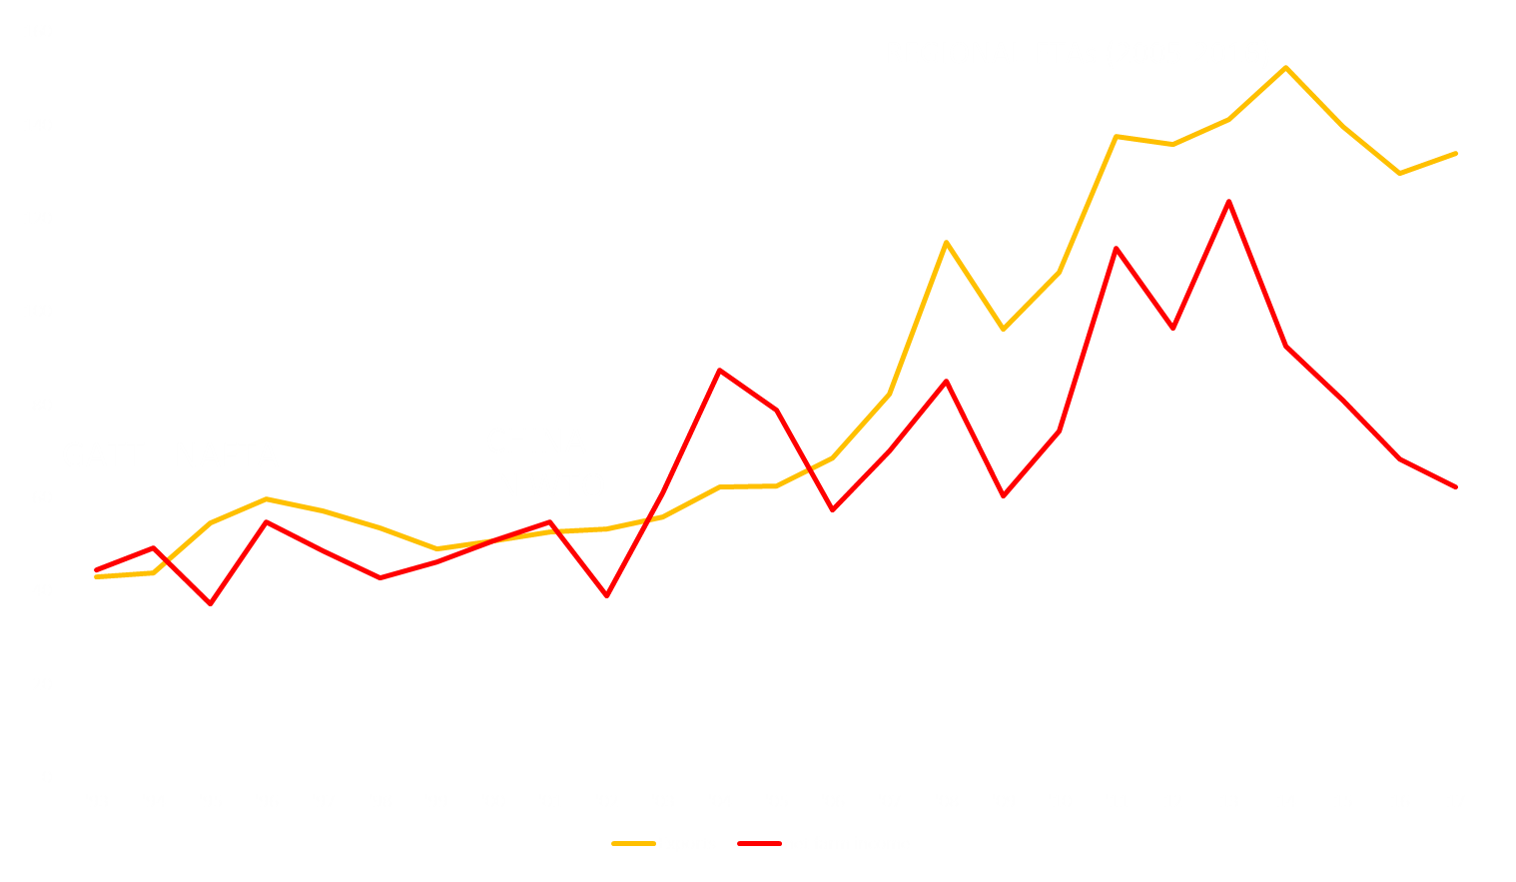
US Agricultural Exports & Net Farm Income, 1993-2017 ($ billion)
FAS Office of Global Analysis; USDA ERS

Slide 21
Trade agreement Issues
2017: Trump pulled US from TPP
2017-2018: Trump initiates renegotiation of NAFTA

Slide 22
Politics & Policy
Trump thrives on management by disruption
Congress not likely to reverse tariffs
No serious current Congressional challenges to trade agreement actions
Short run gains in hopes that importing countries will reduce offenses
Risk is that trade wars ensue (recent gains from Pac-Rim now at risk)
WTO challenges likely

Slide 23
Foreign holdings of US debt
US debt $ 19.8 tril.
  Public-owned: $14.3 tril. (76% of total)
    $6.3 tril. Foreign-owned

Slide 24
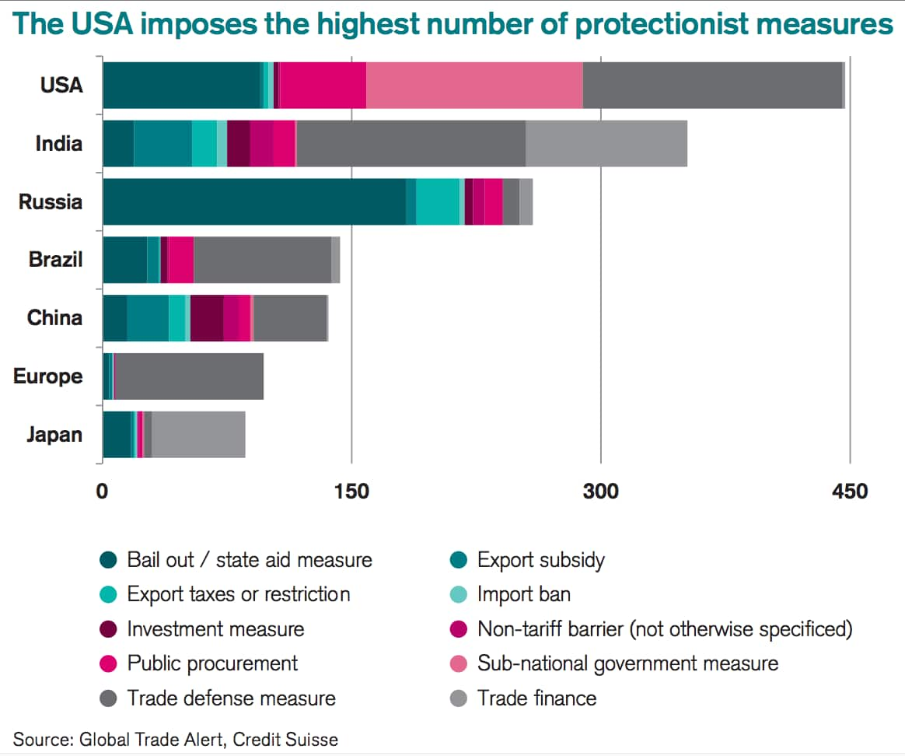

Slide 25
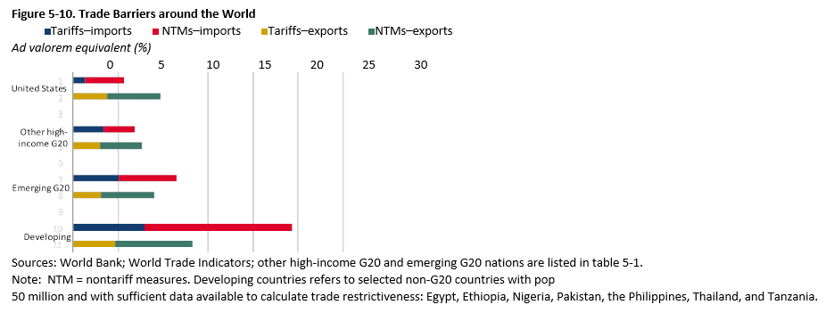

Slide 26
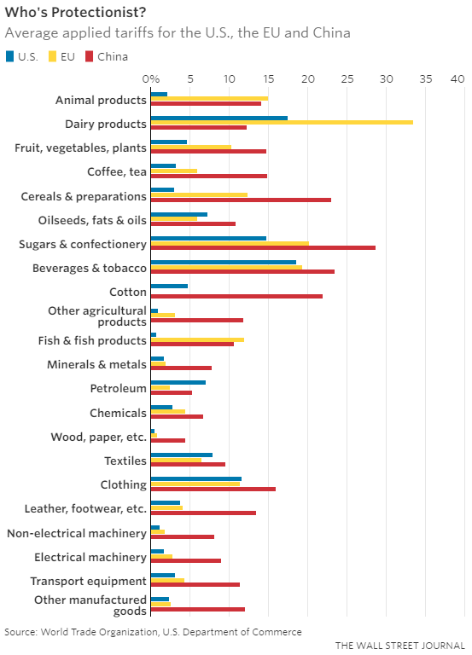
https://www.washingtonpost.com/news/fact-checker/wp/2018/03/08/trumps-trade-war-does-the-u-s-have-the-lowest-tariffs-in-the-world/?utm_term=.81981bf9994a

Slide 27
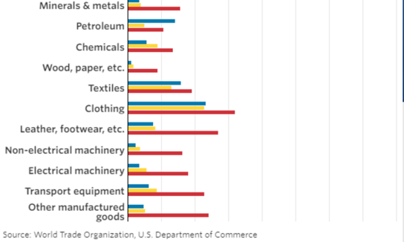
https://www.washingtonpost.com/news/fact-checker/wp/2018/03/08/trumps-trade-war-does-the-u-s-have-the-lowest-tariffs-in-the-world/?utm_term=.81981bf9994a

